Slide 1

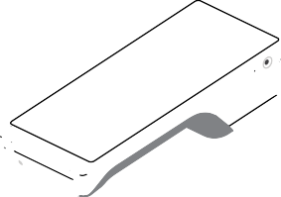
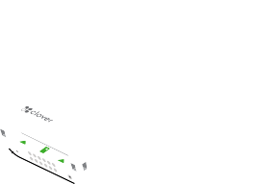

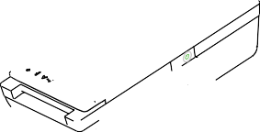
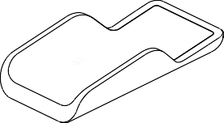

Flex
Quick Start Guide Kurzanleitung / Instructions de démarrage
Guía de inicio rápido / Guida introduttiva / Snelstartgids
clover.com/help/flex-3

Slide 2
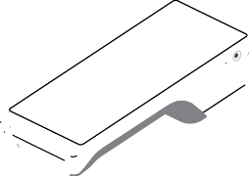
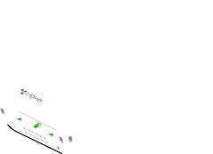





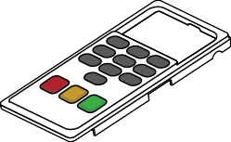
Included
Inclus
Im Lieferumfangs Se incluye Incluso
Inclusief
40 mm
1.5 in
Select regions
Certaines régions Ausgewählte Regionen Algunas regiones
Per alcune zone Sommige regio’s

Slide 3
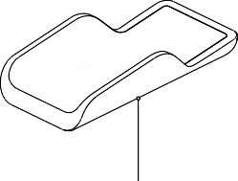


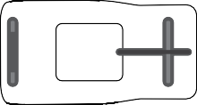



1
2
3
Plug in last, to a grounded AC power outlet.
Brancher en dernier sur une prise de courant alternatif (CA) mise à la terre. Im letzten Schritt in eine geerdete Steckdose einstecken.
Enchufar al último, a un tomacorriente de CA con conexión a tierra. Per ultimo inserire in una presa elettrica con messa a terra.
Sluit als laatste aan, op een geaard wisselstroomstopcontact.

Slide 4








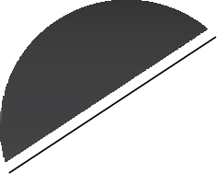
4
5

Slide 5
FCC Part 15
This device complies with Part 15 of the FCC Rules. Operation is subject to the following two conditions: (1) This device may not cause harmful interference, (2) This device must accept any interference received, including interference that may cause undesired operation.
FCC Part 15 Class B-specific
Note: This equipment has been tested and found to comply with the limits for a Class B digital device, pursuant to part 15 of the FCC Rules. These limits are designed to provide reasonable protection against harmful interference in a
residential installation. This equipment generates, uses and can radiate radio fre- quency energy and, if not installed and used in accordance with the instructions, may cause harmful interference to radio communications. However, there is no guarantee that interference will not occur in a particular installation. If this equip- ment does cause harmful interference to radio or television reception, which can be determined by turning the equipment off and on, the user is encouraged to try to correct the interference by one or more of the following measures:
Reorient or relocate the receiving antenna.
Increase the separation between the equipment and receiver.
Connect the equipment into an outlet on a circuit different from that to which the receiver is connected.
Consult the dealer or an experienced radio/TV technician for help.
FCC Warning
Changes or modifications not expressly approved by the party responsible for compliance could void the user‘s authority to operate the equipment.
FCC exposure limit compliance statement (SAR statement)
This equipment complies with radio frequency (RF) exposure limits adopted by the Federal Communications Commission for an uncontrolled environment.
This equipment should be installed and operated with minimum distance 20 cm between the radiator & your body.

Slide 6
Innovation, Science and Economic Development Canada (ISED) statement: CAN ICES-3 (B)/NMB-3(B)
This device complies with ISED’s licence-exempt RSSs. Operation is subject to the following two conditions:
This device may not cause harmful interference, and
This device must accept any interference received, including interference that may cause undesired operation.
Le présent appareil est conforme aux CNR d’ ISED applicables aux appareils radio exempts de licence. L’exploitation est autorisée aux deux conditions suivantes:
le dispositif ne doit pas produire de brouillage préjudiciable, et
ce dispositif doit accepter tout brouillage reçu, y compris un brouillage susceptible de provoquer un fonctionnement indésirable.
Caution
The device for operation in the band 5150-5250 MHz is only for indoor use to reduce the potential for harmful interference to co-channel mobile satellite systems;
Where applicable, antenna type(s), antenna models(s), and worst-case tilt angle(s) necessary to remain compliant with the e.i.r.p. elevation mask requirement set forth in section 6.2.2.3 shall be clearly indicated.
Avertissement
Le guide d’utilisation des dispositifs pour réseaux locaux doit inclure des instruc- tions précises sur les restrictions susmentionnées, notamment:
les dispositifs fonctionnant dans la bande 5150-5250 MHz sont réservés uniquement pour une utilisation à l’intérieur afin de réduire les risques de brouillage préjudiciable aux systèmes de satellites mobiles utilisant les mêmes canaux;
lorsqu’il y a lieu, les types d’antennes (s’il y en a plusieurs), les numéros de modèle de l’antenne et les pires angles d’inclinaison nécessaires pour rester conforme à l’exigence de la p.i.r.e. applicable au masque d’élévation, énoncée à la section 6.2.2.3, doivent être clairement indiqués

Slide 7
CE RF Exposure Compliance
This device meets the EU requirements (1999/519/EC) and the International Com- mission on Non-Ionizing Radiation Protection (ICNIRP) on the limitation of expo- sure of the general public to electromagnetic fields by way of health protection.
This device is restricted to indoor use only when operating in the 5150 to 5350 MHz frequency range.
Radiation Exposure Statement
The product complies with the Canada portable RF exposure limit set forth for an uncontrolled environment and are safe for intended operation as described in this manual. The further RF exposure reduction can be achieved if the product can be kept as far as possible from the user body or set the device to lower output power if such function is available.
Déclaration d’exposition aux radiations
Le produit est conforme aux limites d’exposition pour les appareils portables RF pour les Etats-Unis et le Canada établies pour un environnement non contrôlé.
Le produit est sûr pour un fonctionnement tel que décrit dans ce manuel. La réduction aux expositions RF peut être augmentée si l’appareil peut être conservé aussi loin que possible du corps de l’utilisateur ou que le dispositif est réglé sur la puissance de sortie la plus faible si une telle fonction est disponible.

Slide 8
IMPORTANT for UK Power Adapter Cord
If the available socket outlet is not suitable for the plug supplied with this equip- ment, it should be cut off and an appropriate three pin plug fitted. With alterna- tive plugs on approved 3 amp fuse must be fitted in the plug or adaptor or in the main fuse box.
The plug severed from the mains lead must be destroyed, as a plug with bared flex- ible cords is hazardous if engaged in a live socket outlet. In the event of replacing the plug fuse, use a 3 amp fuse approved by ASTA to BS 1362, i.e. carries the
mark. Always replace the fuse cover, never use plugs with the fuse cover omitted.
WARNING — THIS APPLIANCE MUST BE EARTHED.
The wires in this mains lead are coloured in accordance with the following code: Green-and-Yellow = Earth Blue = Neutral Brown = Live
As the colour of the wiring in the mains lead of this appliance may not corre- spond with the coloured markings identifying the terminals in your plug, proceed as follows:
The wire which is coloured Green-and-Yellow must be connected to the terminal in the plug which is marked with the letter “E”, or by the earth symbol or coloured Green-and-Yellow.
The wire which is coloured Blue must be connected to the terminal which is marked with the letter “N” or coloured Black or Blue.
The wire which is coloured Brown must be connected to the terminal which is marked with the letter “L” or coloured Red or Brown.
Argentina
Este producto utiliza para su funcionamiento una fuente de alimentación, modelo FSP040-RHBN3 marca Clover con las siguientes características técnicas: Entrada: AC 100-240 V, 50-60 Hz, 1.5 A, Cl. I; Salida: DC
12 V, 3.33 A, que ha sido certificada para su utilización en el mercado argentino.
Conectar una fuente diferente a la provista podría ocasionar un incendio o choque eléctrico. No utilice una fuente diferente a la provista con el equipo.

Slide 9
EU Declaration of Conformity
Hereby, Clover Network, LLC declares that the radio equipment type, C405/K405 is in compliance with Directive 2014/53/EU. The full text of the EU declaration of conformity is available at the following internet address:
eu.clover.com/eu-compliance
The frequency band and the maximum transmitted power in EU are listed below:
WWAN
LTE Band3: 23 dBm (Conducted) LTE Band7: 23 dBm (Conducted) LTE Band20: 23 dBm (Conducted)
CE max SAR
Body: 1.611 W/Kg
Limb: 3.382 W/Kg
NFC
-4.92 dBμA/m @10m
WLAN
2400MHz-2483.5MHz: 20 dBm (EIRP)
5150MHz-5250MHz: 23 dBm (EIRP)
5250MHz-5350MHz: 23 dBm (EIRP)
5470MHz-5725MHz: 23 dBm (EIRP)
Wireless Charger
100~200KHz: 81.5 dBμV/m @10m
Restrictions in AT/BE/BG/CZ/DK/EE/FR/DE/IS/IE/IT/EL/ES/CY/LV/LI/LT/LU/HU/MT/NL/NO/PL/PT/ RO/SI/SK/TR/FI/SE/CH/UK(NI)/HR/UK. 5150MHz-5350MHz is for indoor use only.
Caution: Exposure to Radio Frequency Radiation
This product complies with EU requirements regarding restriction of exposure of persons to radio-frequency energy (RF) emitted by telecommunication and radio devices as it is designed and manufactured in such a way as not to exceed the exposure limits indicated by the European Union Commission. The permitted SAR limit for the general population is 2.0 W/Kg for body and 4.0 W/Kg for limb. This limit guarantees an ample safety margin that protects all persons regardless of age and health condition. SAR is measured with the device at 5mm to the body and at 0mm to the extremity, while transmitting at the highest certified output power level in all frequency bands of the device. The highest SAR level recorded for this model was equal to body 1.611W/Kg, & limb 3.382W/Kg.

Slide 10
Clover Flex 3
Model Number: C405
Clover Flex Wireless Cradle
Model Number: K405
Patent
clover.com/patents
Clover Network, LLC. 415 N Mathilda Ave
Sunnyvale, CA 94085, USA
EU Importer:
Marketplace Merchant Solutions Ltd Unit 9, Richview Office Park Clonskeagh, Dublin 14, Ireland
Waste Electrical and Electronic Equipment-WEEE
NOTE: This product is covered electronic equipment under the European Union’s Waste from Electrical and Electronic Equipment (“WEEE”) Directive (2012/19/EU). The WEEE Directive requires that covered equipment be collected and managed separately from typical household waste in all EU member states. Please follow the guidance of your local environmental authority or ask the shop where you purchased the product for collection or recycling options.
HDYJ6001010-3B
v11

