Slide 1
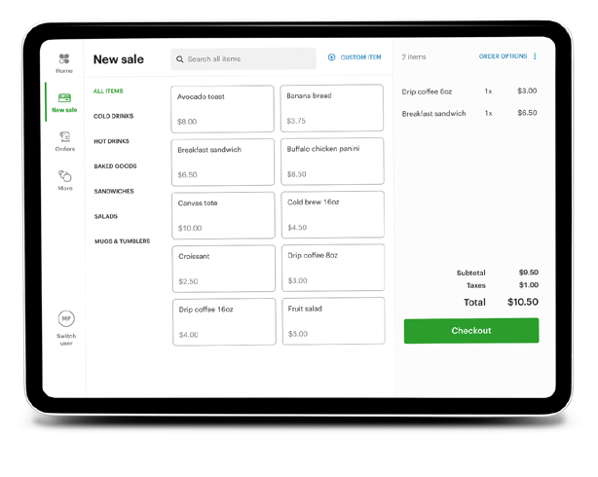
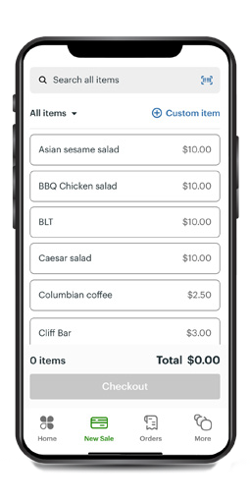
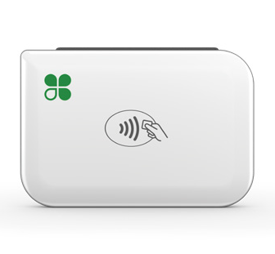


Take your business everywhere with Clover Go
Clover Go
Run your business wherever your customers are with the Clover® Go mobile Point-of-Sale (POS) system. Clover Go lets your customers pay the way they want to – and enables you to track your sales in real-time, from anywhere on your mobile phone or your tablet.
Never miss a sale
Accept all major credit and debit cards, contactless payments, checks and cash with your mobile device – with or without an internet connection.
Clover Go consists of a free app
and an optional reader that connects to your mobile device*.
Clover Go App
allows you to more securely key in or scan card information with your mobile device and track your sales. Available for Apple iOS orAndroid devices
Clover Go Reader
add this portable reader for insert or contactless payments with NFC-chip-enabled cards and mobile wallets such as Apple Pay and Google Pay. The Clover Go reader is small and lightweight measuring
3.17 in x 2.21 in x 0.46 in and weighing 2.3oz.
Run your business from anywhere
Run your business and track your sales in real-time from anywhere.
Be safe and secure
Control access with roles and permissions, fingerprint login and two-factor authentication.
All transactions are encrypted to help protect your customers’ data and your business.
*A Clover merchant account is required to use Clover Go. Don’t have a Clover merchant account? Contact your Sales Executive or Relationship Manager.

Slide 2
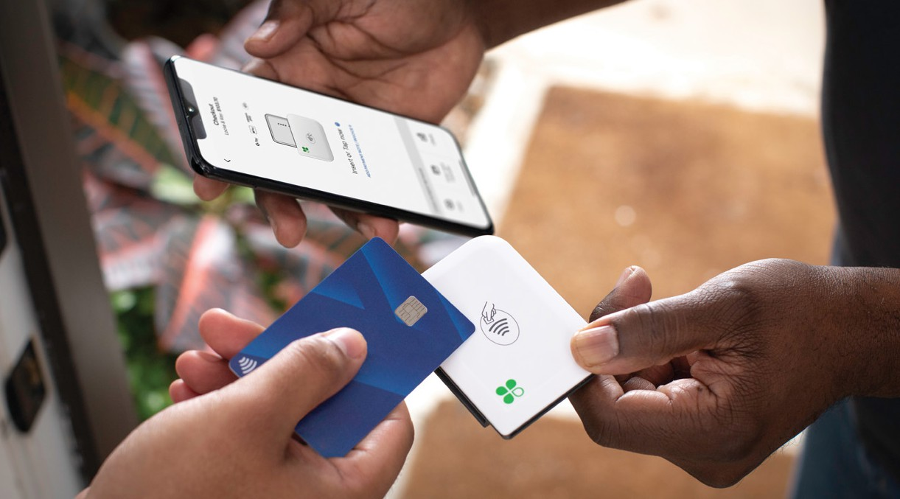



Accept payments and track your sales with your mobile phone or tablet.
Clover Go
Accept payments anywhere
Take payments anywhere with your mobile device and an optional, compact reader.
Track sales in real-time
An interactive sales screen provides a snapshot of daily sales, top-selling items and individual employee sales performance over time.
Do business online or offline
Clover Go works with or without an internet connection so you never miss a sale.
Send paperless receipts
Electronic receipts can be emailed or sent by text.
 | Clover Go Key Features
Accept all payment types | All major credit and signature debit cards, checks, and cash
Quick checkout | Enter the dollar amount and checkout
Checkout by item | View items by categories and sell by item
Receipts | Send paperless receipts by email or text
Customer signature | Capture customer signatures on your mobile device
Refunds | Issue refunds from your mobile device
Sales reports | Access interactive sales reports to view daily sales, most popular items sold and more
Offline mode | Accept payments without an internet connection
Reader device | Pair an optional Clover Go reader for card insert or tap
User roles and permissions | Control access to different parts of the app based on employee roles
Multilocation support | Manage multiple locations or businesses
24/7/365 support | All day, everyday support to assist you with your needs
Let's get started. Connect with an expert.
CMM 6-23

