Slide 1



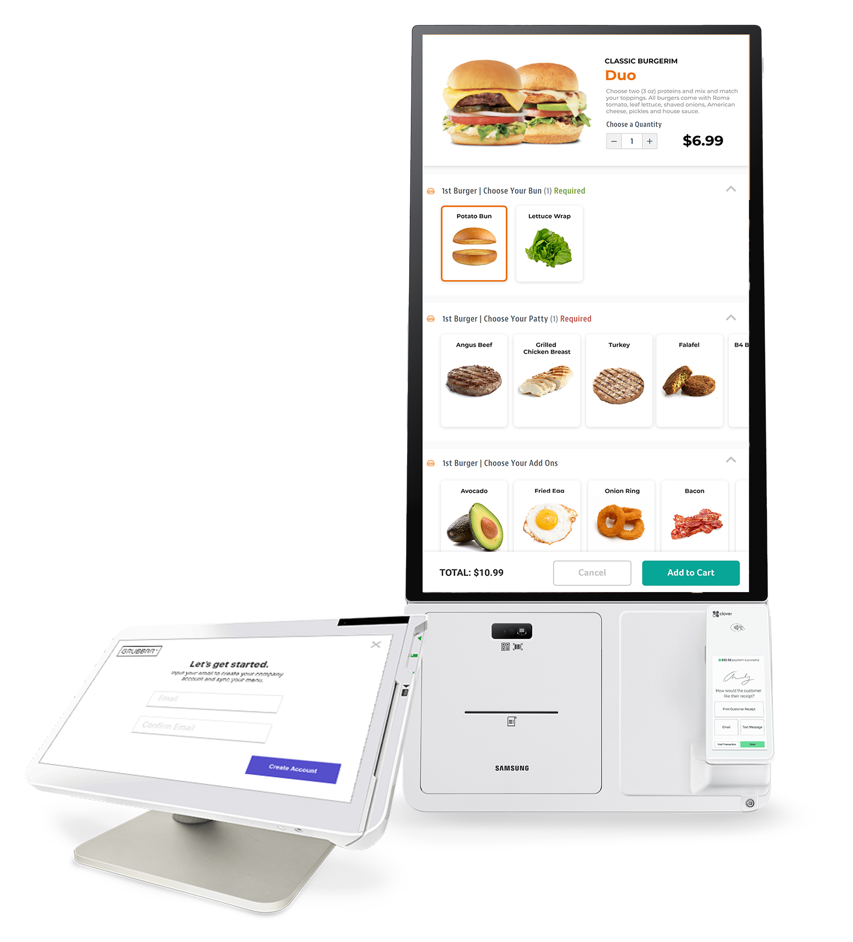
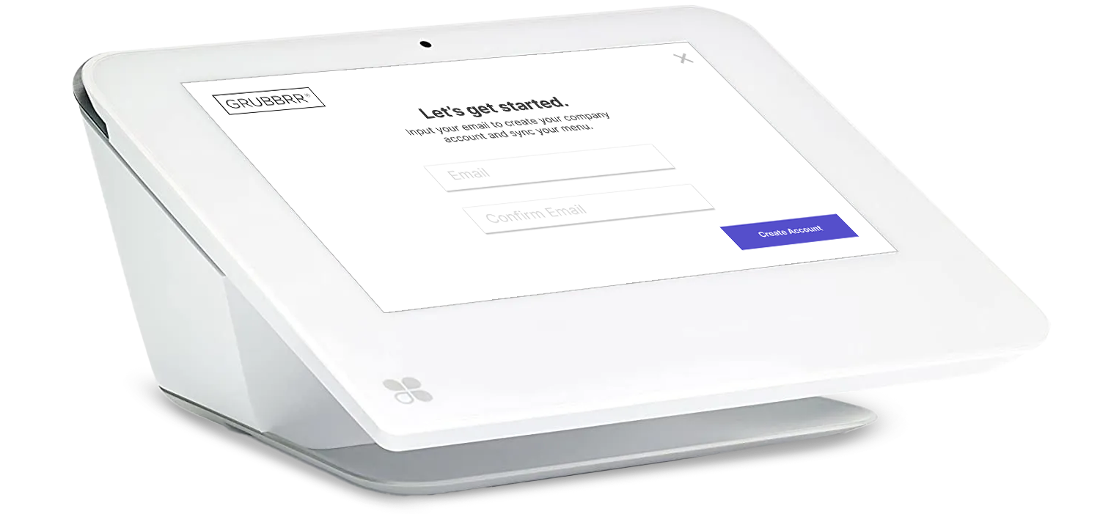


SAMSUNG KIOSK
NEW
POWERED BY GRUBBRR
CLOVER EDITION
Small Business Kiosk Platform
Right now, restaurant operators are struggling to combat inflation, the labor shortage, and rising consumer demand for omnichannel dining.
To adapt, GRUBBRR and Samsung have developed a fully integrated, turn-key solution designed to help restaurant operators run their business more efficiently with fewer employees.
The Samsung Kiosk Powered By GRUBBRR Clover Edition uses smart upsell technology to increase average ticket size and drive incremental revenue. By automating front-of-house tasks, restaurants can reallocate labor to more value-add positions, thereby decreasing operating costs, increasing average ticket size, improving the customer experience, and streamlining operations.
Automated Menu Import & Sync
Enable Self-Ordering
Upsell Feature Increases Avg. Ticket Size
Reduce Labor Cost of Cashier
Improve Customer Experience
FDA Approved Antibacterial Screen
Available on the Clover App Store
SEE THE SOLUTION IN ACTION
SCAN QR CODE FOR DEMO
M ADE FOR
Enter Name
Phone
Email
Company Name
Your Logo
Goes Here
CALL (855) 547-8227 OR EMAIL SALES@GRUBBRR.COM

Slide 2
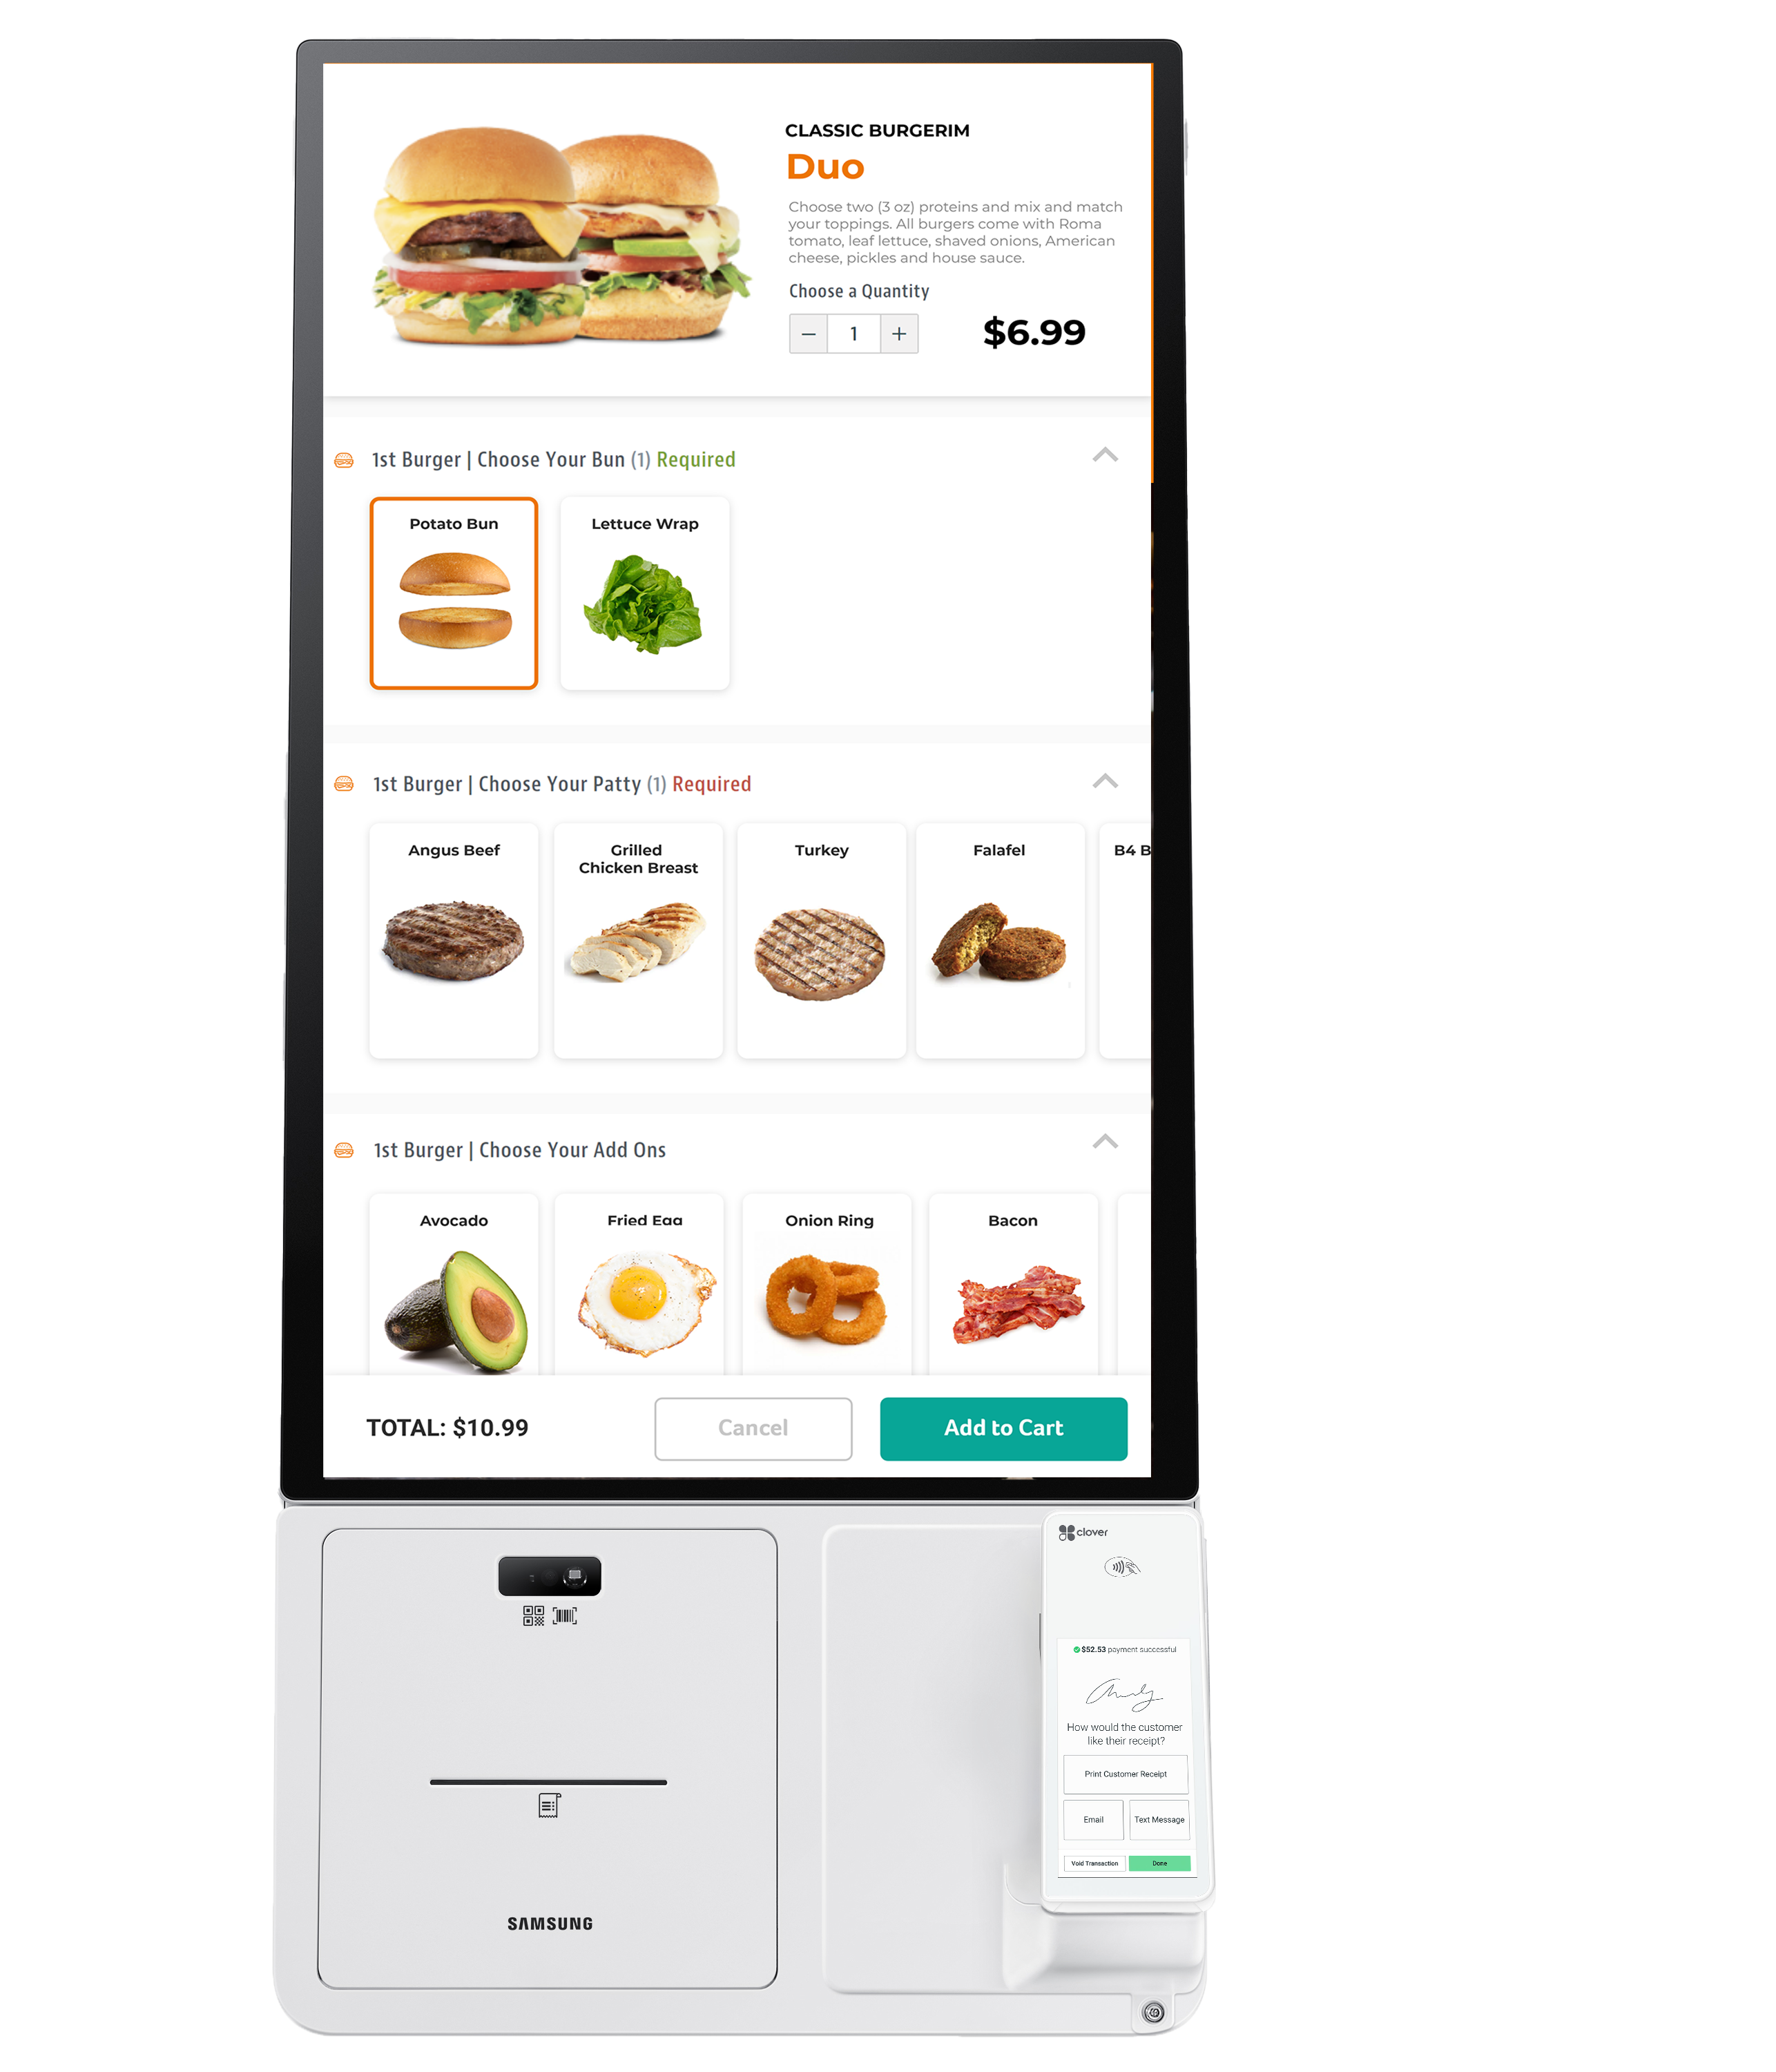
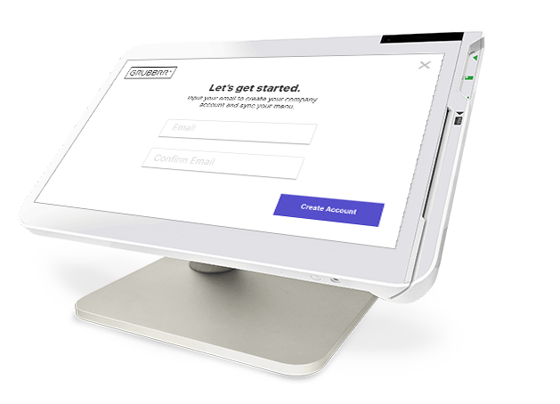
Easy Hardware
& Software Setup
1
Clover POS & Samsung Kiosk Arrive Onsite
2
Samsung Kiosk App Powered By GRUBBRR is Installed
3
Onboarding Integration & Menu Sync is Complete
4
Merchant Receives Calendly Email
GRUBBRR Team Completes Menu Build with Pictures, Screensaver, and Logo
5
6
QA Menu Review
7
QA Approved and Menu is Published
Enter Name
Phone
Email
Company Name
Your Logo
Goes Here
CALL (855) 547-8227 OR EMAIL SALES@GRUBBRR.COM

