Slide 1


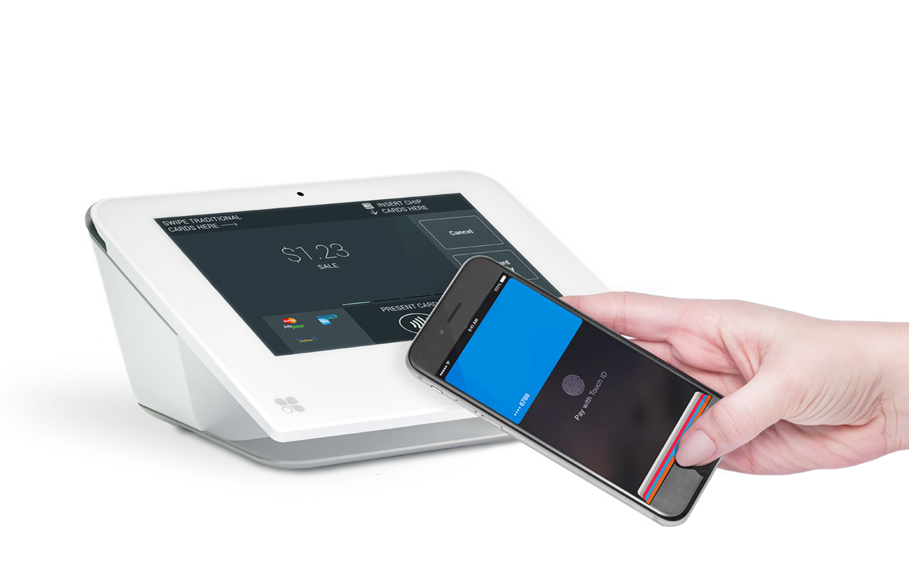




Clover Mini
Meet the mini POS that always comes up big
Powerful and sleek. Clover Mini takes swipe, chip, and contactless payments right out of the box. It can also do taxes, accounting, inventory, rewards, and virtually anything else your business needs.
Mighty and Mini
Need a reliable terminal? Maybe a full-featured POS? Clover Mini is both. Expand functionality with over 300+ apps in the Clover App Market.
Keep It in the Cloud
Your Clover Web Dashboard lets you see your complete sales history, monitor inventory, and manage employees—wherever, whenever.
Features that help get the job done:
Ready, Set, Grow
The Clover platform provides robust hardware and software solutions that grow with you as your business evolves.
Accepts credit and EBT card swipes, EMV® chip + PIN/ signature, and contactless payments like Apple Pay®, Google Pay® and Samsung Pay®
Bright, durable 7-inch display with antimicrobial Corning® Gorilla® Glass
A First Data Company
Visit clover.com or contact your representative to learn more.

Slide 2
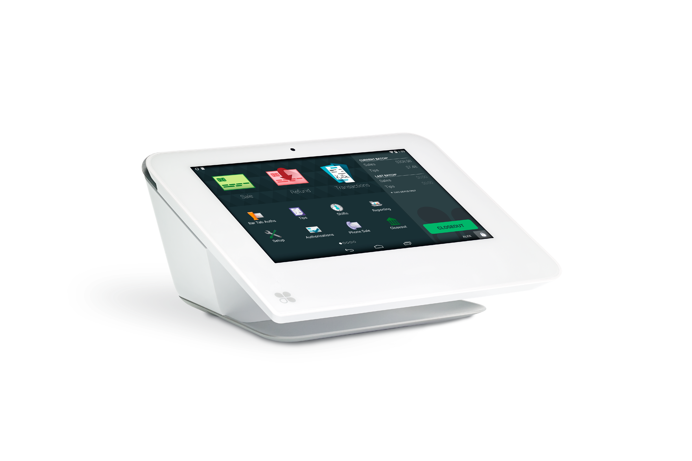







Clover Mini
A First Data Company
Less clutter. More productivity.
Say goodbye to crowded counters and say hello to getting more done. Clover Mini gives your customers more ways to pay, while you get the benefits of a full-featured POS in a compact device.
Essential Apps for Every Business
With over 300 apps and growing, the Clover App Market lets you customize your Clover Mini with do-it-all apps for accounting, inventory, marketing, gift cards and whatever else your business needs. Get started with:
Register
Take orders, add or remove items, and accept payments.
Rewards
Set up and run your own digital loyalty and marketing program in a snap.
Reporting
Gain business insights from sales reports and business metrics.
Orders
Look up orders and do more with them such as take payments or issue refunds.
Customers
View customer information, transaction history, and marketing preferences.
Time Clock
Manage employee schedules, overtime, timesheets, payroll exports, and much more.

