Slide 1


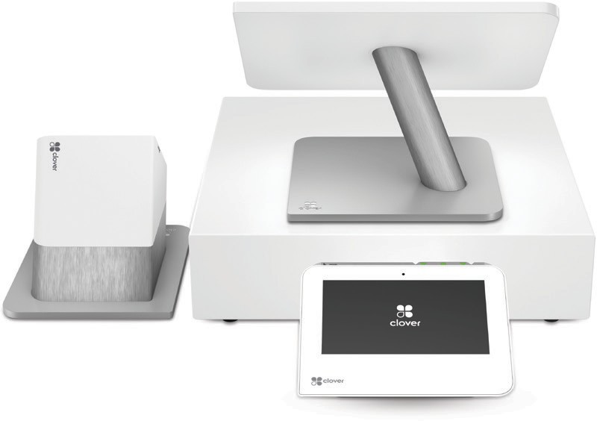


Station Duo
Our fastest, most customer-engaging point-of-sale (POS)
An all-in-one full service POS that helps centralize the management of your daily operations and deliver five-star service.
Let them drive
Station Duo comes with a smart terminal for your customers. That means they can confirm their orders and complete payment faster.
Accept all major payment types
Let your customers pay how they want to pay. Swipe, Insert or Tap. Credit, Debit, Apple Pay®, Google Pay® and more.
Move at the speed of now
Station Duo is our fastest, most powerful POS system. From inventory and orders to managing your staff and running reports, it’s all at your fingertips.
The smart and simple way to run your business securely
Secure – Help protect your business and customer information with end-to-end encryption and data tokenization, integrated EMV® chip sensors and fingerprint logins
24/7/365 Support – You can’t do it all on your own. When you need help, we’ve got your back

Slide 2
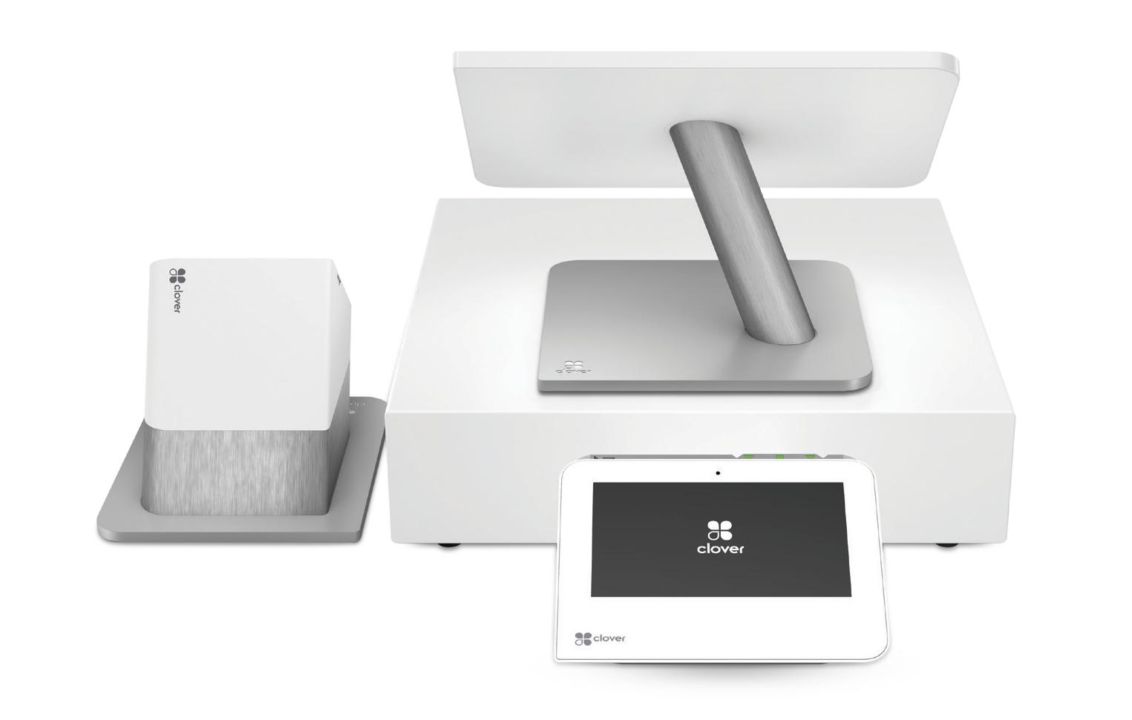


Station Duo
Technical Specifications
High-res displays for merchant and customer
Integrated LTE for primary or fallback connectivity
Our newest high-speed printer that’s even faster
A smart POS system built for speed and simplicity
Tackle your daily traffic spikes without breaking a sweat. Station Duo is our fastest, most customer-engaging point-of-sale system, designed for speed, security and engagement.
Cut the counter clutter
One central hub for power and processing. One screen for you, one for your customers.
And, simple rates for all of your credit, debit and gift card payments.
Business control at your fingertips
Access and manage your back-of-house data, reports and payroll anywhere you need to run your business. See the patterns and trends driving your sales and take a smarter approach to marketing.
Apps for every business
Turn your Clover into a well-oiled multitasking machine, so that you can do more for your business than you imagined. No matter the industry our apps will help you tackle the trickiest tasks associated with running your restaurant, retail or services business.

