Slide 1







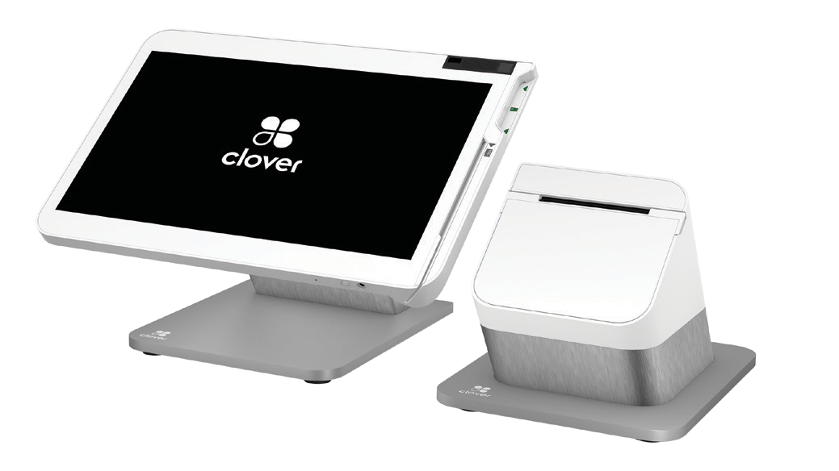


Clover Station Solo for Restaurants
Accept payments and manage your restaurant business with Clover Station Solo
A powerful, all-in-one restaurant
point-of-sale (POS) device to manage your dine-in, take-out and delivery services
Clover® Station Solo provides the power you need to process guest payments, print receipts, track sales transactions, and run Clover’s software to manage your restaurant business.
The convenience of all-in-one
Accept payments in-person or over-the-phone, enter and fire orders to the kitchen, print bills and receipts and access the Clover Dining software to manage your restaurant.
A powerful POS system to accept payments and run your business
Accept card payments with the card insert and swipe slots integrated into the screen
Take orders over-the-phone by keying in card information in Virtual Terminal
Print receipts with the included printer
Manage orders, inventory, employees and other parts of your business with Clover Dashboard
The power to run your business
Runs on a high-performance chip and the latest operating system to give you the speed you need.
Security built-in
Control access with roles and permissions, fingerprint login and two-factor authentication.

Slide 2


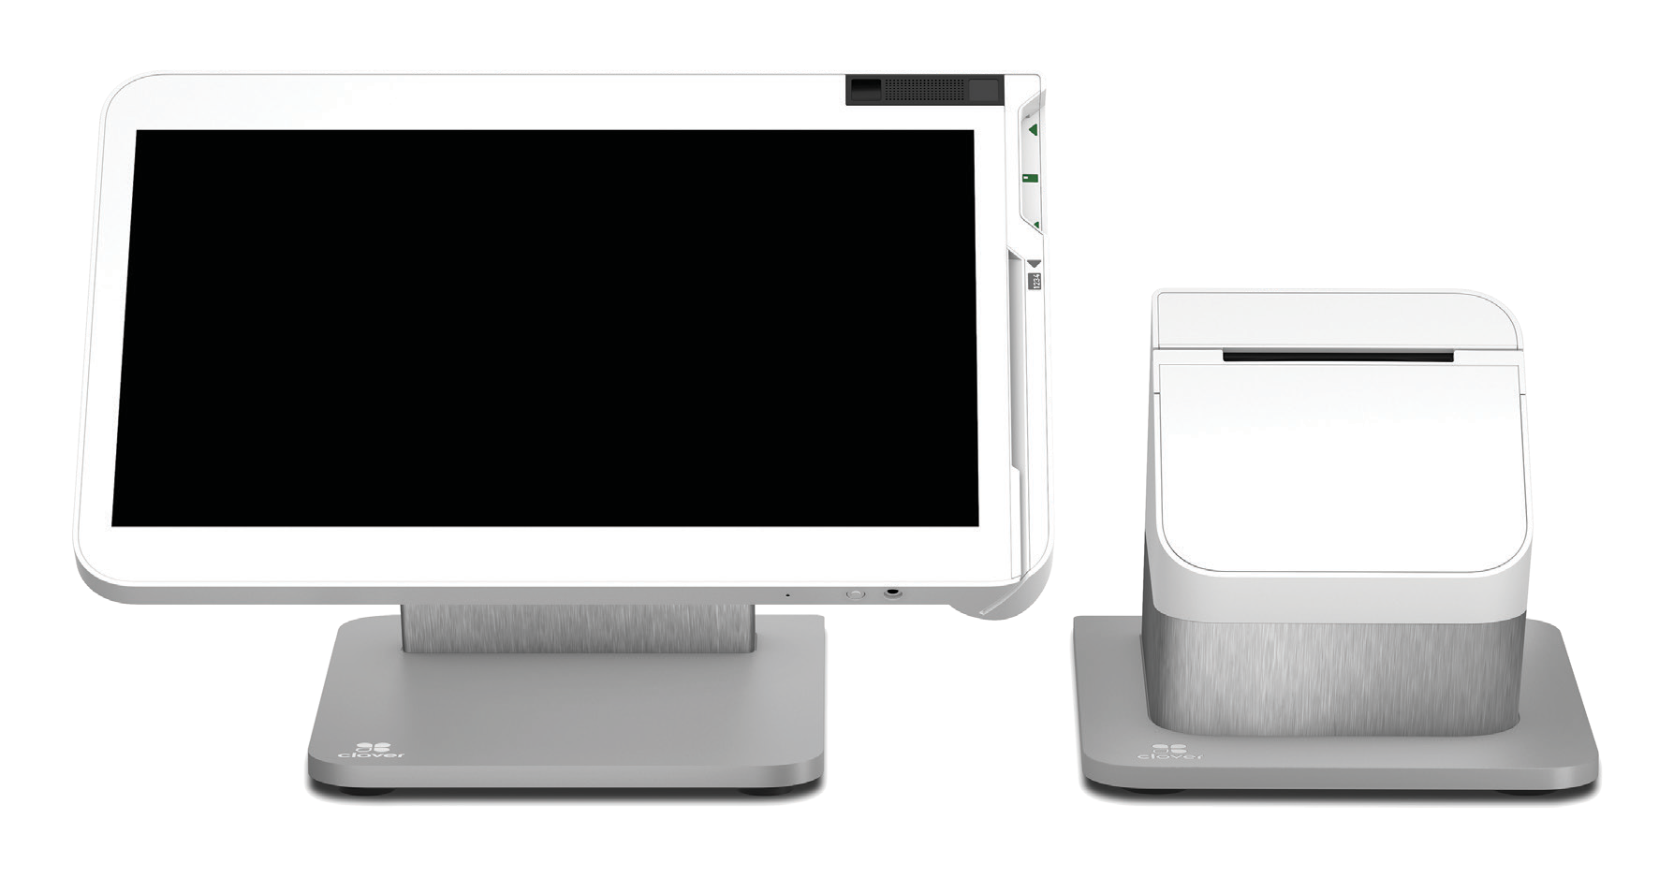
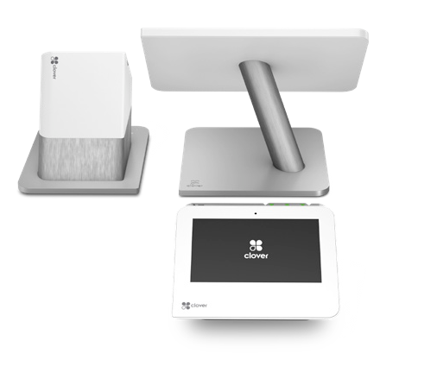
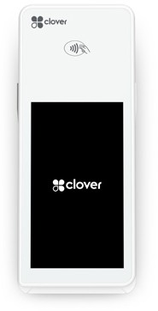
Clover Station Solo for Restaurants
Technical Specification
High-performance Qualcomm 660 chip and Android 10 operating system for fast performance
One 14” merchant-facing display with a 1920x1080 resolution that tilts to accommodate different heights
Supports card swipe and insert
Connectivity through wired Ethernet, Wi-Fi 802.11 a/b/g/n/ac Dual-Band 2.4 GHz/5 GHz or LTE
Includes a Clover receipt printer
Use Clover Station Solo with other Clover devices to provide the best experience for your guests
Clover Station Duo
With a second screen for customers, Clover Station Duo is ideal for the front of your restaurant where guests can insert, swipe or tap their card, or enter promotions and loyalty information.
Clover Flex
The portable Clover Flex allows you to take orders, manage orders, accept payments, and print receipts for your guests at tableside or curbside.
Name | Email | Phone
© 2021 Clover Network, Inc. The Clover name and logo are registered trademarks owned by Clover Network, Inc. and are registered or used in the U.S. and many foreign countries.
714110 2021-3

