Slide 1
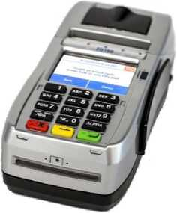
Credit sale
FD150 QRG
RETAIL/RESTAURANT
REPRINT RECEIPTS
From Main Idle Screen press SALE Enter Transaction Amount and press GREEN BUTTON
Insert, Swipe, Tap or Manually enter Card Number
Press YES when prompted to print CUSTOMER COPY
From Main Idle Screen press OTHER Press on REPRINT
Enter Transaction Number from Original Receipt and press GREEN BUTTON MERCHANT COPY Prints by Default Press YES when prompted to print CUSTOMER COPY
Credit void (only if batch open
lADJUSTING TIPS
From Main Idle Screen press OTHER Press on VOID
Enter Transaction Number from Original Receipt and press GREEN BUTTON Verify Transaction Details and Press OK
From Main Idle Screen press OTHER Press on ENTER TIPS Enter Transaction Number from Original Receipt and press GREEN BUTTON Press EDIT TIP
Enter TIP AMOUNT and Press GREEN BUTTON
Press the NEXT button for Next Transaction
Repeat until all Transactions are Adjusted
CREDIT REFUND (IF BATCH CLOSED
OPERATOR PASSWORD 990712
From Main Idle Screen press OTHER Press on REFUND Enter Amount to be RETURNED and press GREEN BUTTON
Insert, Swipe, Tap or Manually enter Card Number
To print Customer Copy press YES when prompted
PRINT TIP REPORT
From Main Idle Screen press OTHER Press on REPORT Press on SERVER TOTALS Press on PRINT REPORT
MANUAL BATCH
From the Main Idle Screen Press OTHER Press on CLOSE BATCH
Batch Will Print

