Slide 1
Desk/5000
Speed up checkout at the counter,
even in the most demanding environments
Provide a robust design for demanding situations
Enable alternative payment methods
Manage space constraints at the counter thanks to a seamless connection to PIN pads

Slide 2





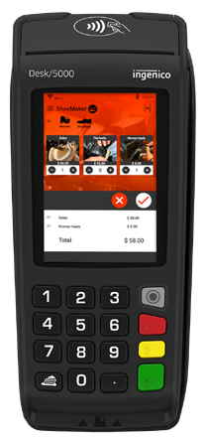
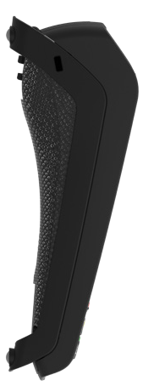
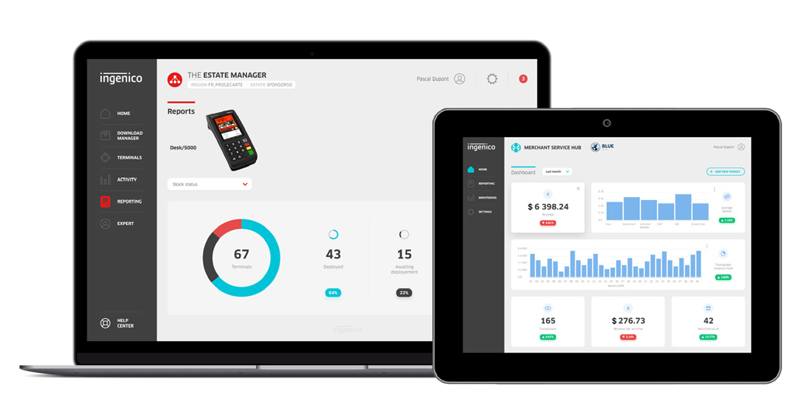

The Desk/5000 covers the most demanding use cases at the merchant’s counter. With the ability to connect to other POS devices – including the
Desk/1000 series PIN pads for richer customer interactions – Desk/5000 is focused on payment in all forms.
Robust design for demanding environment
The responsive keypad improves PIN entry
combined with the advanced outer casing make the Desk/5000 very robust, to suit with the most demanding situations.
Optimized checkout with a PIN pad connection The compact Desk/1000 series can connect to Desk/5000 terminal – saving space on the worktop and speeding up the checkout.
Highest security
The Desk/5000 is certified and fully compliant with the latest global and local PCI regulations. The Telium TETRA OS has been future-proofed with top-of-the-line cryptography software and Ingenico’s world-class peer-to-peer encryption technology to keep data safe.
Optimal user-experience
The terminal’s intuitive user interface – including powerful multimedia capabilities and a large 3.5 inch color touchscreen – provides best-in-class experiences for customers.
Sustainable design and packaging
Our state-of-the-art manufacturing techniques enhance the ability to recycle this terminal. Paper consumption has been reduced on the Desk/5000 thanks to new digital receipt solutions and digitized product documentation.
Compatible with Ingenico’s suite of services Keeping the solutions connected, the Desk/5000 works in unison with Ingenico’s supporting service platforms, meaning merchants will have access
to business services such as estate management
Processor | Application & Crypto processor | Cortex A5
Memory | Internal External | 512 MB Flash, 512 MB RAM MicroSD up to 32GB
OS |  | Telium TETRA
SAM |  | 2 SAM
Card readers | Magstripe Smart card Contactless | ISO 1/2/3, 500K lifespan EMV Level 1, 500K lifespan EMV Level 1
Display | Color | 3.5'' backlit, HVGA (480x320) pixels
Touchscreen | Resistive
Keypad |  | 16 hardtop keys, raised marking, backlit
Audio | Buzzer Speaker Audio Jack
 |  | Mono Stereo
Video | Video accelerator | H264 codec
Thermal printer | Speed in l/s Paper roll cage | 20 l/s 2 1/4'' (58mm) width x 40mm
Terminal connectivity | Wired | Dial-up MODEM Ethernet 10/100 base T
Terminal connections | USB Power Supply | 1 USB Host 1 USB Slave Dedicated power Jack 1 RS232
Power supply |  | 32W (8v – 4a)
Terminal size |  | 7.3x2.6x3.2x2.6'' (187x82x68 mm)
Weight |  | 12 oz (340 g)
Environment | Operating Temperature Storage Temperature Operating Humidity | 32°F to 104°F (0°C to +40°C) -4°F to 131°F (-20°C to +55°C) 85% non-condensing at 104°F (+40°C)
Accessory | Magic Box Privacy shield Stylus Kit | 1xRS + 1xPower+1xEth.+1xLine In Field upgradable
 |  |  | Optional Optional
Security |  | PCI PTS 5.x

