Slide 1


More powerful, even more user-friendly features.
V E R S I O N 1 0
V.10 2022

Slide 2
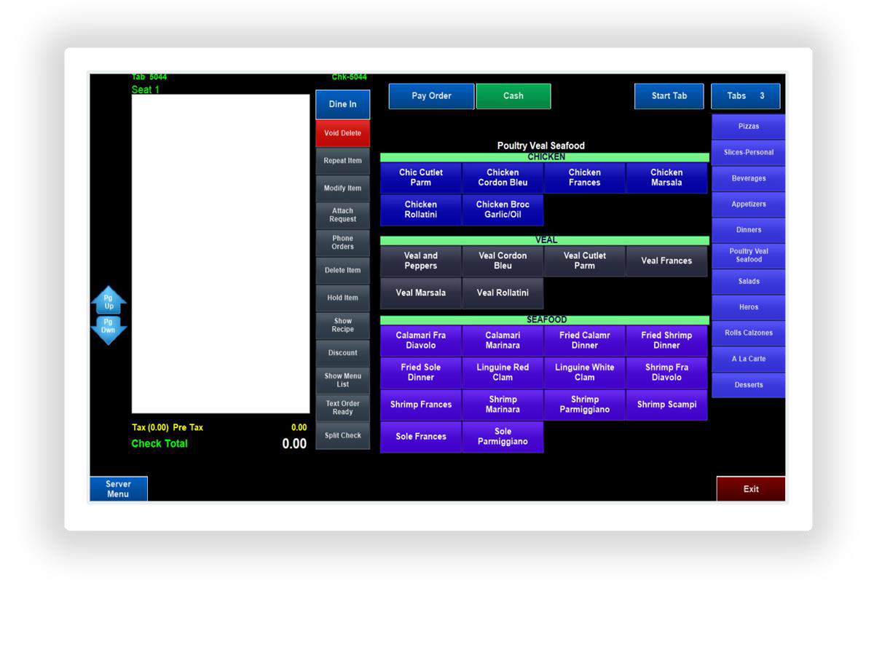

Simple, yet signiicant
NEW LOOK. NEW TOOLS. BETTER PERFORMANCE.
Complete tasks faster, gain a beter view of your data and feel conident that you’re running your restaurant with the latest technology.
The new design offers a streamlined experience that’s better suited for today’s digital world.
The changes are subtle enough that you can easily navigate through familiar screens with minimal effort, but you’ll notice a lighter design and newly optimized ways to get your job done faster.

Slide 3
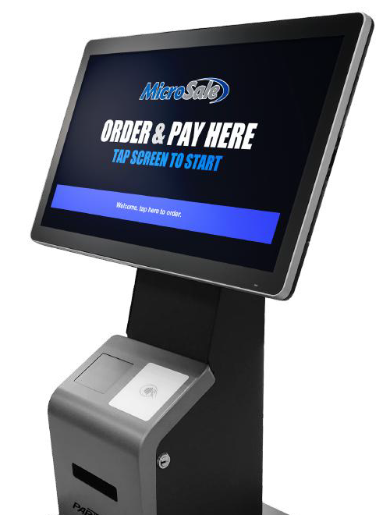

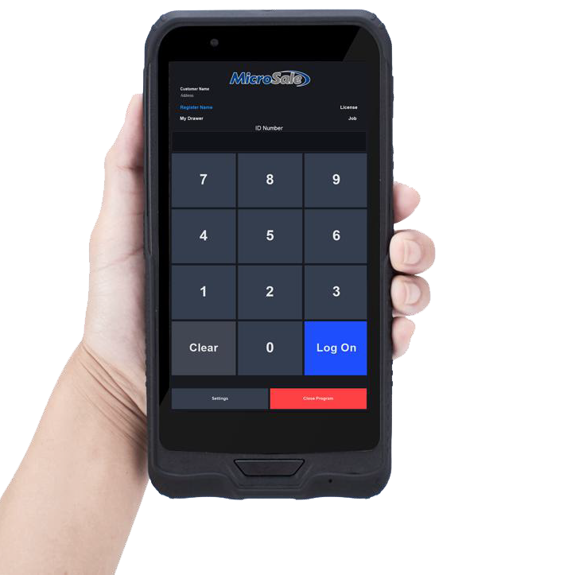


New ways to accept orders,
more revenue
F U T U R E - P R O O F Y O U R B U S I N E S S
New, minimal design
Self-service kiosk
Lower wait times, eliminate lines and get through lunch with less employees.
Redesigned with a clean, minimalist style to make order entry quick and simple.
Turn any Windows device into a kiosk Customize backgrounds and buttons
Upload languages and custom voice prompts Email receipts
Take orders on the move
New tablet interface
Version 10 includes two built-in tablet interfaces; choose between traditional landscape or portrait-mode.
The Windows-based tablet application is substantially lighter, running up to 2x faster than the standard sotware.
Why portrait-mode?
The new vertical-style layout is designed for small-form tablets. Easily interact with the sotware using one hand.
Compatible with Windows Devices

Slide 4

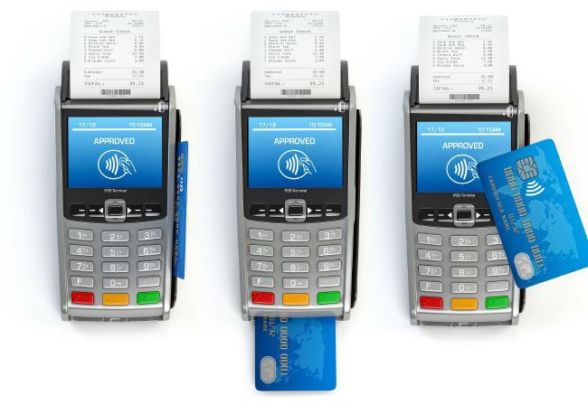

Get mobilized, secure, and the
latest payment technology
Enjoy quick transaction speeds using the EMV chip reader of your choice - gain peace of mind with secure yet flexible solutions.
Accept contactless payments
Delight your customers by accepting contactless payments.
Chip, tap, swipe
Apple Pay, Google Pay, Samsung Pay
Pick the processor right for you
PAX and Datacap support nearly every EMV device and processor available in the US.
Eliminate processing fees
Version 10 supports both available cash discount programs on the market.
Automatic discount for cash payments Surcharge for credit card payments
Accept modernized ways to pay
Using a pay at the table device, your customers can settle the bill without ever losing sight of their card
QR Code Payments is a pay-at-the-table solution that uses the guest’s phone to pay the bill

Slide 5


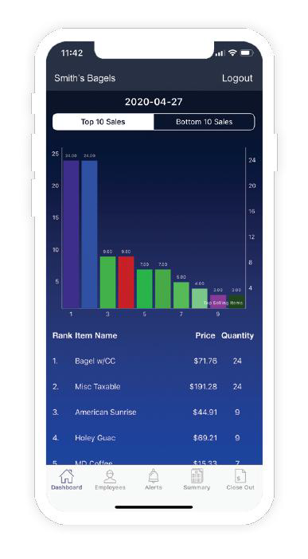

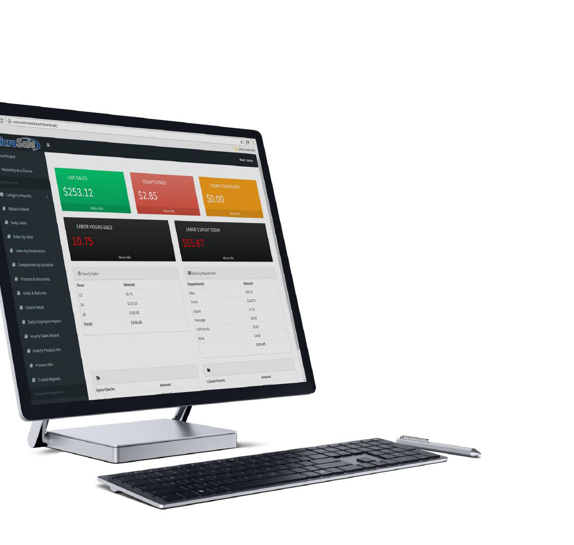




All your restaurant's data
in the palm of your hand
C L O U D R E P O R T I N G
Subscribe to ReportingAnywhere to track your day’s progress with live data streaming on your smartphone.
The ReportingAnywhere package includes a website for detailed reports and a simplified real-time app available on the App Store and Google Play.

Slide 6







Make fast, easy decisions with
clear, understandable data
R E P O R T I N G & B A C K O F F I C E U P D A T E S
Choose who receives reports via email
You can now create recipient groups and decide who receives your sensitive data via email. You may want
General Managers to receive payroll data while Shit Leaders receive only sales information.
Complete end-of-shit tasks faster
Quicker tip entry
Tip List allows you to enter tips one ater another in a spreadsheet view.
Transaction Review: ind data faster
All previous weeks’ inancial data is automatically
itemized in a selection list, saving multiple steps as you no longer have to go through backup iles.
Apply Tip button: Instead of exiting ater a tip is added, a list of all closed checks immediately prompts to add additional tips at one time.
Easily count cash in the safe
Ater the closeout runs, it prompts to enter the amount in
the safe, providing additional accountability to help track your cash on-hand.
Quicker manager access
Managers can now log into the system without
clocking in or having an open audit. This change makes it more eficient when managers need to assist staff with manager- restricted tools.
Track cash for servers without banks
Servers can now take cash payments on any register
with a cash drawer while accounting for the cash payments on their individual audit (shit report).
Automatically calculate shared tips
Group Audits have been designed to simplify tip
distribution between bartenders, saving managers hours per week.
Quicker shit closing
Any employee can now close an audit
assigned to a cash drawer; this change is beneicial in establishments that use generic audits such as “AM Shit”.
New Integrations
This one-way integration imports data from MicroSale into QuickBooks. The integration automatically imports inancial data directly into QuickBooks.
Compeat provides integrated Accounting, Back Ofice, Workforce and Intelligence portfolio in one place.

Slide 7







Refined & reworked time keeping
for full transparency over your labor
Automated Payroll Close
You no longer have to run a payroll close in the sotware.
The automated payroll close signiicantly improves the sotware across all facets.
Payroll automatically sends to your provider.
Save time and no longer worry about when you need to run your payroll. Eliminates all potential corruption that can occur when the payroll is not regularly closed.
MAJOR ENHANCEMENT
Prevent time discrepancies
Employees are prompted at the end of their shit with their shit details including total hours worked, clock in
time and clock out time.
Easily edit times for forgoten clock outs
Employees who forgot to clock out push to the top of the time clock editor, allowing managers to easily view
and edit the time before payroll is due.
See all hours worked for the pay period
Only shits worked for the current week or pay period display onscreen, so there is never a question on hours.
Lock-down employees’ time clock permissions
You can set bartenders to clock in and out freely, while forcing manager approval for cooks or delivery drivers.
Prevent overpayments
If someone forgot to clock out, they are prompted to
see a manager before clocking in for the next shit; preventing overpayments and ensuring accuracy.
Peace-of-mind with daily backups
Never worry about lost data: time records automatically backup every night.
New Integrations
Restaurant Employee Scheduling Sotware. Make scheduling, timesheets, team communication, task and tip management, and labor compliance easy. www.7shits.com
Schedule the right people at the right time and reduce labor costs. HotSchedules Powered by Fourth gives you everything you need for total workforce scheduling. www.fourth.com

Slide 8



New shortcuts,
Boosted eficiency
I M P R O V E D W O R K F L O W
Version 10 is packed full of shortcuts to reduce staff’s computer time. New shortcuts include faster split payments, auto-voiding from the order screen, and multi-ring next round capability.
Smarter Search
Prompt servers‘ drinks at the bar station with Berg
Using a Berg Liquor Control System, drinks entered
from the server stations will now automatically populate on the bartender’s terminal and unlocks the controls to make the drink.
the fexible search options allow you to search by table number, customer name or check number.
Previously, the search required a match on the few letters typed. Now, simply type in any part of the name and all matching items populate.
Prevent walkouts & speed up checkout
Useful in bars and breweries, you can attach a credit card to a table to eliminate the stress of
potential walkouts and provides your customer with a quick option when ready to cash out.
Cash out individual seats instantly
You’re busy – especially when a party is trying to cash out. Now you can take payments on individual seats
directly from the order screen, bypassing the payment screen completely.
Split all items in a single tap
Simply enter how many times you want to share an item
to automatically split everything by that denomination on separate seats.
Easily delete single line items
Delete any line item (menu item or modifier) without having to delete the entire item and re- enter it before sending to the kitchen.
Re-ring multiple drinks at once
Quickly ring in multiple drinks in one tap and repeat or edit attached modifications.
Simpliied course ordering
Course ordering is now completely automated.
Items are preprogrammed to specific courses, if an item needs to be changed, simply switch the course using the “change course” button.
Void & close a check instantly
You can now void all items off an open check to automatically void and close the entire ticket.
Email customer receipts
You can now email receipts. Find out how you‘re doing by attaching a survey link.
Make higher tips with preset tip percentages
As an optional setting, you can rotate the POS screen during checkout for a customer to choose a preset tip
amount from the large, easy-to-read options.

Slide 9

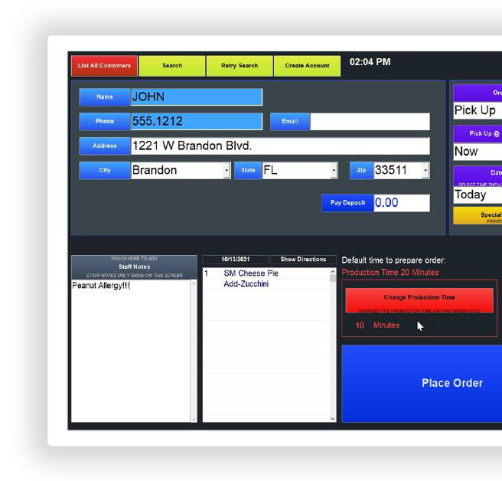


New look, new tools,
Streamlined takeout
With a new design and streamlined functionality, you'll be able to take orders faster and more easily than ever before.
Highlights
Customer proiles are now linked by phone number only (previously by name or number), preventing duplicate proiles.
Improved search for phone orders: you can now search by any criteria such as address or number.
Efortlessly pay separately on one call-in order, with the new shortcut, Pay by Bag.
Easily reconcile third-party delivery payments when using a tablet for receiving orders and the POS for tracking sales; Now you can label orders for UberEats, DoorDash, etc., to more clearly reconcile sales.
New Integrations
Enter addresses faster with 100% accuracy
For phone orders, customers’ addresses auto-complete to speed up entry and prevent mistakes.
Accept third-party delivery orders directly in MicroSale
Orders placed through third-party delivery platforms automatically flow into your MicroSale system through Chowly’s gateway.
Assign orders to drivers from the on-screen map to see stops closest together for the most eicient delivery routes.

Slide 10

Get years of free updates
MicroSale is an evolving sotware solution that continues to improve with every release. Updates are developed and released for two to three years ater a major version launch so that you can get the most out of your investment.
About MicroSale
KIS Sotware Dba MicroSale POS is a hospitality focused sotware platform specializing in quick service, full service, bars, and pizzerias. With over 30 years in business, MicroSale serves over 95 certiied resellers and independent sales organizations throughout the United States and Puerto Rico.
MicroSale provides an afordable and complete POS solution with advanced features such as mobile ordering, kitchen displays, menu boards, online reporting and remote management. MicroSale is a PADSS Certiied application using EMV chip technology through PAX Technologies and Datacap. As a complete all-in-one solution, MicroSale is certiied and integrated to QuickBooks Online, OLO Online Ordering, HotSchedules, and more.

