Slide 1

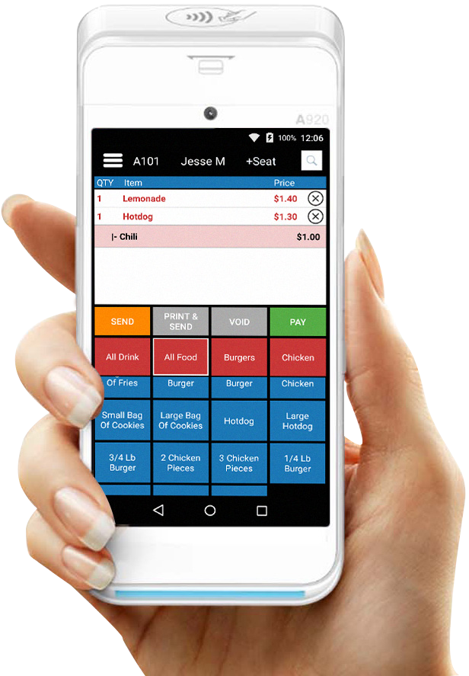
ALL-IN-ONE PAY AT THE TABLE SOLUTION
Thank you for choosing Paradise Point of Sale's Pay at the Table solution! This terminal will allow you to take orders quickly and accurately, reduce wait
times, and settle checks with ease.
If you need assistance setting up, please schedule a time with us by visiting the Calendly website below or give us a call and we will schedule a time for you.
Enter Name
Phone
Email
Company Name
https://calendly.com/paradise-pos-installation-and-training
877-777-5530 info@paradisepos.com paradisepos.com
Your Logo
Goes Here
1

Slide 2
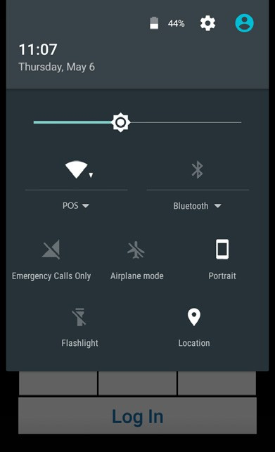
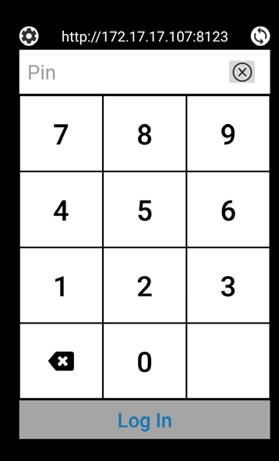
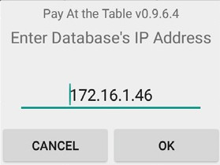
Connecting to WiFi
If your A920 came with your initial Paradise POS purchase, the device should already automatically connect to Wifi after you finish installation.
To verify the network you are connected to, press and hold your finger at the top of the screen, then slowly swipe all the way down. You should see a POS network listed as connected under the Wifi symbol.
If you've received the A920 after your initial Paradise POS purchase, make sure to schedule a time with our Installation/Training team to get the device connected.
Login Screen
Login - Employee numbers from the main Paradise POS database carry over. Simply type in your number and select login to access the menu.
Database Settings - The gear at the top left allows the user to connect the device to the appropriate main Paradise station. Example see below.
2

Slide 3
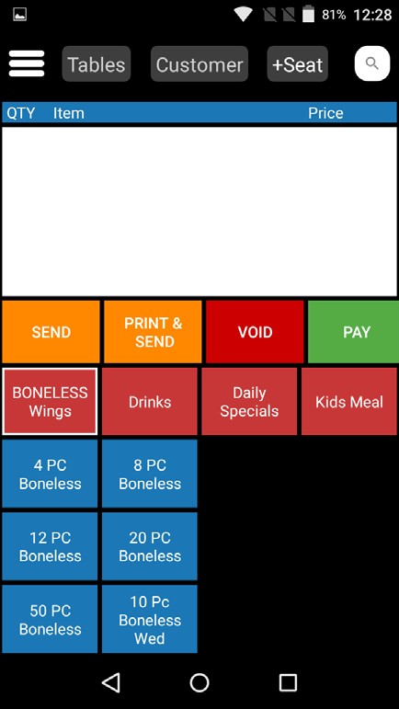
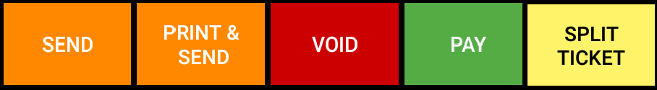
Home Screen
Tables
Switch between open tables/tickets.
Search Bar
Customer
Assign a customer to a ticket from your customer database.
Add Seat
Separate items you ring up by seat, just like on a main station.
Ticket Field
Categories
Swipe categories left and right to access them all.
Items
Access all your menu items, synced from your database.
Send & Pay Options
Swipe to view all options.
Send - Send the ticket to kitchen printer.
Print & Send - Send the ticket to the kitchen and print a copy of the receipt.
Void - Void the ticket that is currently open.
Pay - Takes you to the Pay screen to complete payment for the ticket.
Split & Pay - Split a ticket and take payment for the split tickets.
3

Slide 4
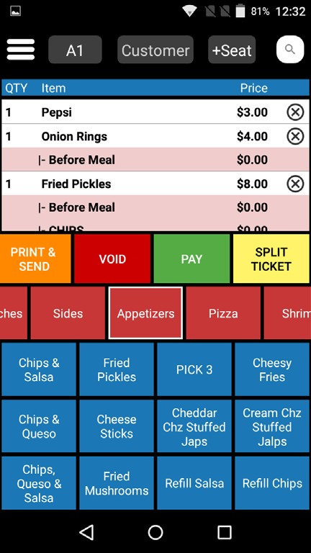
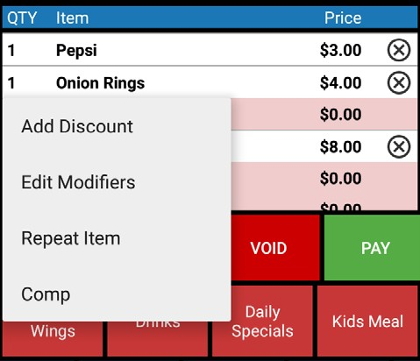
Item Options
Press & Hold Options
Press and hold any item on the ticket for additional item options.
Add Discount - Add a discount to the selected item.
Edit Modifiers - Edit the modifiers currently attached to the selected item.
Repeat Items - Repeat the selected item.
Comp - Comp the selected item. Only sent items can be comped.
4

Slide 5
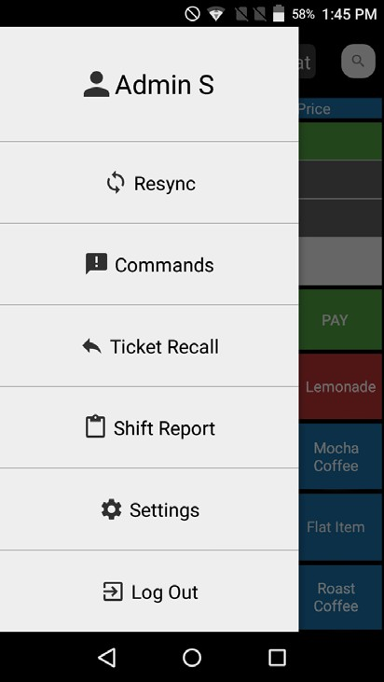
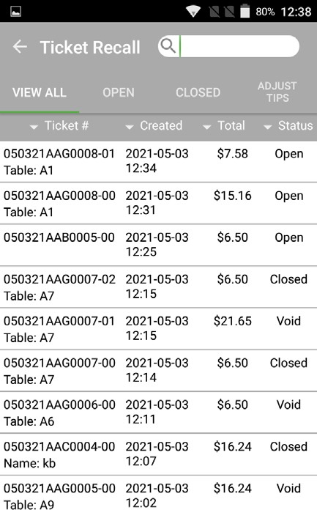
Options Sidebar
Resync
When any menu changes are made to the main station, this allows you to sync those changes. Ensure that the Paradise app on the iPad is always running and that the iPad is never put in sleep mode.
Commands
Just like the main Paradise station, this allows you to add tags such as To Go or Do Not Make to tickets for the kitchen.
Shift Report (Coming Soon)
Run a shift report directly from the device after tips have been added and all tickets closed, just like you would on a Paradise main station.
Ticket Recall
Opens the Ticket Recall screen, allowing you to edit tickets and add tips to closed tickets.
View All - View all tickets, open and closed.
Open - View only open tickets.
Closed - View only closed tickets.
Adjust Tips - Adjust tip amount on tickets closed to card.
5

Slide 6
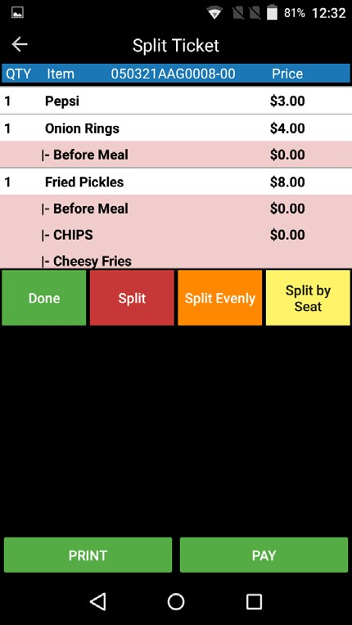
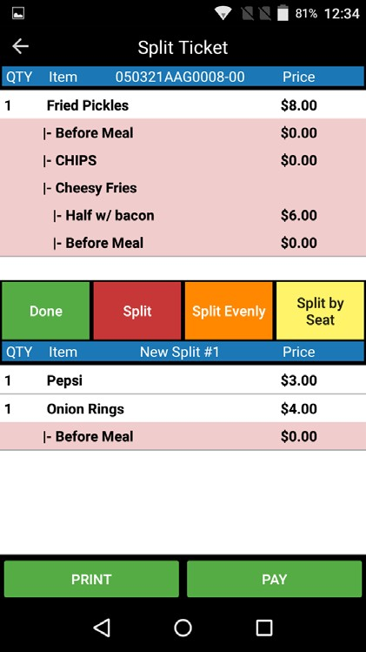
Split Ticket
Split - Adds one blank ticket to the field below that items can be added to. Selecting the button again creates another blank ticket that can be cycled to.
Split Evenly - Prompts how many tickets to evenly divide the main ticket into.
Split by Seat - If the seat function was used on the main ticket when ordering, this will split each seat into its own ticket.
Splitting a Ticket
To move items from the original ticket to any split tickets below, tap the items to select them. Multiple items can be selected at a time. Once selected, tap the ticket you want to add them to below.
Print - Prints the new split tickets. Once selected, this saves the new split tickets as well.
Pay - This will allow you to pay the split tickets. Once select, the device will prompt you to select the tickets
₆ you'd like to take payments on.

Slide 7
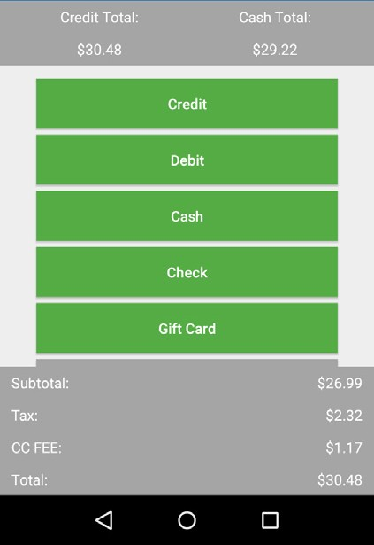
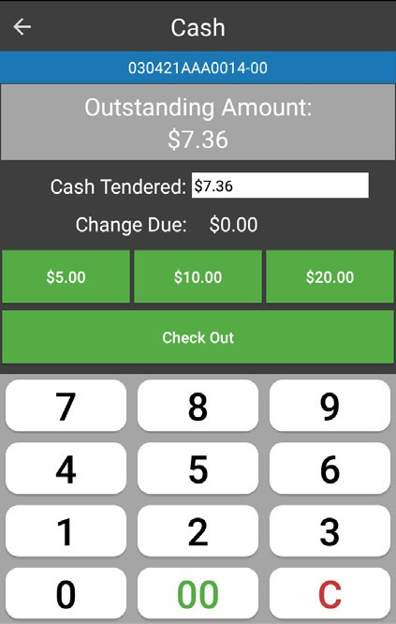
Payment
Taking Payment
Taking a payment on the device works as it does on the main station. If applicable, the Credit and Cash totals are displayed at the top of the screen, as well as all available payment options and the ability to apply a discount to the entire ticket.
Cash Payment
The outstanding amount is displayed at the top of the screen. To edit the amount tendered, make sure to select the Cash Tendered text box and type in the customer's cash amount and Check Out. There are three quick cash amounts selections that can be selected instead.
7

Slide 8
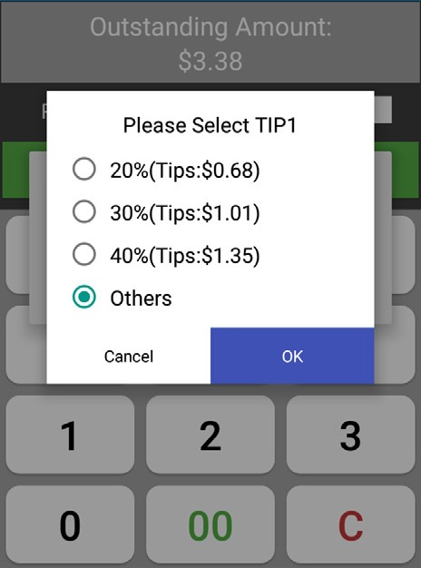
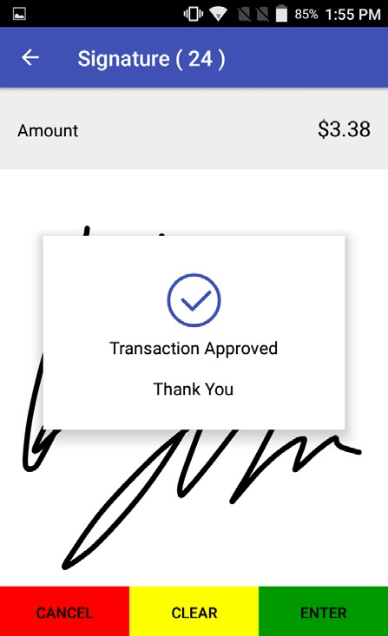
Card Payment
The tip amount should prompt before payment. Select Others to set a custom amount instead of one of the defaults listed.
Signature & Email
After running a card payment, the customer can sign their receipt on screen and on the next page, select their receipt options. Email Receipt will prompt the customer to supply their email address.
8

