Slide 1
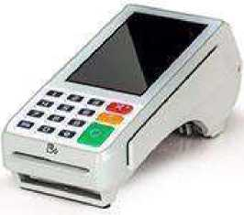
Credit sale
PAX A80/A920 QRG RETAIL/RESTAURANT
REPRINT RECEIPTS
From Main Credit Screen press SALE Enter Transaction Amount and press CONFIRM
Insert, Swipe, Tap or Manually enter Card Number
To print Customer Copy press OK when prompted
From the Main Credit Screen press [FUNC]
Press on [RE-PRINT]
Press on [PRINT ANY]
Enter TRANSACTION NUMBER from Receipt
Choose RECEIPT TYPE: CUSTOMER COPY or MERCHANT COPY
Credit void (only if batch open
From Main Credit Screen press V/SALE Enter Transaction Number from Original Receipt and press CONFIRM Verify Transaction Details Scroll Down and press CONFIRM
lADJUSTING TIPS
From the Main Credit Screen Press [FUNC]
Press [TIP MENU]
Press [VIEW UNTIPPED TRANS.]
Select Transaction from the LIST Verify Transaction Details and Press [ADJUST]
Input TIP AMOUNT and Press CONFIRM Repeat until all Transactions are Adjusted
CREDIT REFUND (IF BATCH CLOSED
OPERATOR PASSWORD CURRENT DATE - MMDDYYYY
From Main Credit Screen press RETURN Enter Amount to be RETURNED and press CONFIRM
Insert, Swipe, Tap or Manually enter Card Number
To print Customer Copy press OK when prompted
PRINT TIP REPORT
From the Main Credit Screen press [FUNC]
Press on [REPORT]
Press on [TIP REPORT]
Press on [PRINT]
MANUAL BATCH
From the Main Credit Screen Press [FUNC]
Press on [BATCH]
Press on BATCH CLOSE
Enter Operator Password if requested.
Matthew Burm - October 24, 2023

