Slide 1
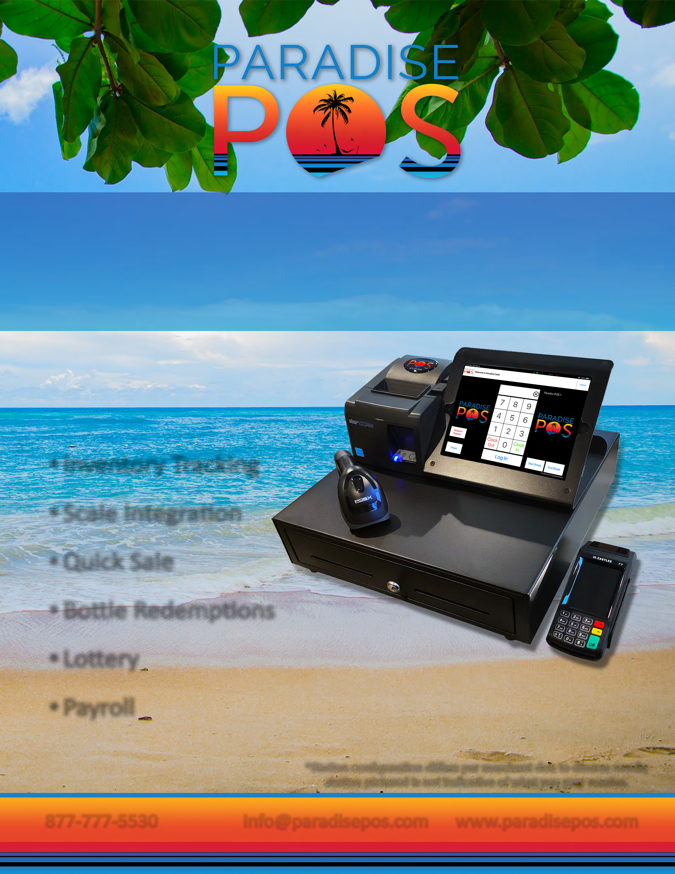
Your customers choose your convenience store because they can quickly drop in, find what they need, and get on with their day. We designed our convenience store point of sale to support the fast, efficient service your customers demand and to make managing your diverse inventory and labor schedules easier.
Inventory Tracking
Scale Integration
Quick Sale
Bottle Redemptions
Lottery
Payroll
*Station configuration differs per merchant due to diverse needs; station pictured is not indicative of what you may receive.
info@paradisepos.com www.paradisepos.com
Enter Name
Phone
Email
Your Logo
Goes Here
877-777-5530

Slide 2

Paradise POS offers a cutting-edge iOS-based point of sale software for technology savvy stores who demand a best-in-class mobile solution for their business needs.
iPad Ready
Easy to Learn Interface
Outstanding Tech Support
Mobile Access
FEATURES
FAST & SIMPLE CHECKOUT
Paradise POS offers semi-integrated payment processing, so credit card data never hits the POS; it all stays in the terminal. This means you are less susceptible to data breaches and you have secure, encrypted transactions.
DISCOUNTS & PROMOTIONS
Easily manage happy hour discounts and promotions so you don't have to worry about manually applying your specials during those busy hours.
Scheduled Discounts
Mix & Match Pricing
TAX OPTIONS
Taxing your items isn't always cut and dry, especially with the differences in state taxes and county taxes. Paradise POS gives you different tax options to tailor the system for your business.
Smart Tax
Multiple Tax Rates
Sugar Tax
ADDITIONAL FEATURES
Bottle Redemptions
Additional Fields
Lottery Functionality
Vendors
Label Printing
Price Check
Scale Integration
Allow Item for EBT
Customer Facing Display (CFD)
Sign on iPad

