Slide 1
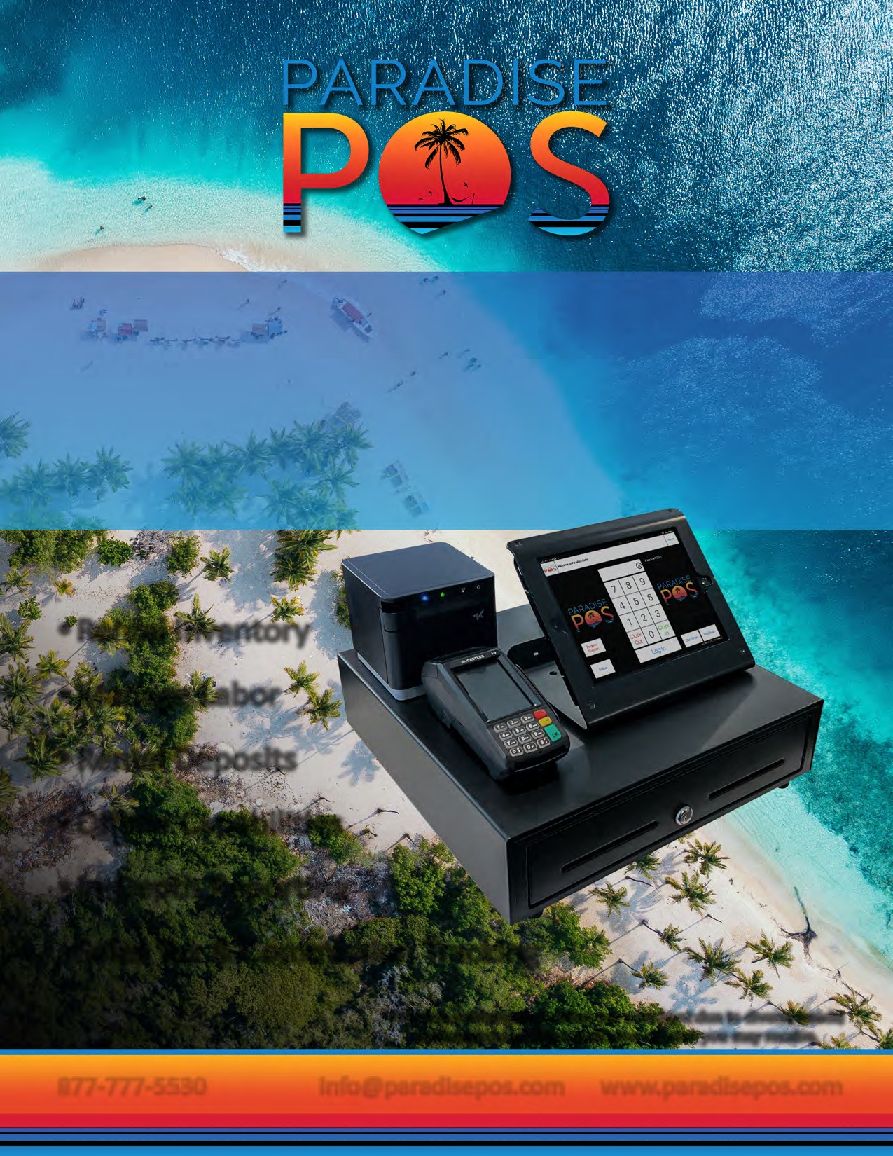
Whether you rent equipment, party supplies, furnishings, or other assets, Paradise POS oﬀers a rental point of sale solution that will help you cut management time and operate more profitably. Your customers will appreciate the fast service they receive, both at pickup and return, as you quickly and accurately manage their accounts.
Rental Inventory
Manage Labor
Rental Deposits
Oﬄine Capabilities
In-Depth Reporting
Sales Tax & Commission Tracking
Enter Name
Phone
Email
Company Name
*Station configuration differs per merchant due to diverse needs; station pictured is not indicative of what you may receive.
info@paradisepos.com www.paradisepos.com
Your Logo
Goes Here
877-777-5530

Slide 2
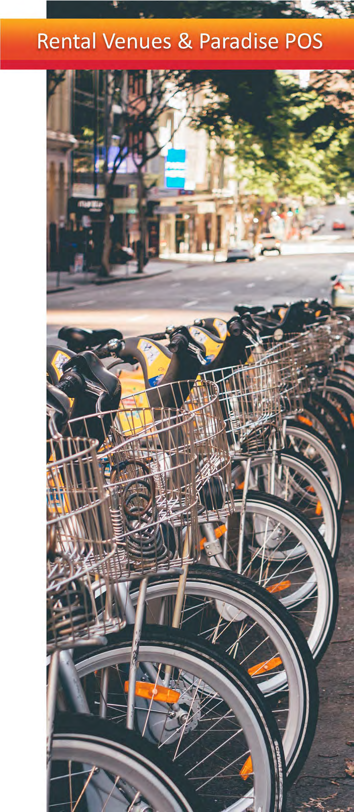

Paradise POS offers a cutting-edge iOS-based point of sale software for technology savvy venues who demand a best-in-class mobile solution for their business needs.
iPad Ready
Easy to Learn Interface
Outstanding Tech Support
Mobile Access
FEATURES
CUSTOMER DATABASE
Keep track of your customers right from your point of sale so you can track customer spending habits and keep track of their previous orders with their ticket history. Store your customers' credit card numbers for House Accounts so that the house account may be paid out later.
House Accounts
Gift Cards
Loyalty Program
REMOTE DASHBOARD
Paradise POS enables you to easily access, monitor, and report data from anywhere at any time, even on your mobile device. We have created a simplified approach to an interactive dashboard with embedded analysis capabilities that allows users to quickly generate at-a-glance reporting and identify areas that need immediate attention.
Remote Mobile Access to Reports
•Inventory Reports
Sales Tax & Commission Tracking
Payroll
Labor Costs
ADDITIONAL FEATURES
Rental Deposits
Fully Customizable Inventory
Customizable Permissions for Each Employee
Rental Time Tracking
Short & Long Term Rentals
Customer Facing Display
Product Management
Multiple Rental Rates

