Slide 1
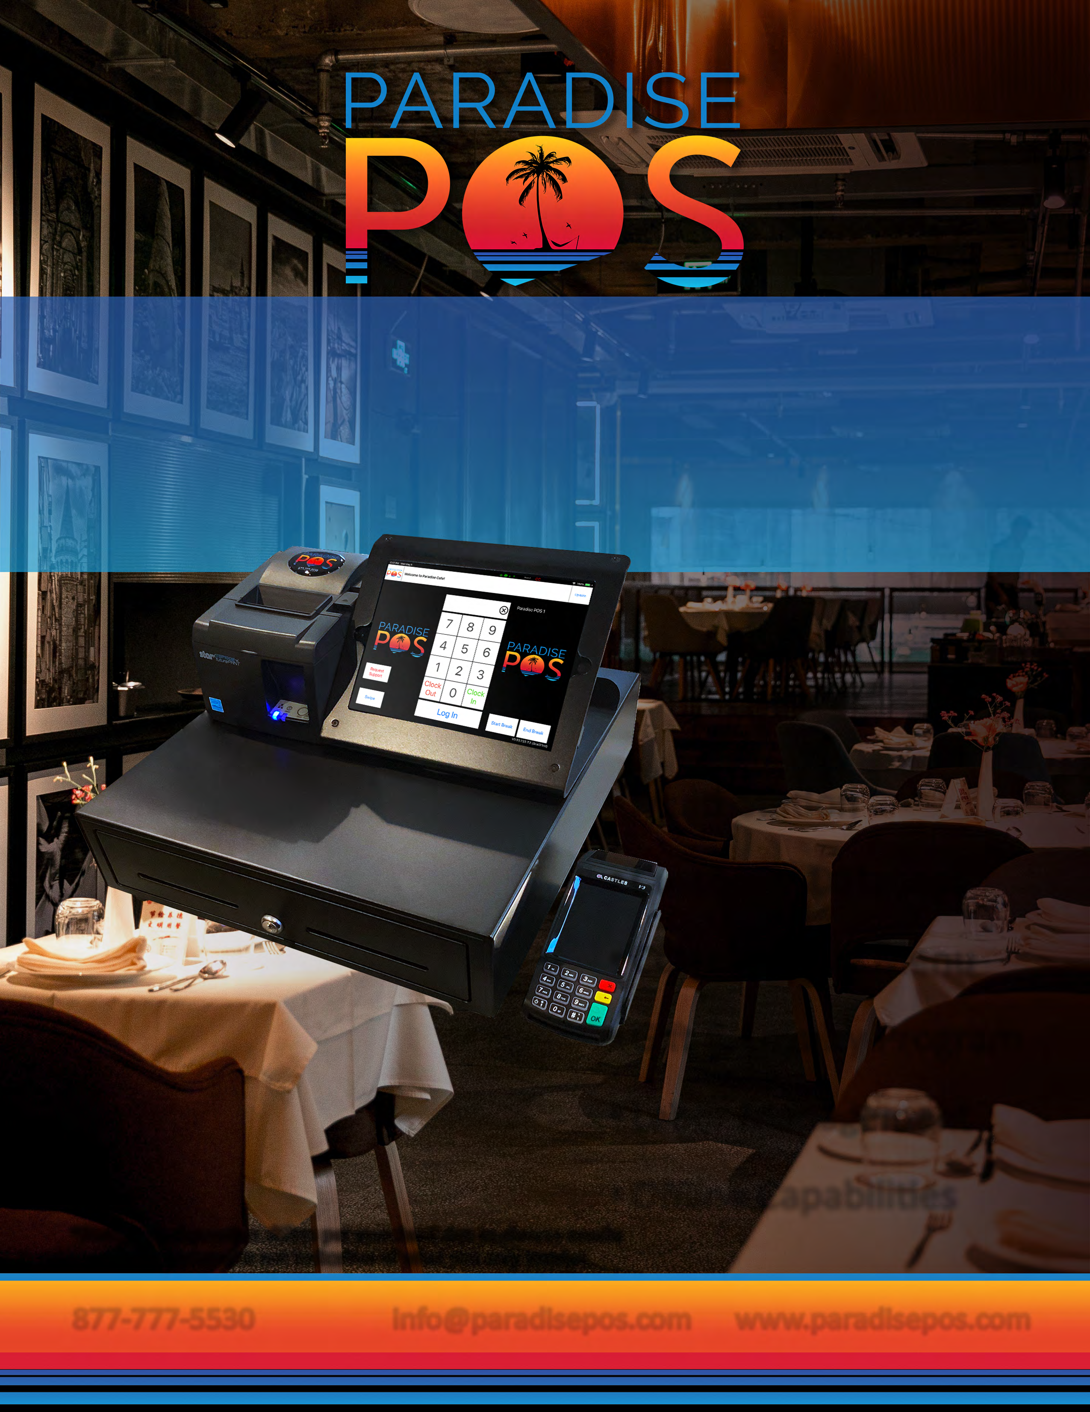
You rely on your POS software for more than entering orders and settling checks for your restaurant — you also need a system that you can leverage for inventory management and reporting. That’s why Paradise POS developed iPad POS software that restauranteurs can rely on to take accurate orders, improve productivity and decrease costs.
Multi-Station
Custo r Database
Custo le Menu
Gift & Loyalty Program
Labor Management
Ofline Capabilities
*Station configuration differs per merchant due to diverse needs; stati ictured is not indicative of what you may receive.
877-777-5530 info@paradisepos.com
Enter Name
Phone
Email
Company Name
Your Logo
Goes Here
www.paradisepos.com

Slide 2

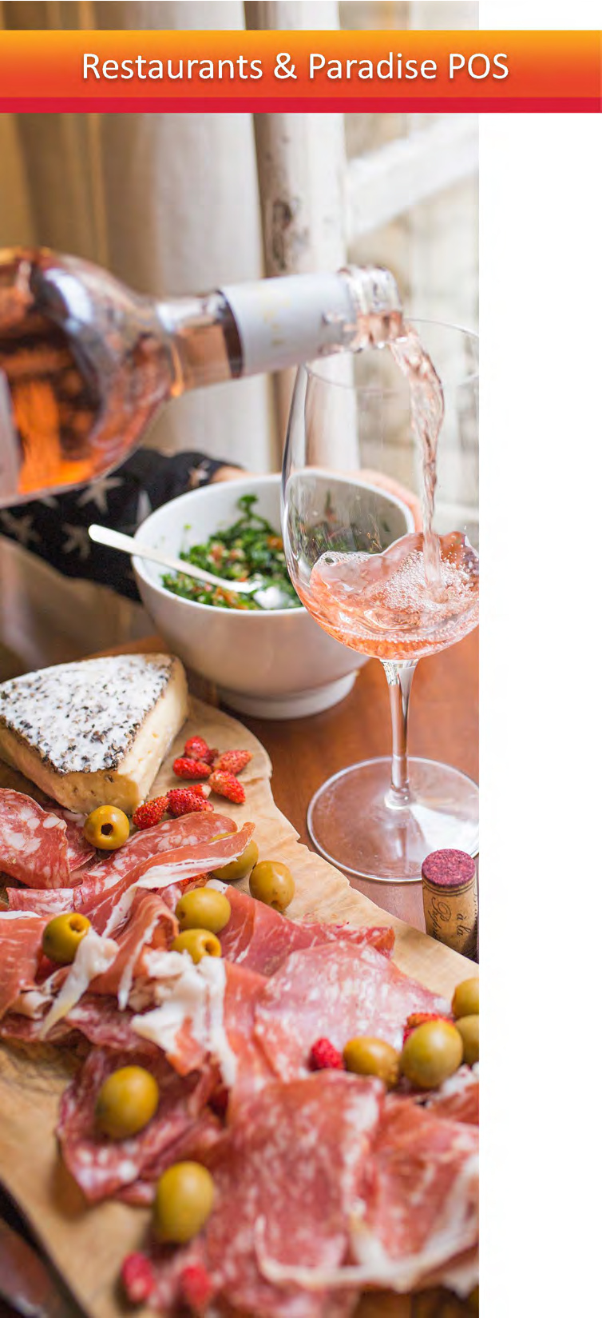
Paradise POS offers a cutting-edge iOS-based point of sale software for technology savvy restaurants who demand a best-in-class mobile solution for their business needs.
iPad Ready
Easy to Learn Interface
Outstanding Tech Support
Mobile Access
FEATURES
CUSTOMIZABLE MENU
Customize menu screens to make the ordering and checkout process intuitive, simple, and accurate. Easily modify or change menu items, pricing, promotions, or specials to attract new customers.The Paradise POS training team will work with you and your staff to optimize your menu for your unique business needs and show you how easy it is to change your menu whenever you want.
Items Maintenance
Modifier Maintenance
Combo Groups
CustomizableTable Diagram
REMOTE DASHBOARD
Paradise POS enables you to easily access, monitor, and report data from anywhere at any time, even on your mobile device. We have created a simplified approach to an interactive dashboard with embedded analysis capabilities that allows users to quickly generate at-a-glance reporting and identify areas that need immediate attention.
Remote Mobile Access to Dashboards
Inventory Reports
SalesTax &TipTracking
Payroll
Labor Costs
ADDITIONAL FEATURES
Kitchen Display System (KDS)
Allow EBT for items
Assign Vendors
Ticket Commands
TransferTickets
SplitTickets
Add Gratuity

