Slide 1
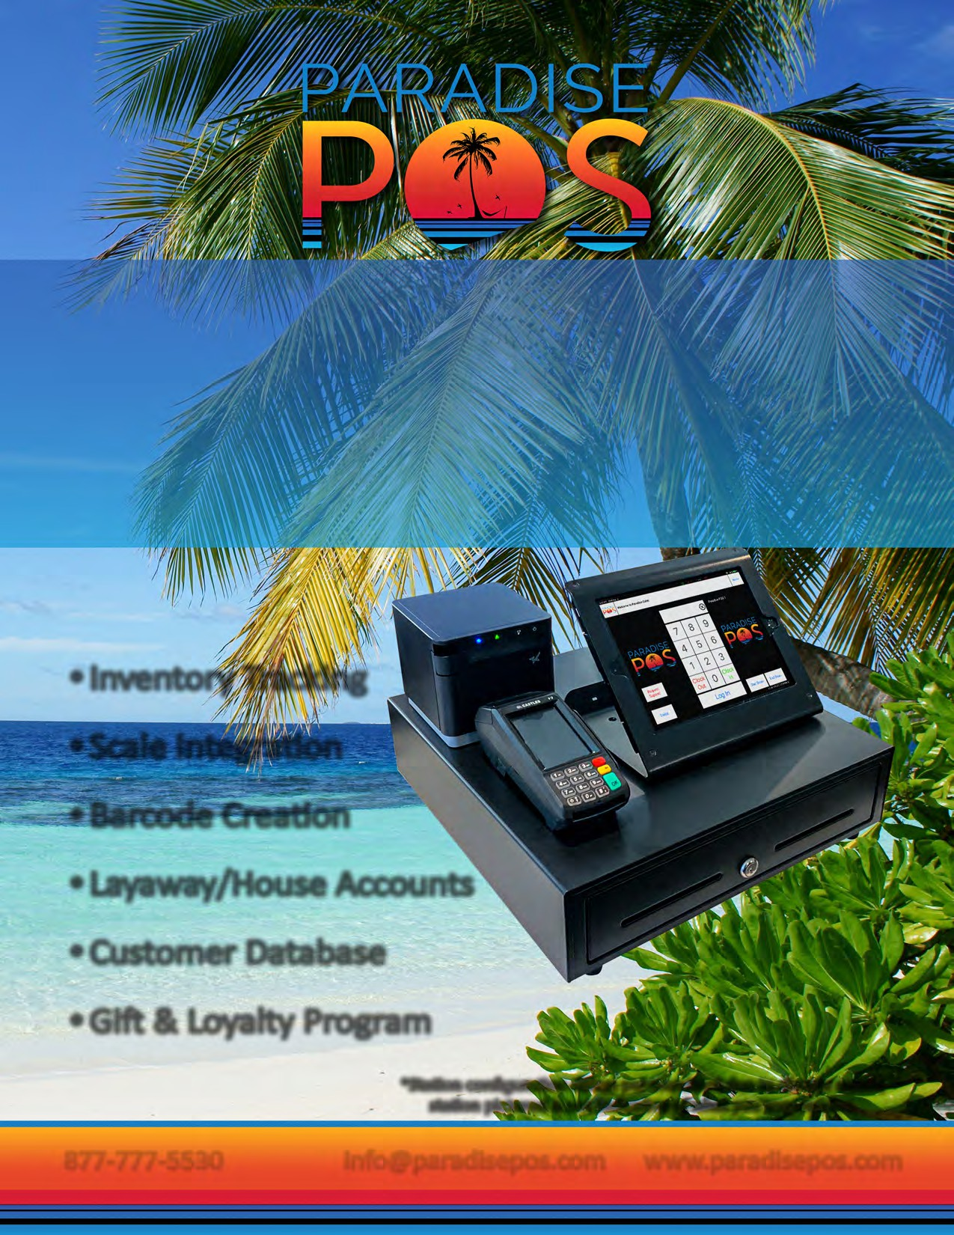
Paradise POS is more than just a retail POS system. It is a complete retail management system that empowers your business to increase revenue, control costs, improve productivity and drive profitability. Customizable by design, our iPad retail point of sale systems enable you to optimize operational efficiency by defining how the POS works. Retail POS from Paradise POS also collects and analyzes data that helps you make smarter, more informed business decisions that impact your bottom line.
Inventory Tracking
Scale Integration
Barcode Creation
Layaway/House Accounts
Customer Database
Gift & Loyalty Program
*Station configuration differs per merchant due to diverse needs; station pictured is not indicative of what you may receive.
877-777-5530 info@paradisepos.com www.paradisepos.com
Enter Name
Phone
Email
Your Logo
Goes Here

Slide 2

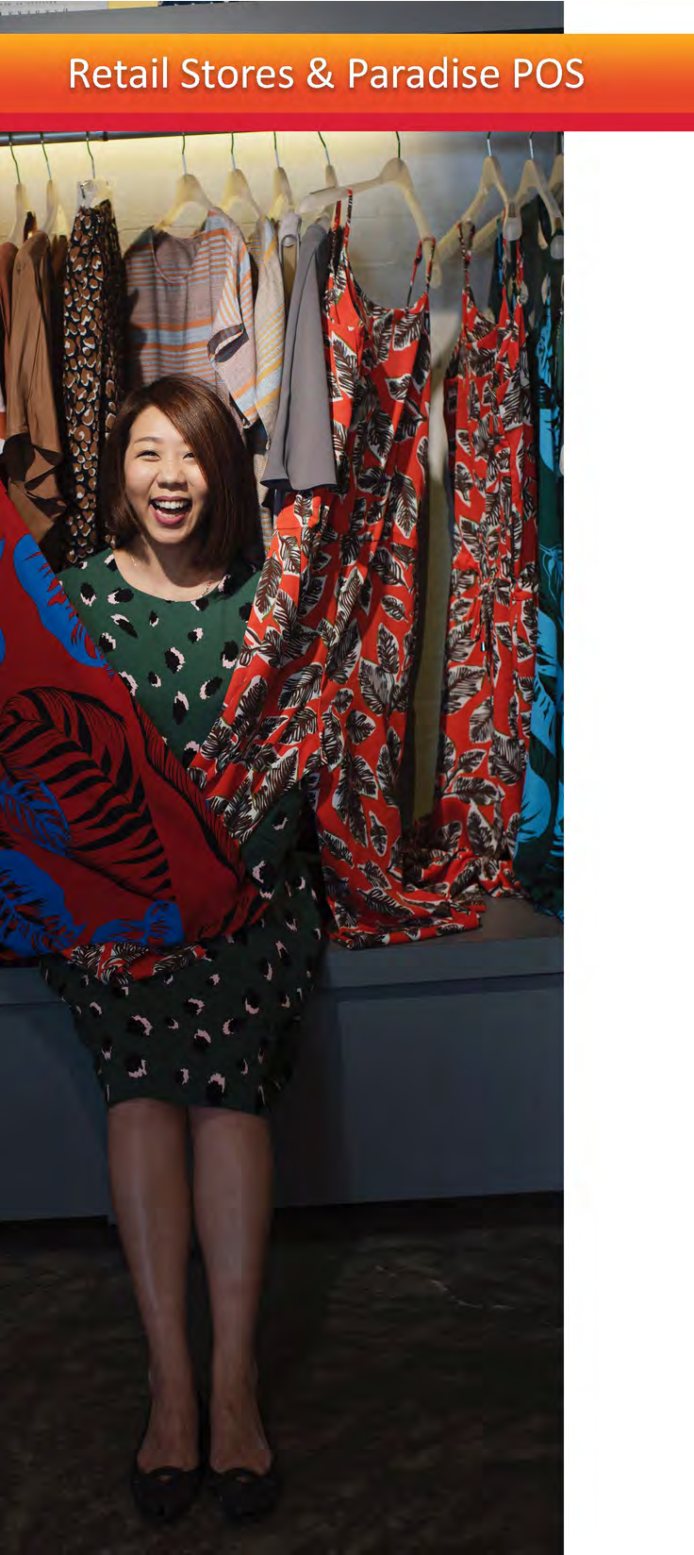
Paradise POS offers a cutting-edge iOS-based point of sale software for technology savvy retailers who demand a best-in-class mobile solution for their business needs.
iPad Ready
Easy to Learn Interface
Outstanding Tech Support
Mobile Access
FEATURES
CUSTOMER DATABASE
Keep track of your customers right from your point of sale so you can track customer spending habits and keep track of their previous orders with their ticket history. Store your customers' credit card numbers for House Accounts so that the house account may be paid out later.
House Accounts
Layaway Feature
Loyalty Feature
Sendin Blue Integration
TAX OPTIONS
Taxing your items isn't always cut and dry, especially with the differences in state taxes and county taxes. Paradise POS gives you different tax options to tailor the system for your business.
Smart Tax
Multiple Tax Rates
Sugar Tax
Tax Rates Per Ounce
ADDITION AL FEATURES
Bottle Redemptions
Additional Fields
Lottery Functionality
Vendors
Label Printing
Price Check
Scale Integration
Allow Item for EBT
Customer Facing Display (CFD)
Sign on iPad

