Slide 1

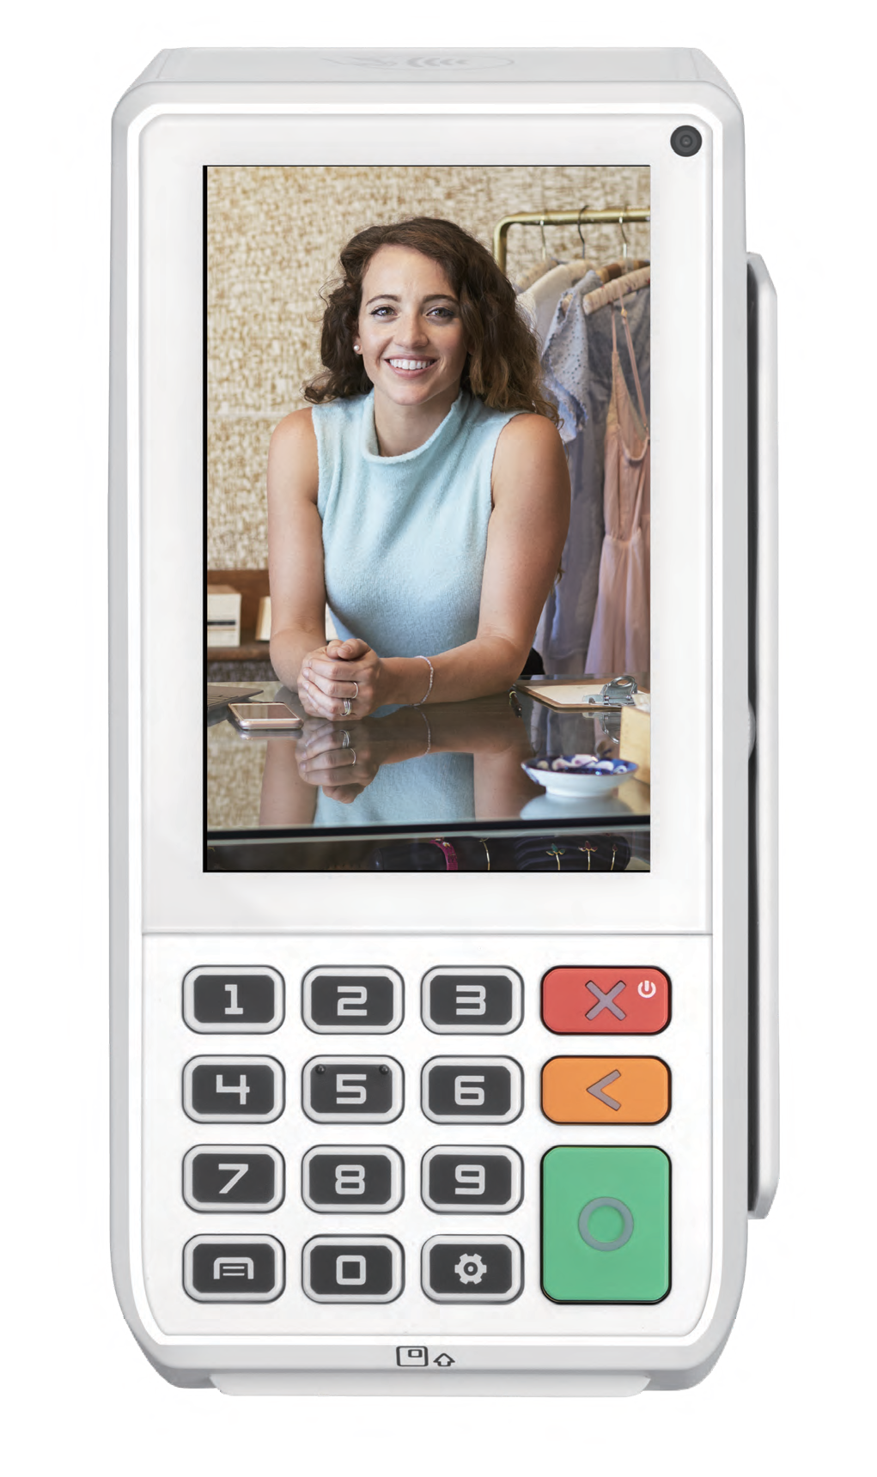


MODERN
Smart Desktop
A80
Food & Beverage
Fashion & Retail Supermarkets
SMARTPOS
Powered by Android 10
PCI 6.x SRED
4"
Display
0.3MP
Front
Advanced Connectivity

Slide 2
















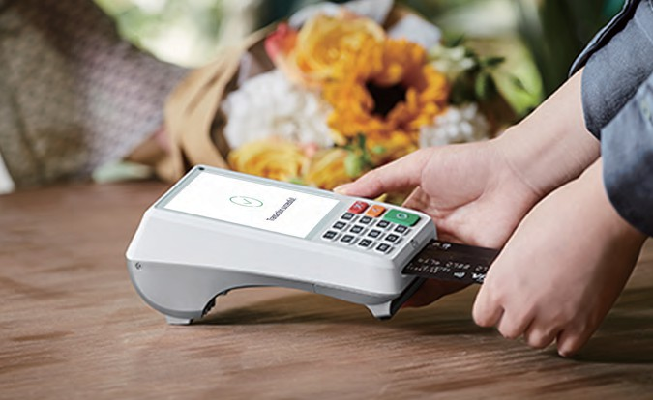
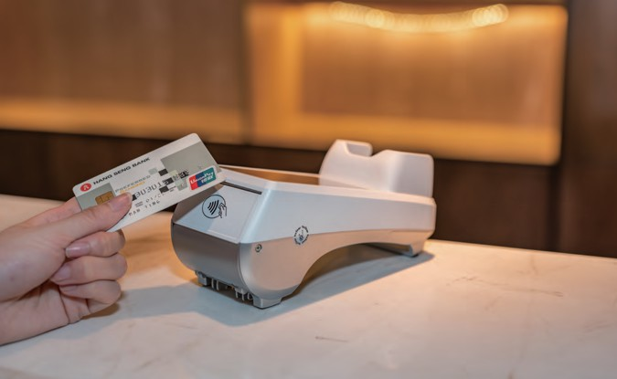
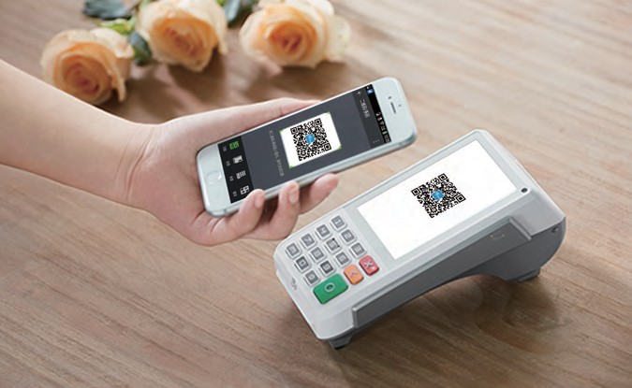
A80
Android Desktop
SPECIFICATIONS
Operating System | PayDroid Powered by Android 10
Processor | Cortex-A53
Memory | 1GB DDR + 8GB eMMC | 2GB DDR + 16GB eMMC(optional) | 1 microSD Card Slot, Supports up to 32GB
Card Readers | Chip & PIN | NFC Contactless | Magnetic Stripe
Cameras | Optional: 0.3MP Front-Facing
Displays | 4'' TFT WVGA 480 x 800 Pixels Multi-Point Capacitive Touch Screen
Comms Configurations | Wi-Fi® 2.4GHz/5GHz (optional) | Dial (optional) | LAN Bluetooth® (optional) | WCDMA (optional) | 4G (FDD-LTE/TDD-LTE) (optional)
Battery | Optional: 720mAh | 7.4V
Printer | 50 lines/sec | Paper Roll Outer Diameter: 50mm
SIM / SAM | 2 SAM | 1 Mini SIM + 2 SAM | 2 Mini SIM + 1 SAM
Keys / Buttons | 15 Keys: 0 ~ 9 | Menu | Func | Cancel | Clear | Enter
Audio | 1 Speaker
Ports | 1 RS232 | 1 PSTN | 1 Ethernet | 1 PINpad | 1 micro-USB 2.0, OTG | 1 Host USB 2.0 | 1 Phone
Adapter | Input: 100-240V AC, 50Hz/60Hz | Output: 9.0V DC, 1.0A
Physical | 181 x 84 x 81mm, 405g (excluding battery)
Environmental | -10°C ~ 50°C (14°F ~ 122°F) Operating Temperature -20°C ~ 70°C (-4°F ~ 158°F) Storage Temperature 5% ~ 96% Relative Humidity, Non-condensing
Accessories | Cluster Cable (optional) | Privacy PIN Shield (optional) | Battery Backup (optional)
Certifications | PCI PTS 6.x SRED | EMV L1 & L2 | EMV contactless L1 | Visa payWave | Mastercard contactless | American Expresspay | Discover D-PAS | JCB J/Speedy | Interac Flash L2 | Mastercard TQM | QUICS L2 | IC | CE | UKCA | BQB| RoHs | UL | FCC

