Slide 1

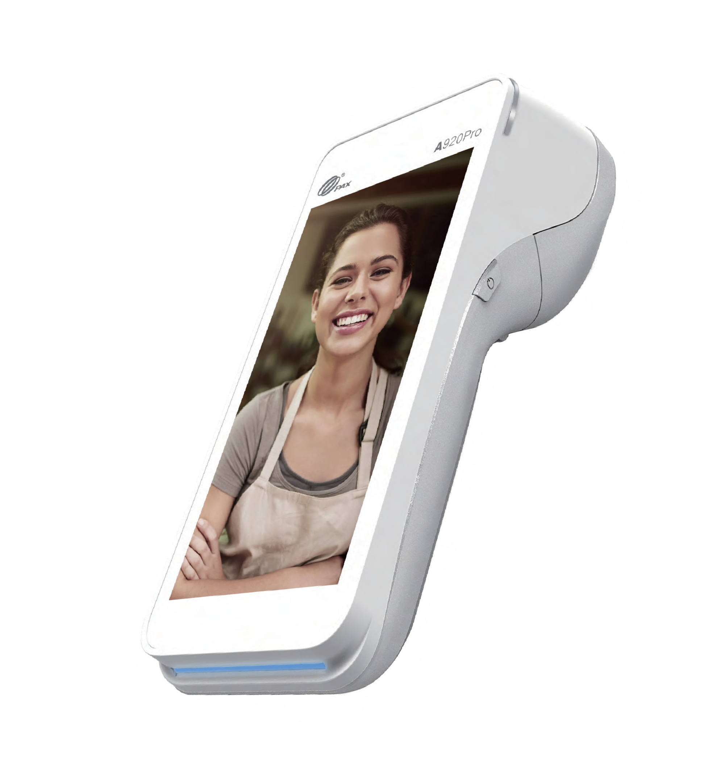



A920Pro
POWERFUL
Smart Mobile
Food & Beverage
Fashion & Retail Transportation
SMARTPOS
Powered by Android 10 or 8.1
PCI 6
PCI 5 SRED
5.5" HD
Display
Top-Side Scanner 8MP Rear Camera
Advanced Connectivity

Slide 2

















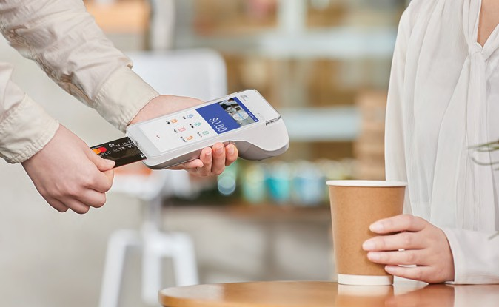
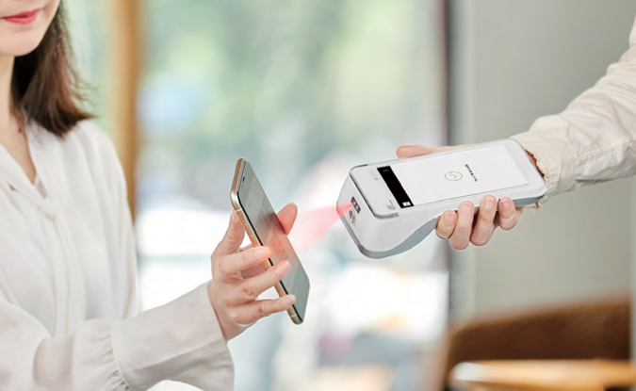
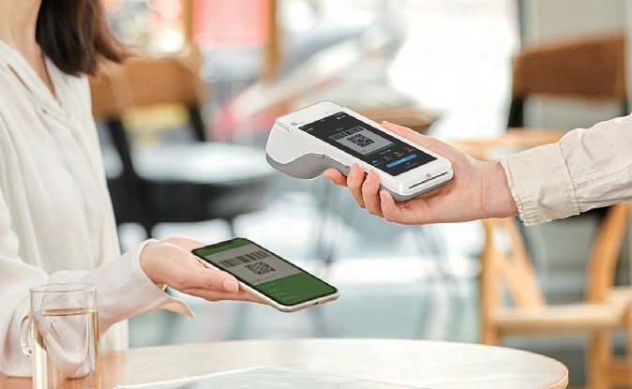
A920Pro
Android Mobile
SPECIFICATIONS
Operating System | PayDroid Powered by Android 10.0 (PCI 6) or Android 8.1 (PCI 5)
Processor | ARM Cortex A53 Quad-Core, 1.4GHz + Secure Processor
Memory | 8GB eMMC Flash + 1GB DDR RAM | Optional: 16GB eMMC Flash + 2GB DDR RAM Extended microSD Card Slot Up to 128GB
Card Readers | Chip & PIN | Contactless | Magnetic Stripe
Cameras | 5MP Front-Facing Camera + 8MP Rear-Facing Camera + Top-Side Barcode Scanner Optional: Higher Quality Barcode Scanner
Displays | 5.5'' IPS HD+ 720 x 1440 Pixels Multi-Point Capacitive Touch Screen
Comms Configurations | 4G + WiFi 2.4GHz + Bluetooth Optional: 4G + WiFi 5GHz + Bluetooth 5.0
Battery | 5150mAh | 3.7V
Printer | 40 lines/sec | Paper Roll Outer Diameter: 40mm
SIM / SAM | 1 Micro SIM + 2 SAM | 1 Micro SIM + 1 SIM + 1 SAM
Positioning | GPS | GLONASS | BEIDOU
Keys / Buttons | 4 Keys: Power ON/OFF | Volume+ | Volume- | Quick Scan Key
Audio | 1 Buzzer | 1 Speaker | 1 Microphone
Ports | 1 Type-C OTG | 6 PIN POGO PIN
Adapter | Input: 100-240V AC, 50Hz/60Hz | Output: 5.0V DC, 2.0A
Physical | 178.3 x 78 x 54.2mm, 390g (Including Battery)
Environmental | -10°C ~ 50°C (14°F ~ 122°F) Operating Temperature, Non-Charging -20°C ~ 70°C (-4°F ~ 158°F) Storage Temperature 5% ~ 95% Relative Humidity, Non-Condensing
Accessories | L920Pro-BC: Charging Base | 1 Power Port (Type-C) | 182.8 x 84.5 x 44.7mm L920Pro-BE: Charging + Wireless | WiFi 5GHz + Bluetooth 5.0 | 1 RS232 (RJ45) | 1 Ethernet (RJ45) | 1 Power Port (Type-C) | 1 Type-C (Device) | 1 USB(Host) | 182.8 x 84.5 x 44.7mm
Certifications | PCI PTS 6.x (Android 10), PCI PTS 5.x (Android 8.1) SRED | EMV L1 & L2 | EMV contactless L1 | Visa payWave | Mastercard contactless | UPI qUICS | American Expresspay | Discover D-PAS | JCB J/Speedy | Interac Flash | Mastercard TQM | Common.SECC UKCC | CE | RoHs | ATEX |FCC | IC | PTCRB | WPC | BIS | Anatel | ABECS

