Slide 1


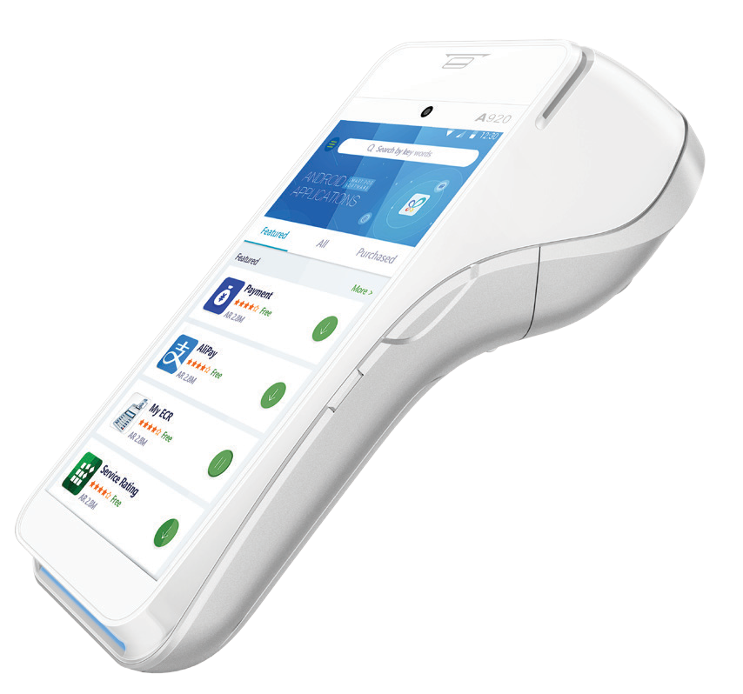




A920
SmartMobile
The A920 is the revolutionary terminal that started it all. A strikingly beautiful and ergonomically designed terminal, this SmartMobile delivers elegance, style, and security to every payment experience. The A920 combines the full features of an Android™ platform with a powerful payment terminal, all in a sleek and compact design. The A920 delivers an integrated camera, high-speed thermal printer, and high-capacity battery to meet the daily demands across all dynamic Retail or Hospitality environments.
DELIVERY
RESTAURANTS
TRANSPORTATION
RETAIL

Slide 2
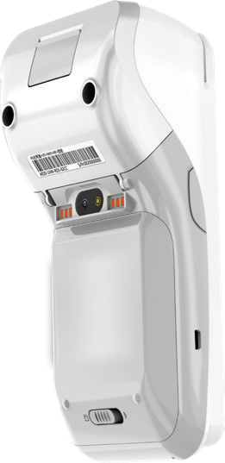
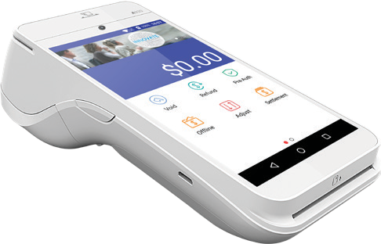
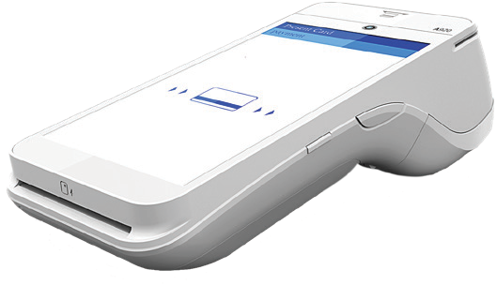




A920
SPECIFICATIONS
MAIN FEA TURES
ADDITIONAL SPECS
Memory | 1GB RAM + 8GB Flash, Micro SD Card Slot | Supports up to 32GB
Processor | ARM Cortex A7 1.1GHz 4 core processor | Cortex-M4
Card Reader Types | Magnetic Card Reader | Smart Card Reader | Contactless
Dual Cameras | 0.3 MP Fixed Focus Front Camera | 5 MP Auto Focus Rear Camera
ommunications | 4G LTE | Wi-Fi | Short range wireless communication
ommunication Ports | Dual SIM | 1 x Micro USB
External Base Options | Charging Base | Multi-Functional Wireless Base
Physical | L x W x H (inches): 6.92 x 3.07 x 2.24 Weight: 11.3 oz (including battery)
Certifications | PCI PTS 5.x SRED | EMV® L1 & L2 | EMV L1 Contactless | Discover D-PAS | Mastercard Contactless | Visa Paywave | American ExpressPay | Interac Flash | UnionPay qUICS
PAXBiz® Powered By Android
5” (720 x 1280) IPS Touchscreen Display
3.7V 5250 mAh Li-Ion
C
C
2”Thermal Printer | 80mm Per Second

