Slide 1

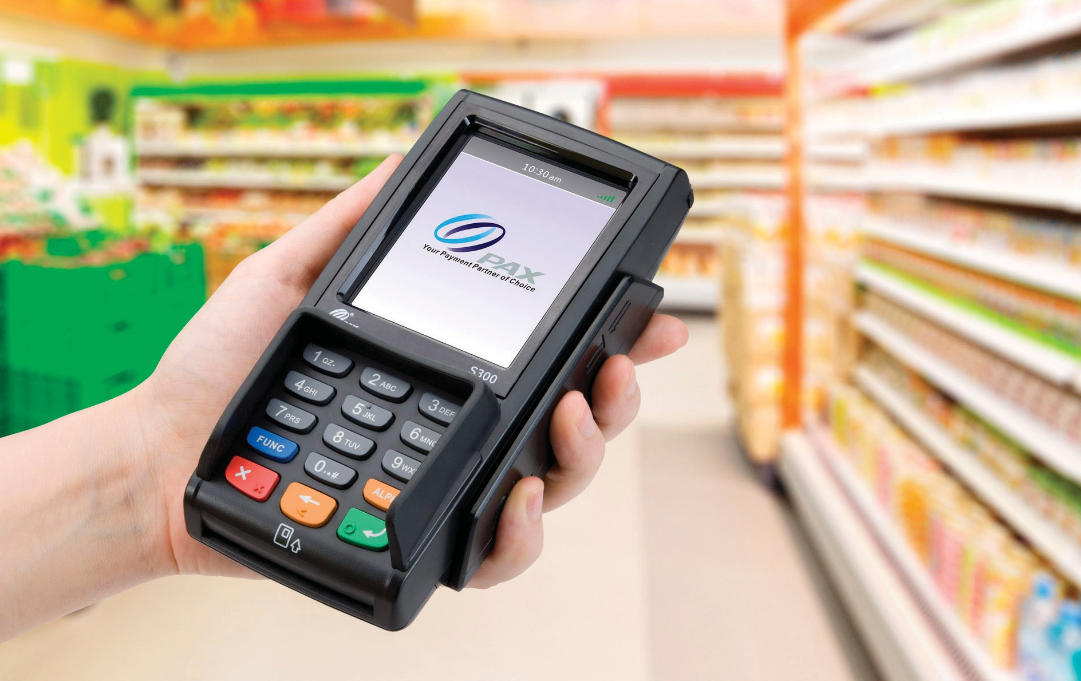




S300
Integrated Retail PIN Pad
PAX’s S300 is the latest integrated retail payment solution for retail merchants who wish to oﬀer high levels of transactional security combined with contactless, e-signature, magnetic stripe and Chip & PIN. With state of the art levels of security design, including PCI PTS 4.x and SRED, the S300 protects and encrypts all transaction information. Featuring a large color touchscreen and loudspeaker, the S300 comes with a 32-bit ARM11 processor and massive amounts of memory.
HOSPITALITY
RESTAURANTS
SMB
RETAIL

Slide 2
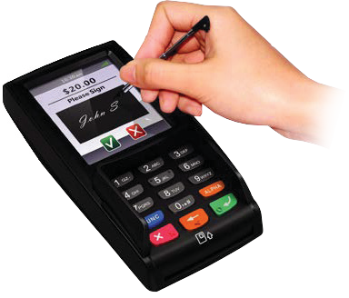
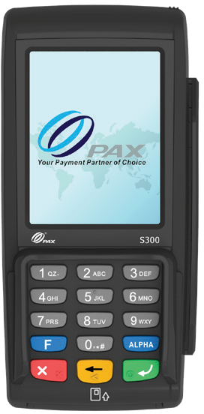
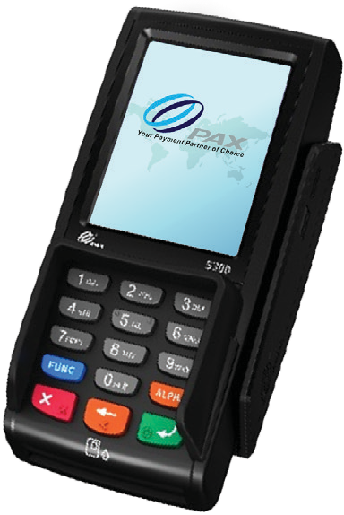




S300
SPECIFICATIONS
MAIN FEA TURES
ADDITIONAL SPECS
Memory | 192MB (128MB Flash, 64MB DDR)
Processor | 32-bit ARM11
Card Reader Types | Magnetic Card Reader | Smart Card Reader | Contactless Card Reader
ommunications Ports | Single Multi-function Cable Port: 1 x RS232 | 1 x USB2.0 Device | 1 x Ethernet
Security | DUKPT, Master/Session, 3DES | ANSI / ISO9564 format 0, 1, 3 | PIN ciphered key algorithm | ANSI X9.9 / X9.19 MAC algorithm
Physical | L x W x H (inches): 6.57 x 3.19 x 1.97 Weight: 10.23 oz
Certifications | PCI PTS 4.x SRED, EMV® L1 & L2, Visa payWave, Mastercard PayPass, American Express expresspay, Discover D-PAS, Interac Flash, JCB J/Speedy UnionPay qUICS
Open & Flexible OS
3.5” (240 x 320) LCD Touchscreen
C
Supports RSA, AES, 3DES
Secure key embedded area

