Slide 1


New Agent - Partner Training Guide

Slide 2


WELCOME!
https://player.vimeo.com/video/545271735?app_id=122963
Notes:
https://player.vimeo.com/video/545271735?app_id=122963

Slide 3

TouchSuite Overview
Merchant Processing
Pricing Methods
GRUBBRR
Equipment - Hardware
Equipment - Software
Required Documents
Table of Contents

Slide 4
Overview
Who Are We
How We Started
What We Do
Our Departments

Slide 5
Who Are We
Founded in 2003 by CEO Sam Zietz
Financial technology, payment processing company
Appeared on Inc. Magazine’s “Inc. 500” list of fastest-growing private companies in America eight times
Gov. Rick Scott presented Sam Zietz with the Governor’s Business Ambassadors Award for TouchSuite’s growth and contributions to Florida’s economy

Slide 6
Sam Zietz worked as an attorney specializing in structured finance, which led him to the payment space
He always knew he wanted to be an entrepreneur and for that, he knew he needed either money or know-how. At the time, he didn’t have any money, so he went to law school to get the know-how.
Founded American Bancard, then changed d/b/a to TouchSuite to be more aligned with the FinTech space
How We Started

Slide 7
What Do We Do
Clover
At TouchSuite, we deliver fintech solutions that help business owners thrive within the community. Our tools have been designed with business owners in mind — our goal is to assist growing businesses reach the next level of success. We offer point-of-sale systems that are fully integrated with affordable payment processing services.
We provide innovative, scalable, and affordable solutions for businesses seeking a true advantage when it comes to efficiently managing their business.

Slide 8
What Do We Do
Clover
TouchSuite offers POS systems and merchant processing, we offer access to working capital, and personalized support to our valued clients.
We have a suite of tools that cater to full-service restaurants, quick-service restaurants, food trucks, salons, spas, retail establishments, festivals, and businesses on the go.
We provide solutions that help our clients grow, and we assist in the development of local economies. Innovation and disruptive technology are changes we’re proud to embrace and promote.

Slide 9
Our Departments
Marketing
Talent Acquisition
Legal & Human Resources
Sales
Development
Finance
Operations

Slide 10
Processing –How It Works
Key Players
Credit Card Authorization
Credit Card Clearing and Settlement

Slide 11
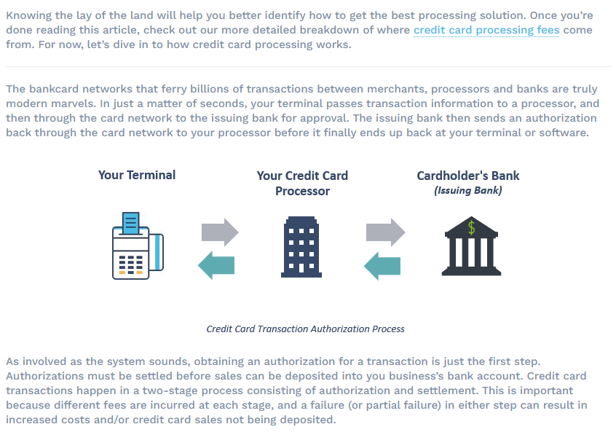
How It Works
Clover
You should have a general understanding of how credit card processing works
_________________

Slide 12
Cardholder
Card Associations
Key Players
Merchant
Issuing Bank
Acquiring Bank

Slide 13





How It Works
Clover
Cardholder: Someone who obtains a bankcard (credit or debit) from a card issuing bank. They then present that card at a business to pay for goods or services.
Merchant: Any business that maintains a merchant account that enables them to accept credit or debit cards as payment from customers (cardholders) for goods or services provided.
The Key Players that are involved in credit card processing
_________________
Acquiring Bank: A registered member of the card associations (Visa and MasterCard). They contract with merchants to create and maintain merchant accounts that allow the business to accept credit and debit cards. Acquiring banks often enlist the help of third-party independent sales organizations (ISO) and membership service providers (MSPs) to conduct and monitor the day-to-day activities of their merchant accounts.
Issuing Bank: Issue credit cards to consumers. The issuing bank is also a member of the card associations (Visa and MasterCard). They pay acquiring banks for purchases that their cardholders make. It is then the cardholder’s responsibility to repay their issuing bank under the terms of their credit card agreement.
Card Associations: Visa and Mastercard act as a custodian and clearing houses for their respective card brands. They govern the members of their associations, including interchange fees and qualification guidelines

Slide 14
How It Works
Clover
Cardholder: Begins a credit card transaction by presenting his or her card to a merchant as payment for goods or services.
Merchant: Uses their credit card machine, software, or gateway to transmit the cardholder's information & the details of the transaction to their acquiring bank.
The Authorization Process
_________________
Acquiring Bank / Processor: Captures the transaction information and routes it through the appropriate card network to the cardholder’s issuing bank for approval.
Card Associations: Transaction information is routed between issuing and acquiring banks through Mastercard’s Banknet network and Visa’s VisaNet network.
Issuing Bank: Receives the transaction information from the acquiring bank (through Banknet or VisaNet) and responds by approving or declining the transaction after checking to ensure that the transaction information is valid, the cardholder has sufficient balance to make the purchase, and that the account is in good standing.
Card Associations: The card issuer sends a response code back through the appropriate network to the acquiring bank (or its processor).
Merchant: Response code reaches the merchant’s terminal, gateway or software and is stored in a batch file awaiting settlement.

Slide 15
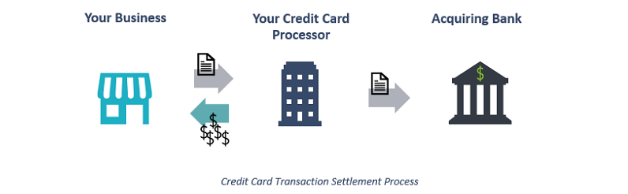
How It Works
Clover
Credit card clearing and settlement is the second part of how credit card transactions work
_________________
Credit card clearing and settlement occurs after the authorization process takes place. For settlement, the merchant sends a “batch” of authorizations to their processor, typically once per day. The processor reconciles the authorizations and submits the batch over the card association networks. The processor also deposits the funds from those sales into the business’s bank account and deducts processing fees. At that point, the business’ role is complete.
The issuing and acquiring banks continue to communicate and move money (with the issuing bank paying the acquiring bank for the cardholders’ purchases) and the cardholder eventually pays the issuing bank. Neither of those steps involves the merchant's business.

Slide 16
How It Works
Clover
Merchant: Begins the settlement process by sending a batch of approved authorizations to their acquiring bank (or the bank’s processor). Batches are typically sent at the close of each day (multiple transactions make up a batch).
The Settlement Process
_________________
Acquiring Bank / Processor: Reconciles and transmits the batch of authorizations through interchange via the association’s network (VisaNet/Banknet). Bank (processor) also deposits funds from sales into the merchant’s bank account via ACH and debits the merchant’s account for processing fees.
Card Associations: Debits the issuing bank’s account and credits the acquiring bank’s account for the net amount of the authorizations (gross receipts less interchange and network fees).
Issuing Bank: It basically pays the acquiring bank for its cardholder’s purchases.
Cardholder: Is responsible for repaying the issuing bank for the purchase and any accrued interest and fees.

Slide 17
Pricing Methods
Interchange Plus
Tiered
Surcharge
Cash Discount
Flat Rate

Slide 18
Pricing Methods
Clover
Interchange Plus
Interchange – Credit card processing rates set by the card brand
Plus – The processors’ markup that is applied to each credit card transaction; Typically expressed as basis points accompanied by an authorization fee
Basis point – Equal to 1/100th of a percentage point
Authorization Fee – Charged each time a merchant sends a transaction to their customer’s issuing bank to be authorized
Interchange Plus – Base credit card processing rates with a fixed markup typically consisting of basis points and an authorization fee

Slide 19
Pricing Methods
Clover
Benefits of Interchange Plus
Most transparent, cost-effective form of merchant account pricing
The separation of processing costs with interchange plus allows for the optimization of interchange expenses
Typically yields savings over the same processing volume when compared to other pricing models
More favorable for small businesses, as merchants usually end up paying lower processing costs

Slide 20

Pricing Methods
Clover
Tiered
Works on a system of qualification to determine which tier a merchant’s transaction falls into
Tiers are called bins, rate buckets, or buckets
There may be various in-between tiers, as well as differences between credit and debit card charges
The Qualified Discount Rate will represent the lowest fees a merchant will pay, and the Non-Qualified Discount rate will be the highest

Slide 21
Pricing Methods
Clover
Pro & Cons of Tiered Pricing
Each tier has its own processing rate, so merchants will always know that they will be charged one of the three rates for every transaction
Transactions typically fall into three categories, simplifying the presentation of payment processing statements for merchants
Processors advertise their qualified rates – the most attractive ones. Rarely do merchants get these rates
Lacks transparency about how the fees break down

Slide 22
Tiered Pricing
Customer cards can fall into these tiers based on the type of card being used as payment, how promptly the transaction is settled, and other risk factors.
Pricing Methods
Qualified
Lower rate - Generally
applies to debit cards,
non-reward based credit
cards, and swipe/chip - NFC
Transactions.
Rates will be applied to card/transactions
that don’t meet the processor’s standards to be
qualified. Typically applies to membership rewards
cards, or manually entered cards.
Rates are going to be higher than qualified rates.
Mid-Qualified
Non-Qualified
Non-qualified rates are what merchants want to avoid. These rates apply to high-reward credit cards. CNP transactions and corporate cards.

Slide 23
Pricing Methods
Clover
Surcharge
Allows merchants to add a percentage checkout fee to a credit card transaction that is paid by the end consumer to help offset the merchant’s credit card processing fees
Surcharge cannot be applied to debit (signature, PIN, PINless) and prepaid cards
AMEX ESA merchants are not eligible for surcharging
Surcharge fee must be a percentage amount
Surcharge fees must be disclosed at the POS, point-of-entry, and separately on every receipt – Full amount must be combined into one transaction
Merchants must be in a state/territory that allows surcharging

Slide 24
Pricing Methods
Clover
Pro & Cons of Surcharging
Bigger Margins - Allows merchants to pass their credit card processing costs on to their customers
Can’t Surcharge Debit Cards - If most of the transactions are processed via debit card, surcharging is not the answer
Might Be Illegal – Depending on where the merchant resides, surcharging may not be an option
Customer Backlash – Some customers won’t take kindly to having to pay more to use a credit card

Slide 25
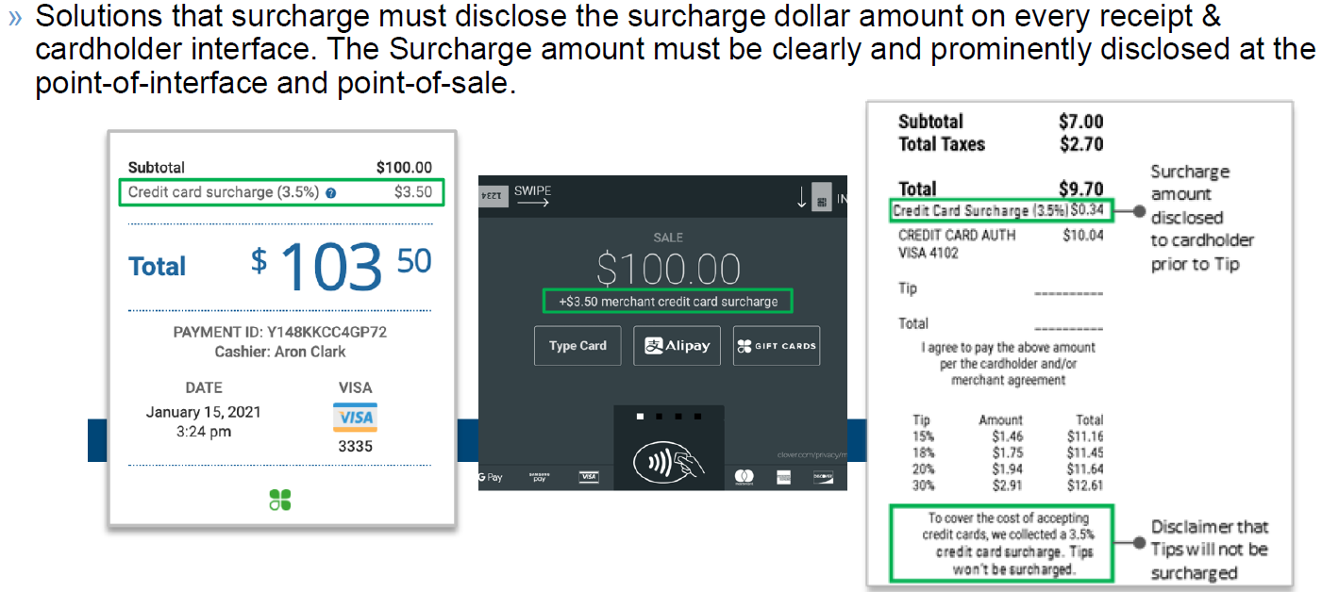
Surcharge Pricing
How does Surcharge work?
Merchant charges consumer 3.50% on sale amount
Sale amount is $100.00
Surcharge (3.50%) would amount to $3.50
Total billed to the cardholder would be $103.50
Pricing Methods

Slide 26
Pricing Methods
Clover
Cash Discount
When a merchant displays credit card prices and offers a discount for customers who pay with cash
Merchants cannot add a fee on top of the usual price and then give a discount
Cash discount must be a reduction from advertised/displayed price
Shelf price must reflect credit card price
Signage must be posted at the POS

Slide 27
Pricing Methods
Clover
Pros & Cons of Cash Discount
Reduce Fees – reducing or eliminating up to 100% of card processing fees associated with accepting credit cards
When customers are encouraged to pay with cash, merchants will significantly reduce the risk of chargebacks, pricing disputes, data breaches, fraud, and other complications
Some customers may not carry cash – lots of people simply don’t carry cash anymore. Customers opposed to making the purchase without getting a discount may walk out without buying anything
Potential drop in sales – Multiple studies have shown that consumers spend more when using credit cards

Slide 28
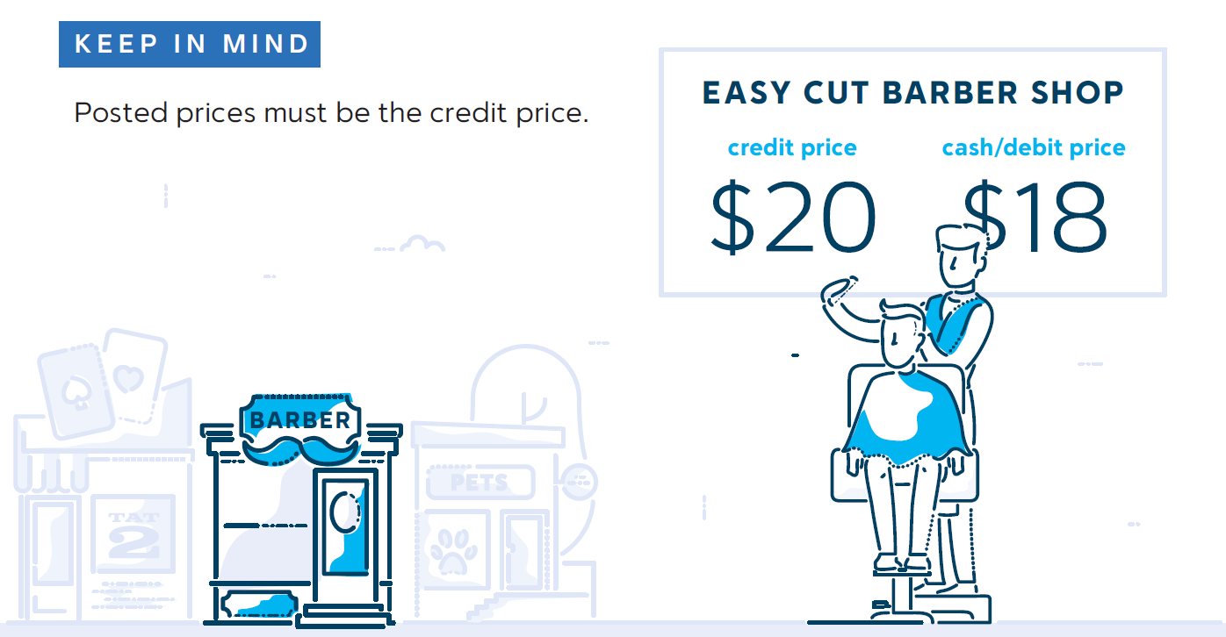
Cash Discount Pricing
Merchants can apply an immediate discount at the POS for payments made with cash, debit cards, and checks.
This discount applies to the standard, posted list price.
Pricing Methods

Slide 29
Pricing Methods
Clover
Flat Rate
Flat–rate credit card processing is a payment model that combines interchange fees and processor markups into a consistent, standardized fee for all transactions of its type
Payment structure is easy to understand but it is not always the most cost-effective option
Common flat rates are currently around 2.6% and 3.5% on the variable side and between $0.05 to $0.50 on the fixed fee side

Slide 30
Pricing Methods
Clover
Pros & Cons of Flat Rate
Flat Rate pricing is simpler for merchants to understand
Sometimes offered without a transaction fee, which can be beneficial for businesses with lots of transactions
Compared to interchange-plus pricing, flat-rate processing fees are typically more expensive
Not suitable for routine, high-volume processing

Slide 31
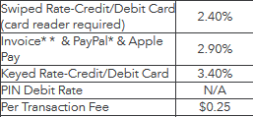
Flat Rate Pricing
The flat rate remains constant for all types of cards but may change based on the type of transaction being processed
Pricing Methods

Slide 32
Equipment
GRUBBRR
Terminals
Clover Suite

Slide 33
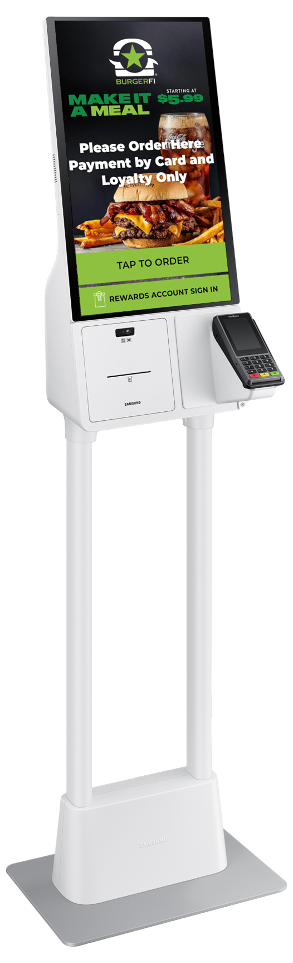
GRUBBRR
Clover
Self-Ordering & Digital Kiosk
Software Solutions
More Orders. More Dollars. Happier Customers.

Slide 34


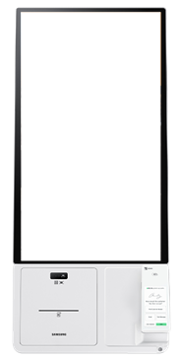
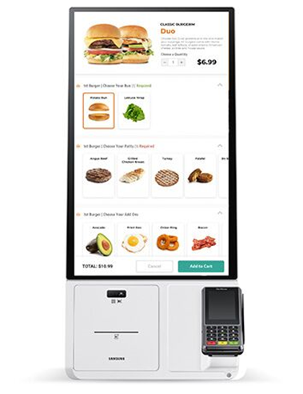


GRUBBRR
Clover

Slide 35
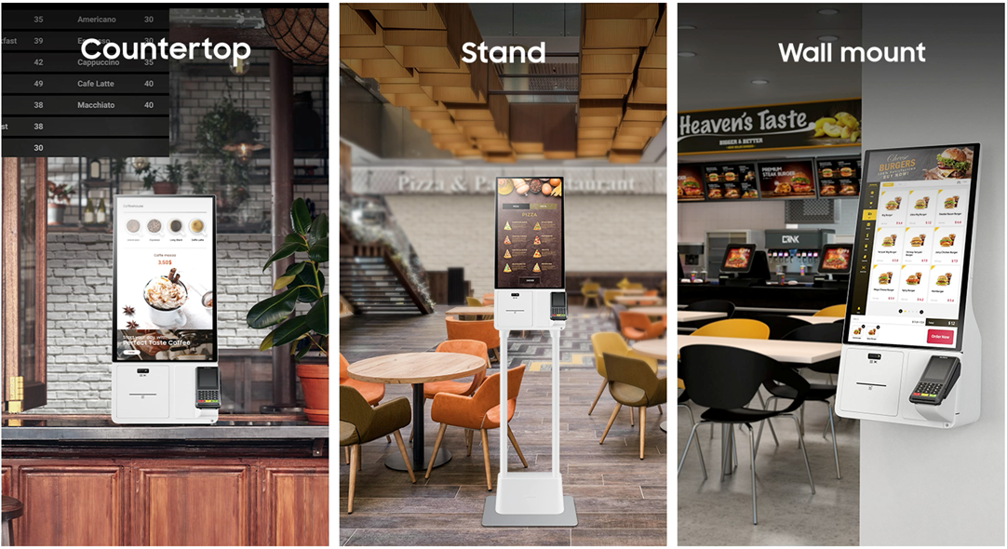
GRUBBRR
Clover

Slide 36
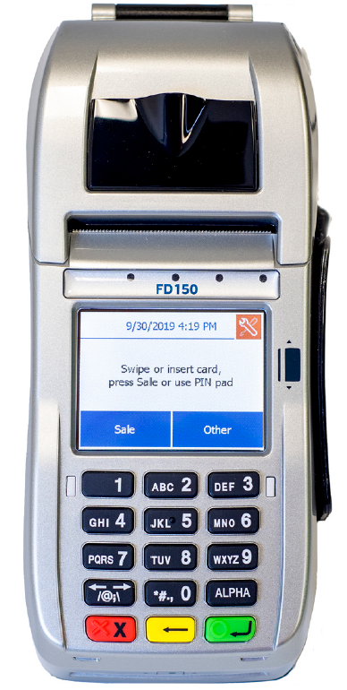
Terminals
Clover
First Data FD150
Affordable terminal solution that combines performance, reliability, and ease of use in a compact device
Industries served: Retailers and restaurants
Touch-screen capability
Ability to accept EMV chip transactions that enhance security
First Data

Slide 37
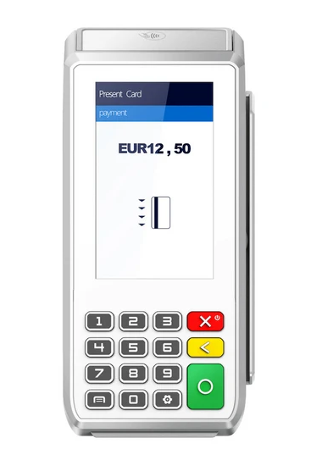
Terminals
Clover
Pax A80
Industries served: Retailers, restaurants, supermarkets
Contactless + Chip & PIN + Swipe
4-inch HD touch-screen
Physical keypad
Front-facing camera
Surcharge (TSYS)
First Data and TSYS

Slide 38
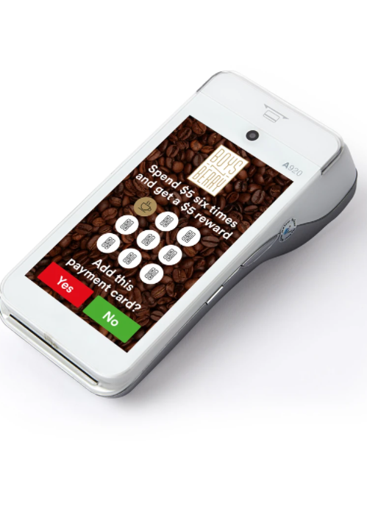
Terminals
Clover
Pax A920
Industries served: Retailers, restaurants, transportation
5-inch touch-screen
Contactless + Chip & PIN + Swipe
Front and rear cameras
Surcharge (TSYS)
First Data and TSYS

Slide 39
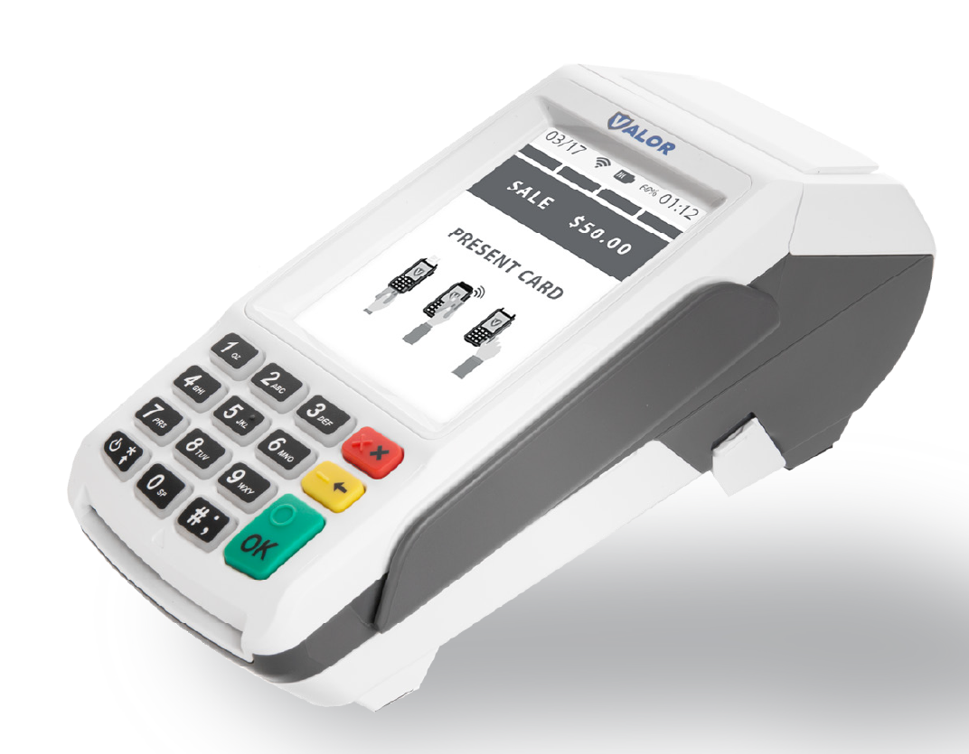
Terminals
Clover
Valor VL100
Countertop POS terminal
Ethernet and Wi-Fi connectivity
Large scale touch screen display
Full transaction information display
Can accept contactless payments
Processes in the cloud through a gateway
Dual Pricing
Surcharge (TSYS)
First Data and TSYS

Slide 40
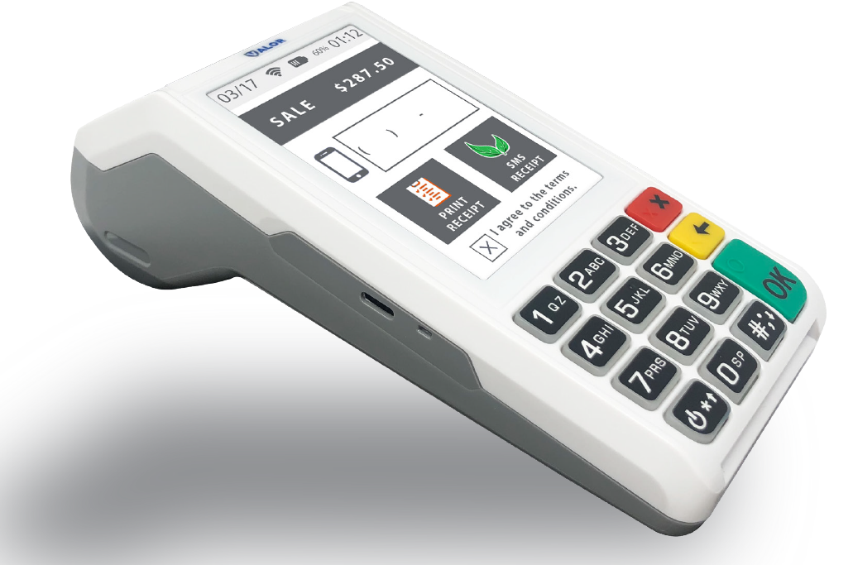
Terminals
Clover
Valor VL110
Handheld POS terminal
Large scale touch screen display
Full transaction information display
Signature capture and pay at the table
Offers paperless signature / Receipt option
Processes in the cloud through a gateway
GPRS / 4G and Wi-Fi Connectivity
Dual Pricing
Surcharge (TSYS)
First Data and TSYS

Slide 41
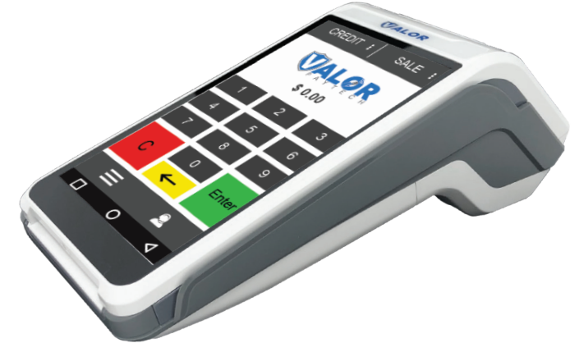
Terminals
Clover
Valor VL500
Handheld POS
Large Scale Touch Screen Display
Full Transaction Information Display
Signature Capture and Pay At The Table
Paperless Signature / Receipt Option
Contactless Payment / Bill Splitting
GPRS / 4G and Wi-Fi Connectivity
Dual Pricing
First Data and TSYS

Slide 42
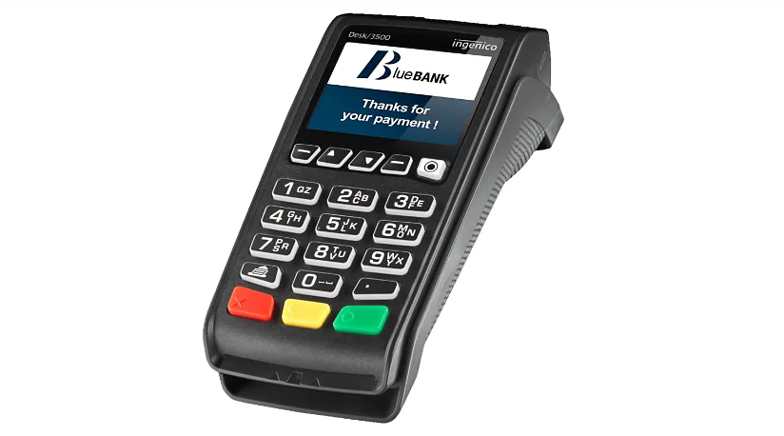
Terminals
Clover
Ingenico Desk 3500
Can be used for retail businesses and restaurants
Accepts swipe, chip, and contactless payments
Offers customers a seamless experience through a conveniently located card-reader zone and faster transaction flows
Surcharge
TSYS

Slide 43
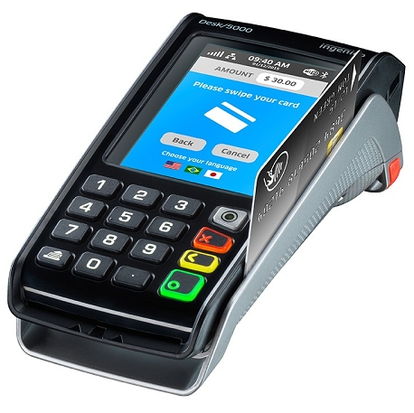
Terminals
Clover
Ingenico Desk 5000
Can be used for retail businesses and restaurants
Accepts swipe, chip, and contactless payments
Large 3.5-inch touch screen
Offers signature capture capabilities for electronic payments and receipt storage
Surcharge
TSYS

Slide 44
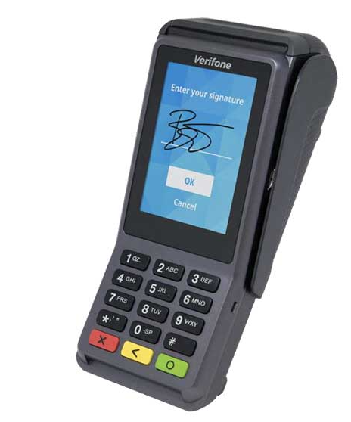
Terminals
Clover
Verifone V200c Plus
Modern, robust design—ideal for countertop use
Accepts swipe, chip, and contactless payments
Packed with more speed and has an interactive user interface
First Data and TSYS

Slide 45
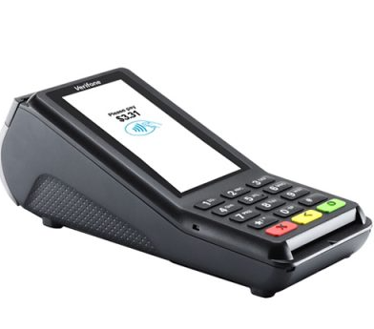
Terminals
Clover
Verifone V400c Plus
Most powerful and advanced countertop device
Accepts swipe, chip, and contactless payments
Has a large color touchscreen that supports signature capture and encourages easy, intuitive customer interaction
Ability to run third-party apps
First Data and TSYS

Slide 46
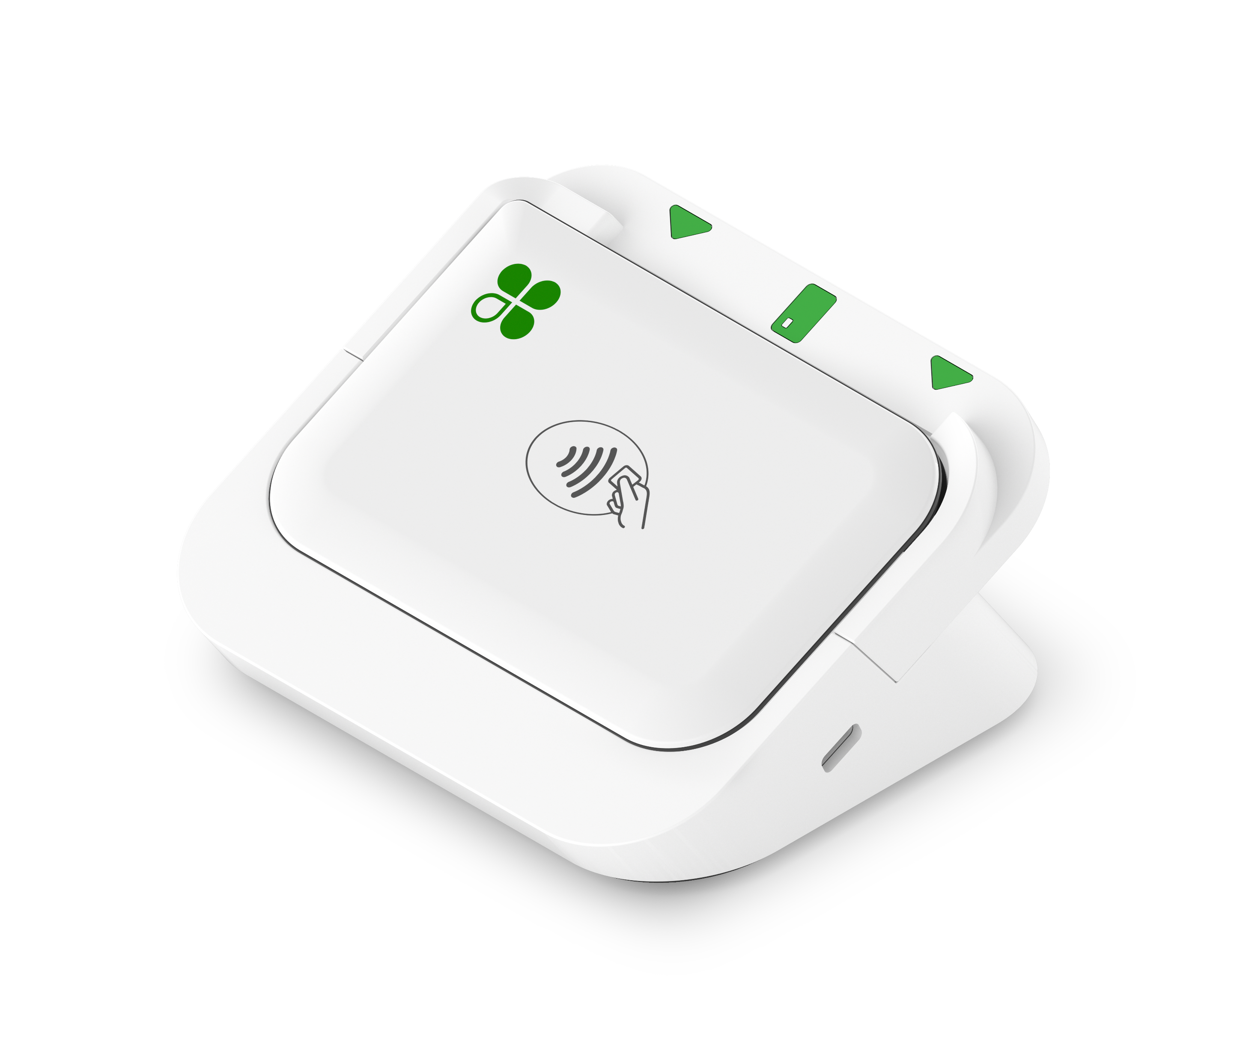
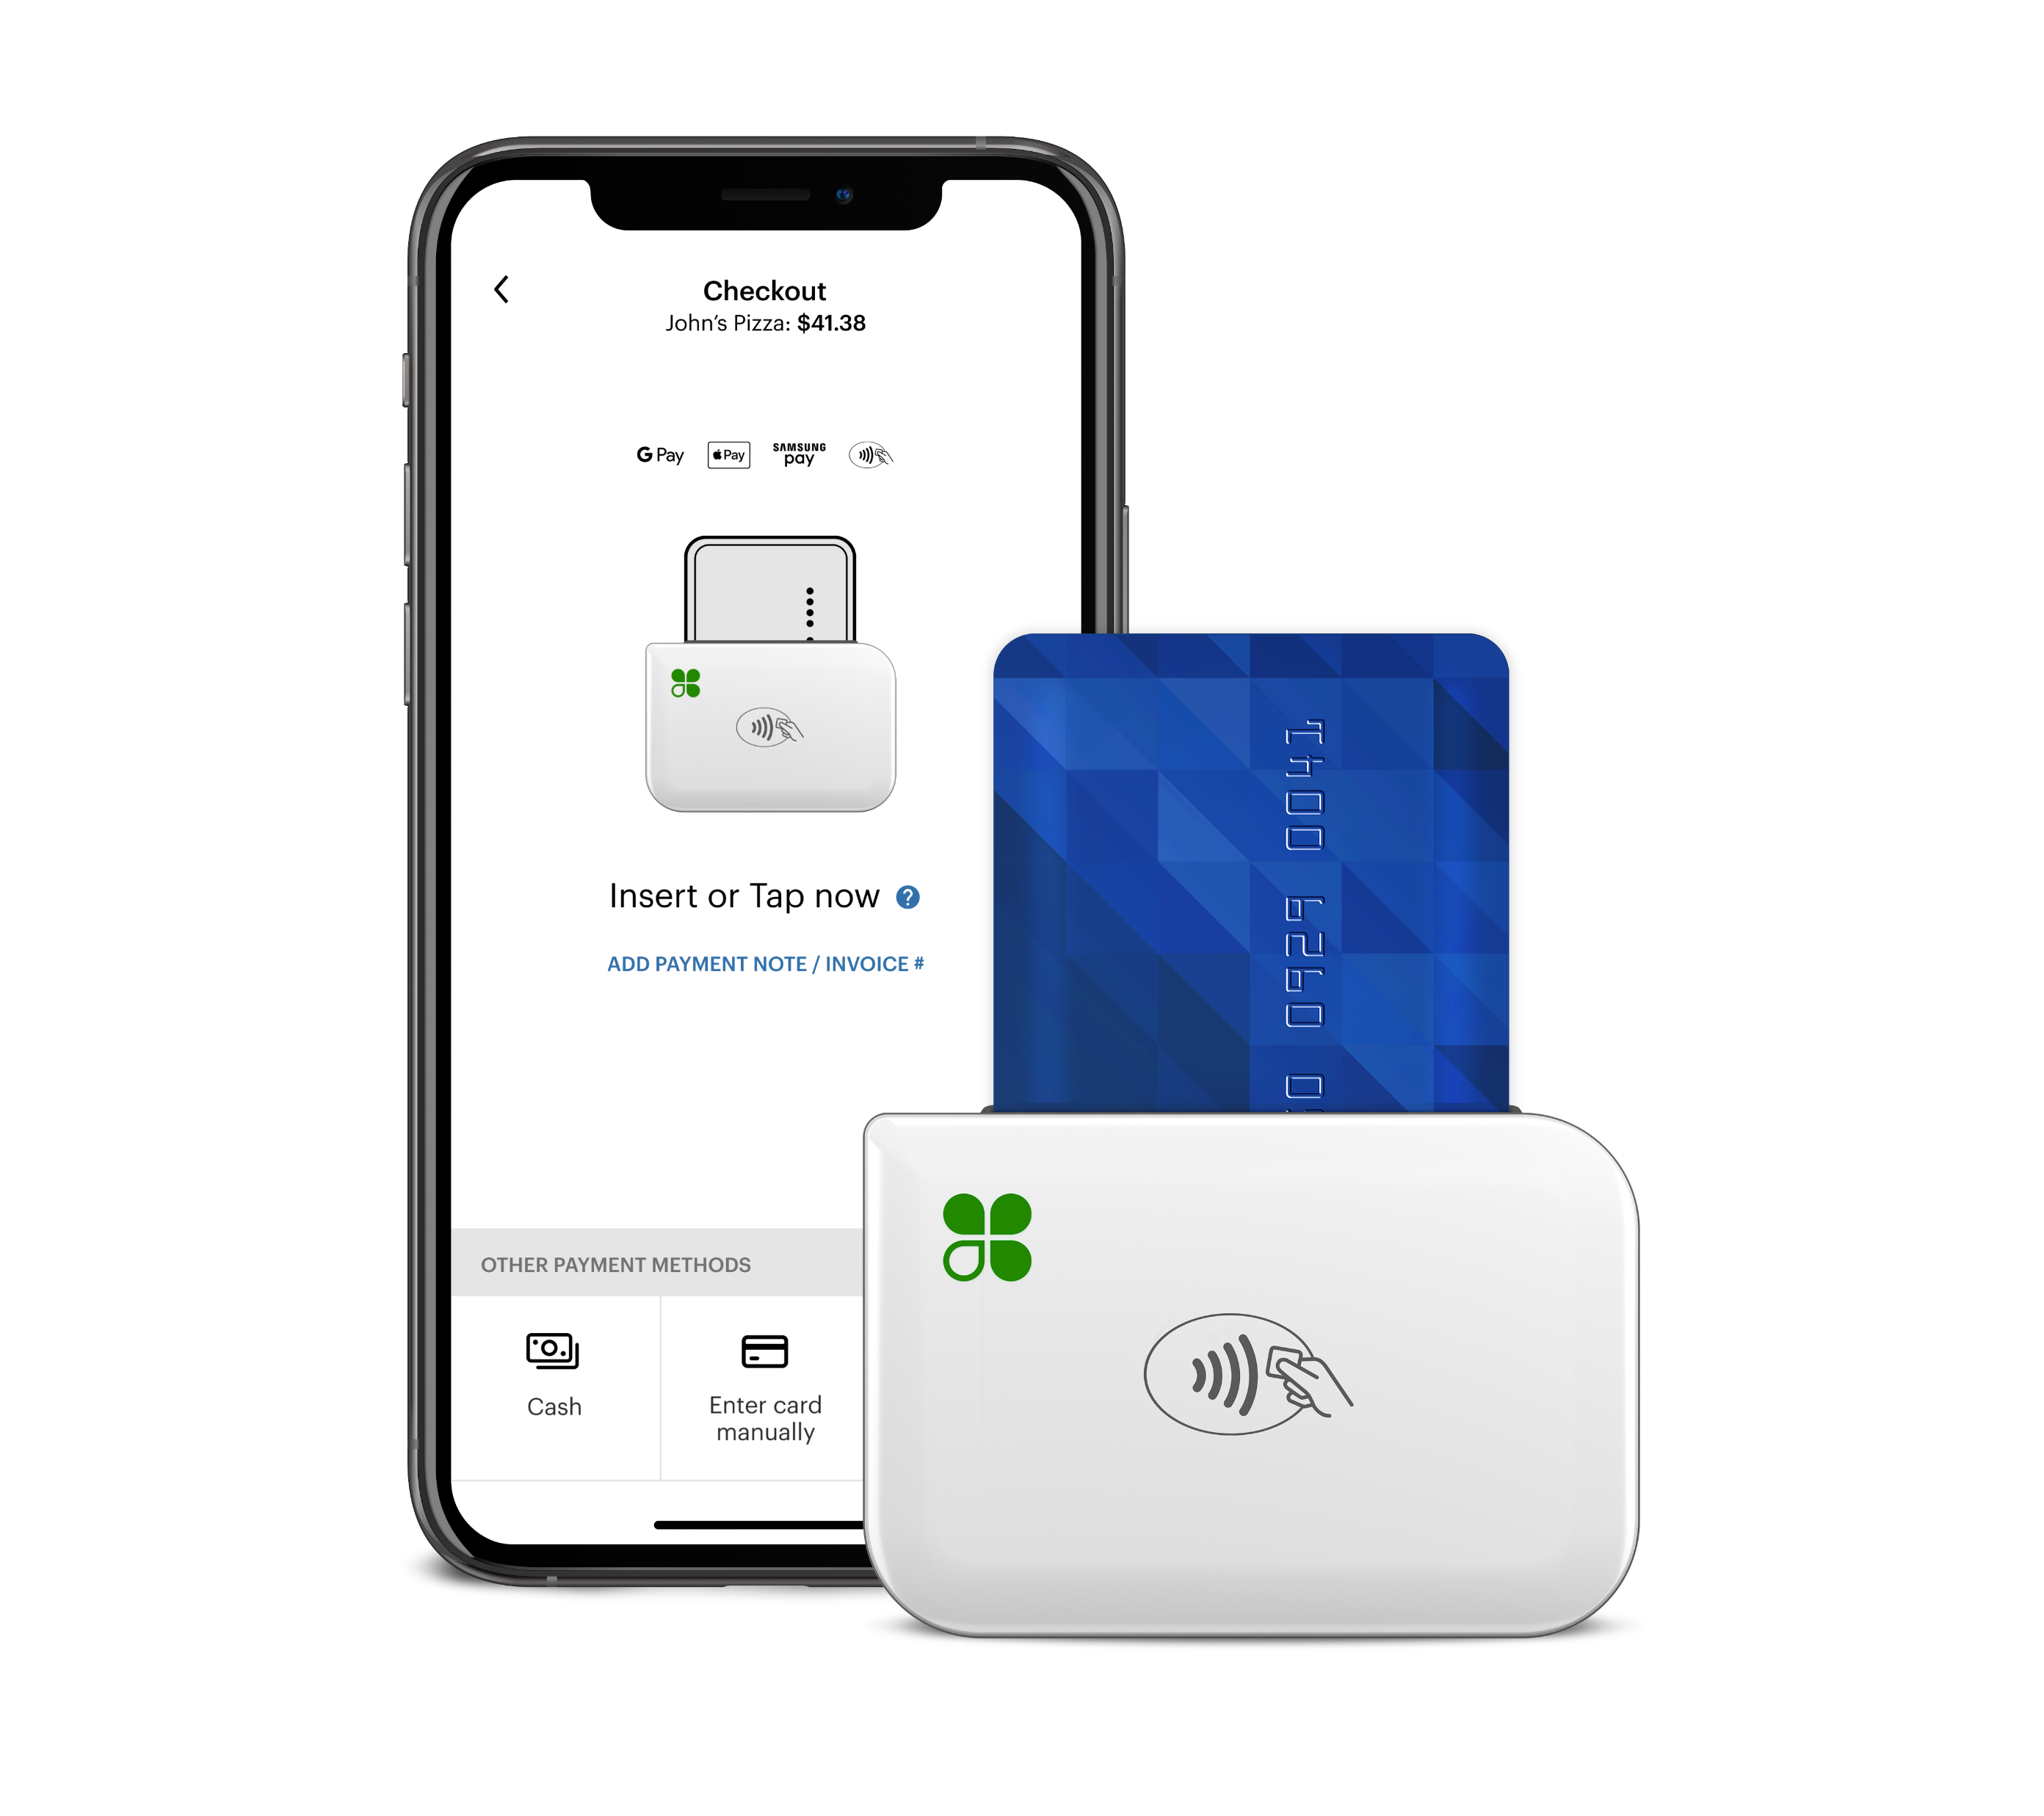
Clover Suite
Clover
Clover Go 3
Payments: Accepts chip, dip, and contactless payments including Tap-to-Pay on iPhone, Apple Pay®, Google Pay® and Samsung Pay®.
Pairs seamlessly with your mobile device or tablet through a Bluetooth® connection
Requires the Clover-Go App, which is easy to download and set up. All you need is a mobile device and the Clover Go mobile credit card reader
First Data

Slide 47
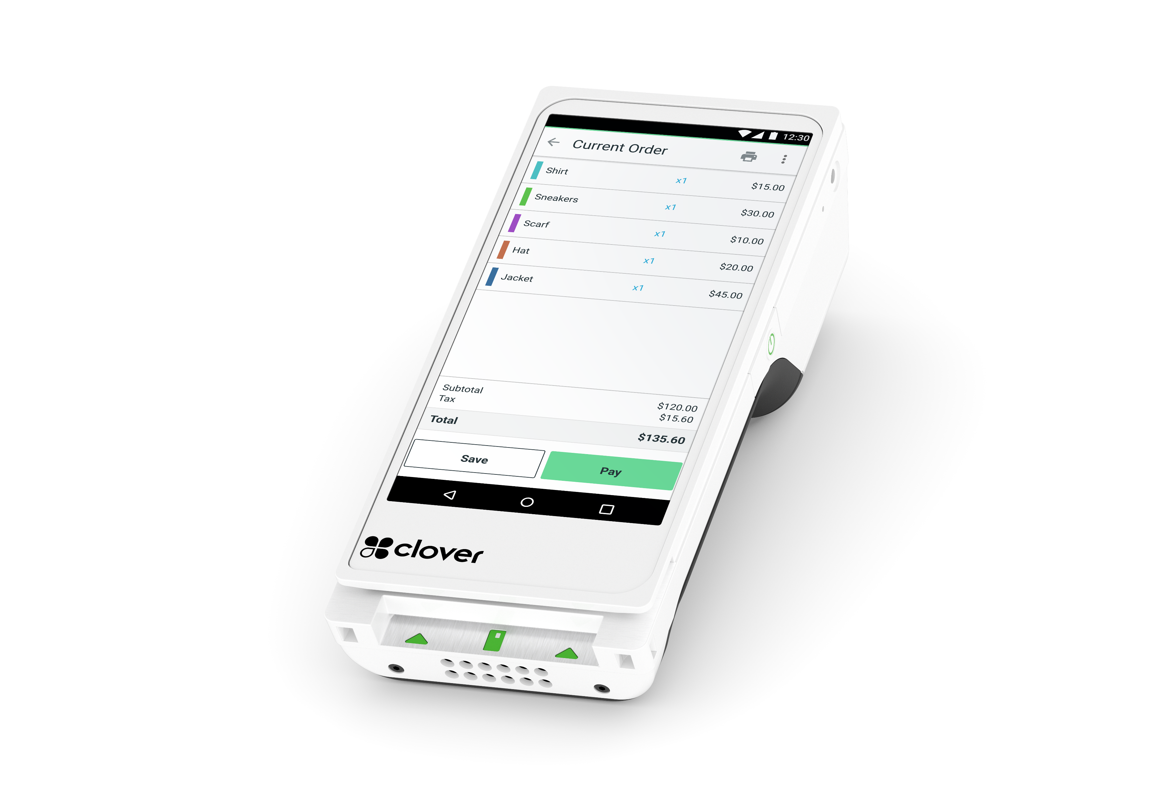
Clover Suite
Clover
Clover Flex (Gen 3)
Accepts chip, swipe, and contactless payments including Apple Pay®, Google Pay® and Samsung Pay®
Accepts payments on the go, tableside, at the counter, and more
Built-in thermal dot printer and can email or text digital receipt
Battery supports up to 8 hours of use
Surcharging
First Data

Slide 48
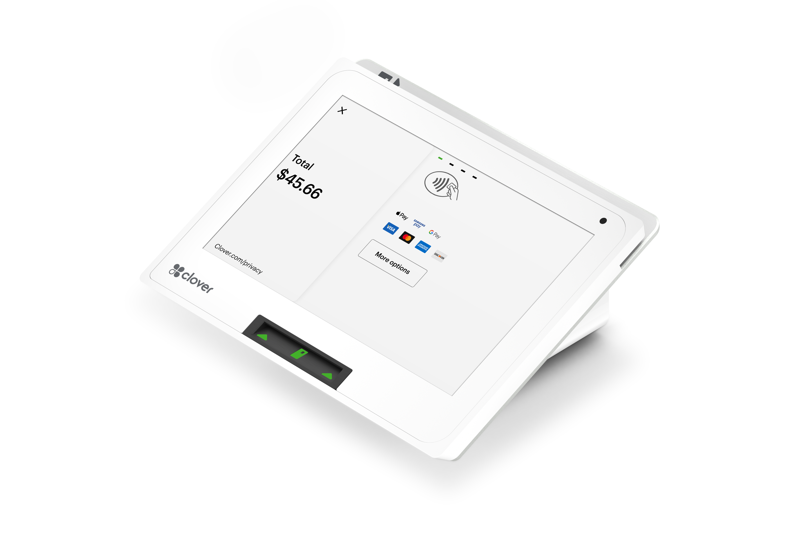
Clover Suite
Clover
Clover Mini 3
Full-featured POS in a compact device
Accepts chip, swipe, and contactless payments including Apple Pay®, Google Pay® and Samsung Pay®
Can be used for full-service and counter-service restaurants
Can be used just for payments or used to run your whole business from inventory to payroll
Surcharging
First Data

Slide 49
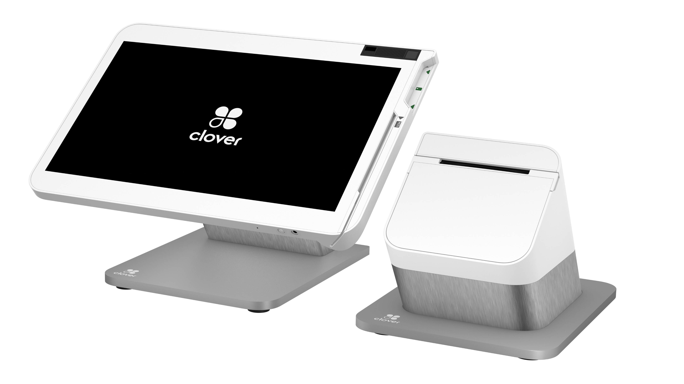
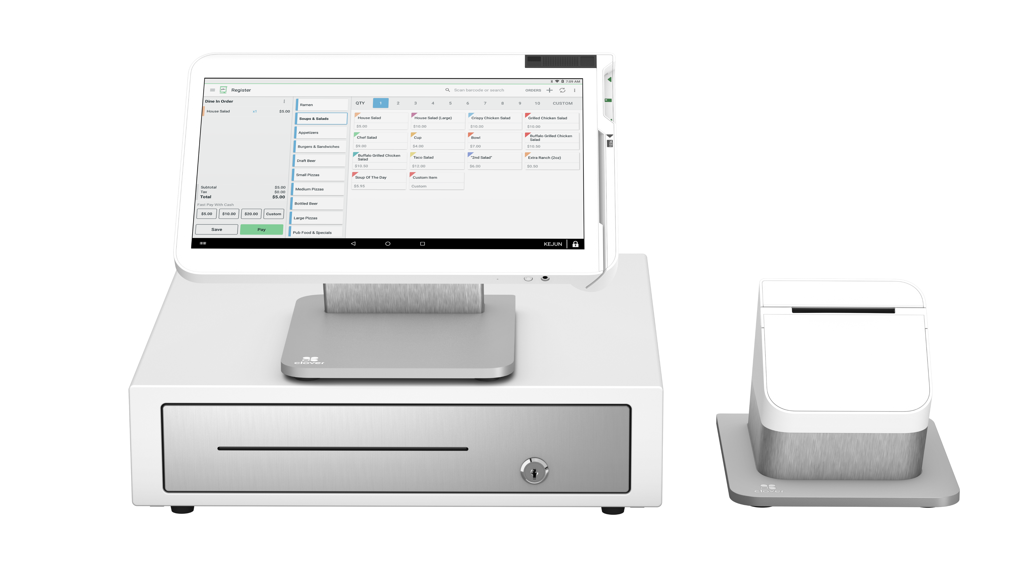
Clover Suite
Clover
Clover Station Solo
Includes a Clover receipt printer (Cash drawer sold separately)
Accepts customer card payments with the card insert and swipe slots integrated into the screen
One 14” merchant-facing display that tilts to accommodate different heights
POS system designed for retail and service businesses, as well as full-service restaurants
Surcharging
First Data

Slide 50
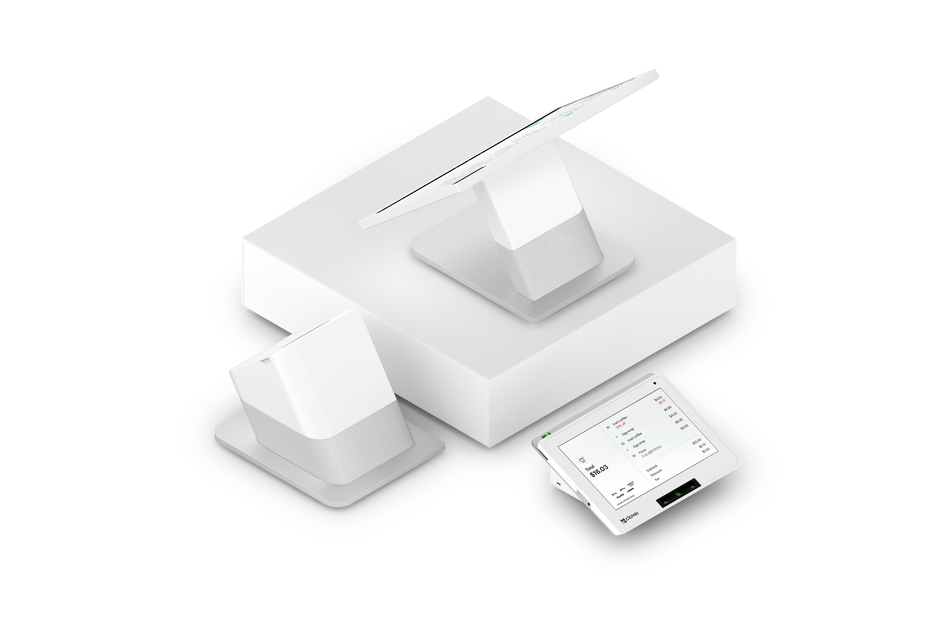
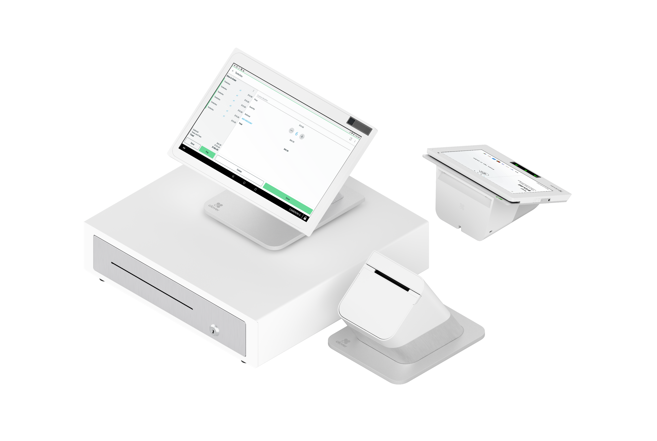
Clover Suite
Clover
Clover Station Duo 2
Includes a Clover receipt printer (Cash drawer sold separately)
Credit or debit. Swipe, dip, or contactless payments like Apple Pay®, Google Pay®
14” HD display for you and an 8” touch screen for your guests to confirm their order, leave a tip, redeem rewards, pay, and request a digital receipt
POS system designed for retail and service businesses, as well as counter-service restaurants
Surcharging
First Data

Slide 51
Software
Gateways

Slide 52

Gateways
Clover
NMI
Accepts all major credit cards
Accept a wide range of devices, third-party integrations, APIs, and SDKs
Enhanced security features (EMV Kernel software)
Recurring billing
Great for E-Commerce platforms
Multiple MID capabilities
First Data and TSYS

Slide 53

Gateways
Clover
Authorize.net
Accepts MasterCard, Visa, Discover, American Express
A diverse collection of shopping carts for E-Commerce; Omnichannel solutions, free tokenization
Secure payment processing platform, supported by Level 1 PCI Compliance
First Data and TSYS

Slide 54

Gateways
Clover
USAePay
Accepts MasterCard, Visa, Discover, American Express
A diverse collection of shopping carts for E-Commerce
Secure payment processing platform, supported by Level 1 PCI Compliance
Omnichannel solutions, free tokenization
First Data and TSYS

Slide 55
Required Documents
Initial application documents
Leased equipment
Purchased equipment
Clover equipment
Merchant Responsibility Disclaimer for Surcharge
Fiserv Surcharge Addendum

Slide 56
Required Documents
Clover
Documents needed for ALL applications:
Merchant Processing Agreement - Initialed, signed, and dated with Certificate of Completion if DocuSign/Adobe Sign is utilized
Photo ID - Cannot be expired or photocopied
Voided Check
    Must have bank name listed
    Must have correct Legal or DBA name listed
    Must have an address
    Must have DDA (Account)/ABA (Routing) encoded at the bottom of the check
    NO started checks
    NO alterations, such as address labels or whiteout
Bank Letter
    Must be on bank letterhead
    Must have reference to the legal/DBA present
    Must have DDA (Account)/ABA (Routing) referenced in the letter
    Must be typed or pre-printed only
    Must have the name of a bank official and contact printed on the letter
High ticket >$999.00 need 3 months’ Bank and Processing Statements

Slide 57
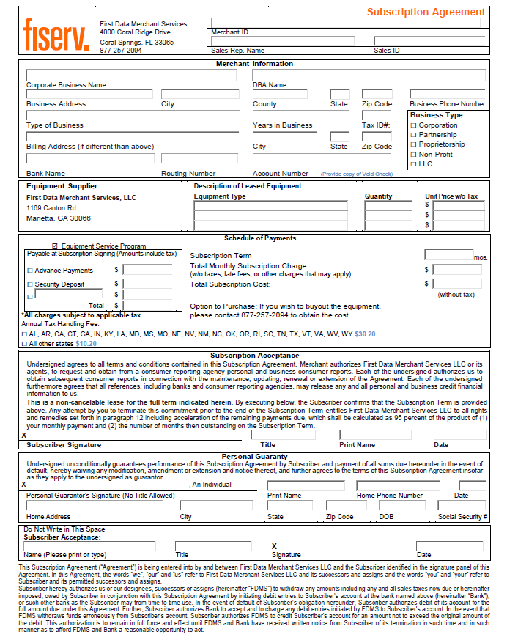
Required Documents
Clover
Leased Equipment
Lease Subscription document is needed prior to Underwriting If equipment is being leased
Lease Subscription Verification calls are needed prior to Underwriting*
You will need to call the merchant to verify the Lease Subscription (561-609-4736)*
We only lease through FDGL now
36- or 48-month lease terms only
Lease Subscription D&A (Delivery & Acknowledgement) Form needs to be signed when the merchant receives equipment.
If DocuSign is utilized, please make sure all Certificates of Completions are uploaded

Slide 58
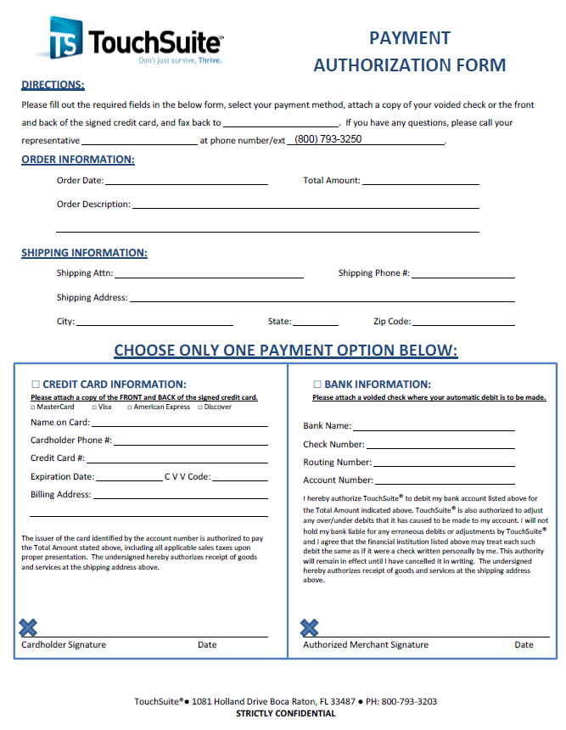
Required Documents
Clover
Purchased Equipment
Payment Authorization Form is needed prior to Underwriting If equipment is being purchased
Payment Authorization is needed for both Merchant and Agent equipment purchases
Shipping costs need to be included in the “Total Amount”
Please make sure the Shipping Address listed on the form is also the same address listed on “Send Equipment to” in IRIS
If DocuSign is utilized, please make sure the Certificate of Completion is uploaded

Slide 59
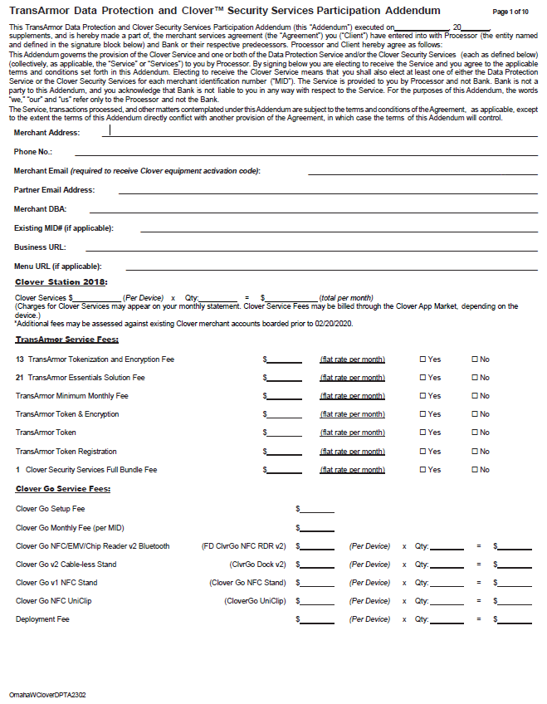
Required Documents
Clover
Clover Addendum
This document is needed prior to Underwriting If the merchant is processing on a Clover device
The Clover Addendum governs the provision of the Clover Service and one or both of the Data Protection Service and/or the Clover Security Services
TransArmor Tokenization and Encryption Fee is needed – This is a fixed monthly $5.00 fee
If DocuSign is utilized, please make sure the Certificate of Completion is uploaded

Slide 60
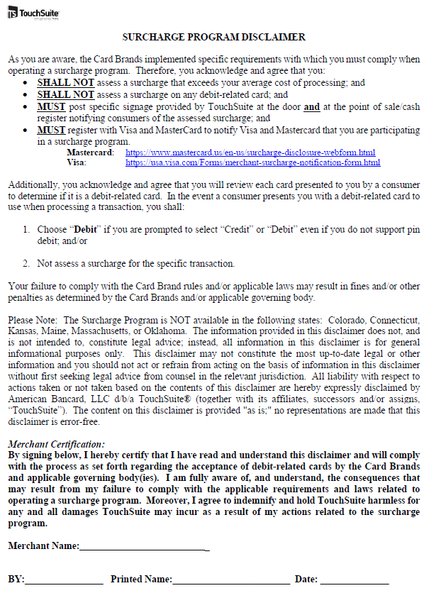
Required Documents
Clover
Merchant Responsibility Disclaimer for Surcharge
This document is needed prior to Underwriting If the merchant will be surcharging on TSYS
The Card Brands have specific rules and requirements for merchants when operating a Surcharge Program – This document is stating that the merchant is acknowledging and agreeing to the rules of the program
If DocuSign is utilized, please make sure the Certificate of Completion is uploaded

Slide 61
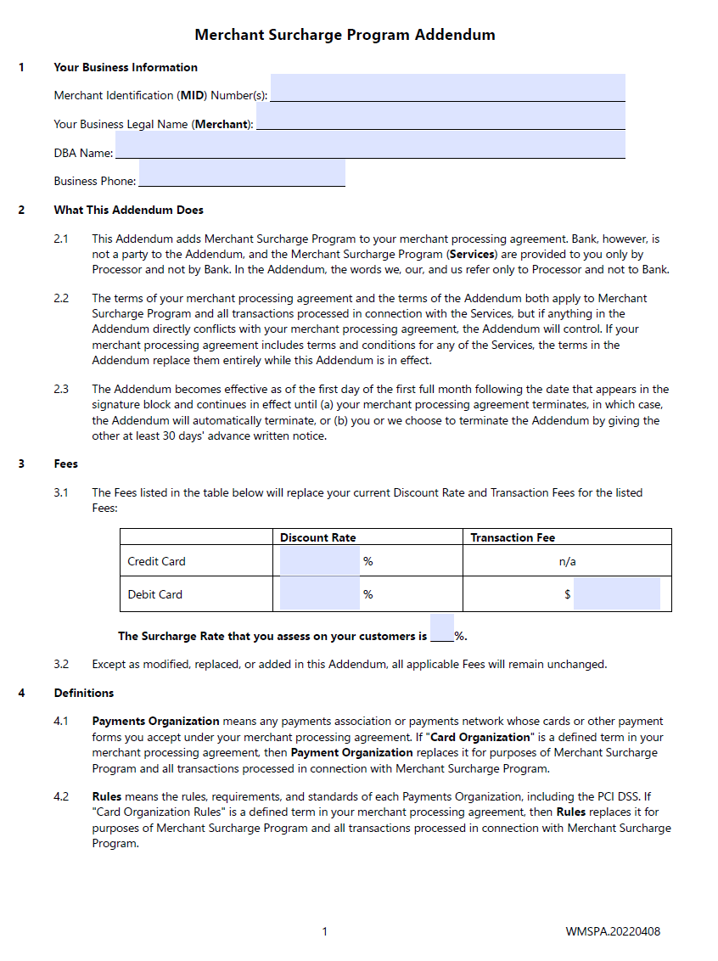
Required Documents
Clover
Fiserv Surcharge Addendum
This document is needed prior to Underwriting If the merchant will be surcharging on Fiserv
The Card Brands have specific rules and requirements for merchants when operating a Surcharge Program – This document is stating that the merchant is acknowledging and agreeing to the rules of the program
If DocuSign is utilized, please make sure the Certificate of Completion is uploaded
The max “Surcharge Rate” is 3.0%
Merchant will need to register with Visa and Mastercard and send our team the Visa Registration Number

Slide 62
Thank you

