Slide 1

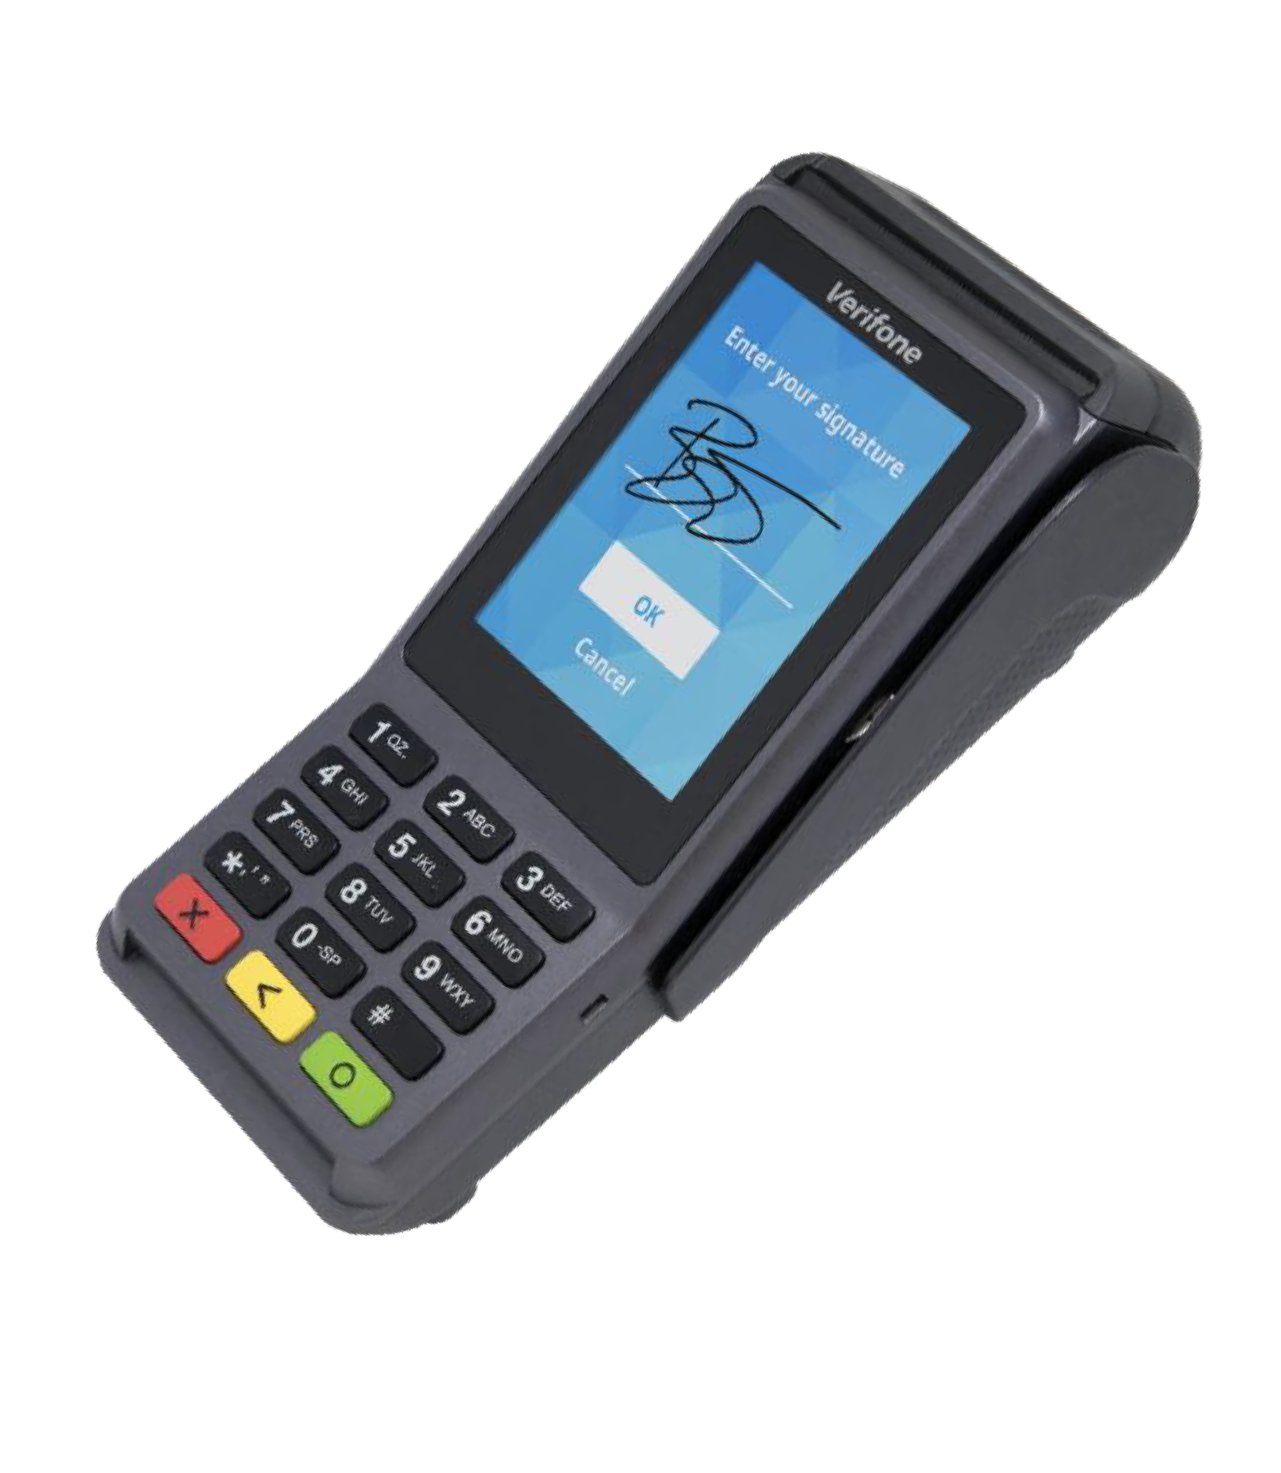
V400c
Countertop Hardware | V400c
The V400c is our most powerful and advanced countertop device.
As part of Verifone’s Engage portfolio, it combines the latest in features, functionality, and performance into an efficient, high-end solution. Whether merchants are looking to accept basic payments or focus on more advanced capabilities, like loyalty, advertising, and other value-added services, the V400c makes it possible.
A large color touchscreen supports signature capture and encourages easy, intuitive customer interaction. Plus, the ability to run third-party apps allows the V400c to be customized to meet a variety of merchant and customer needs. The V400c also joins Verifone’s industry-leading selection of devices that meet PCI 5.X requirements. And with end-to-end encryption and tokenization, merchants can worry about something other than device security.
Supports Verifone’s estate management solution for remote device •
management, value-added services, updates and diagnostics
Supports a variety of third-party apps through Verifone’s Merchant Marketplace
Accepts all payment types: NFC/CTLS, mobile wallets, EMV and •
magstripe
Optional features, such as dual-band WiFi and Bluetooth 4.2 BLE
S p e c i f i c a t i o n s
Processor
600 MHz, Arm Cortex-A9 32-bit RISC
Memory
384 MB (256 MB Flash, 128 MB SDRAM)
Display
3.5" (320 × 480) HVGA capacitive color touchscreen; oleophobic, smudge-resistant coating
Operating System
Linux, with Verifone security enhancements
Connectivity
Dial-up, Ethernet
Printer
30 lps, 40 mm paper roll
Card Readers
Triple track MSR: ISO 7810, 7811, 7813; smart card reader, 2 SAM slots
Contactless
ISO 14443 Types A and B, ISO 18092- capable, MIFARE, supports major NFC/ CTLS schemes
Peripheral Ports
2 USB connectors: 1 host, 1 host/client; 1 powered RS-232
Keypad
10 + 5 buttons, backlit, optional privacy shield
Audio
Multi-tone buzzer
Security
PCI PTS 5.X-approved; capable of supporting AES DUKPT
Power
AC input 100-240 VAC, 50/60 Hz; DC output 11.6 V 1.55 A
Environmental
Operating temperature: 0° to 50° C (32° to 122° F); storage
temperature: -20° to 60° C (-4° to 140° F); relative humidity: 5% to
90%, non-condensing
Physical
190 mm L × 80 mm W × 70 mm H; 381 g
V400c Plus
Memory: 1024 MB (512 MB Flash, 512 MB SDRAM), microSD Connectivity: 5 GHz + 2.4 GHz WiFi, Bluetooth 4.2 BLE Audio: Speaker
Copyright 2020 Verifone, Inc. All rights reserved. Verifone and the Verifone logo are either trademarks or registered trademarks of Verifone in the United States and/or other countries. All other trademarks or brand names are the properties of their respective holders. All features and specifications are subject to change without notice, and do not constitute a warranty of any kind, including, but not limited to, warranties of merchantability or fitness for a particular purpose. Product display image for representation purposes only. Actual product display may vary. Reproduction or posting of this document without prior Verifone approval is prohibited.

