Slide 1
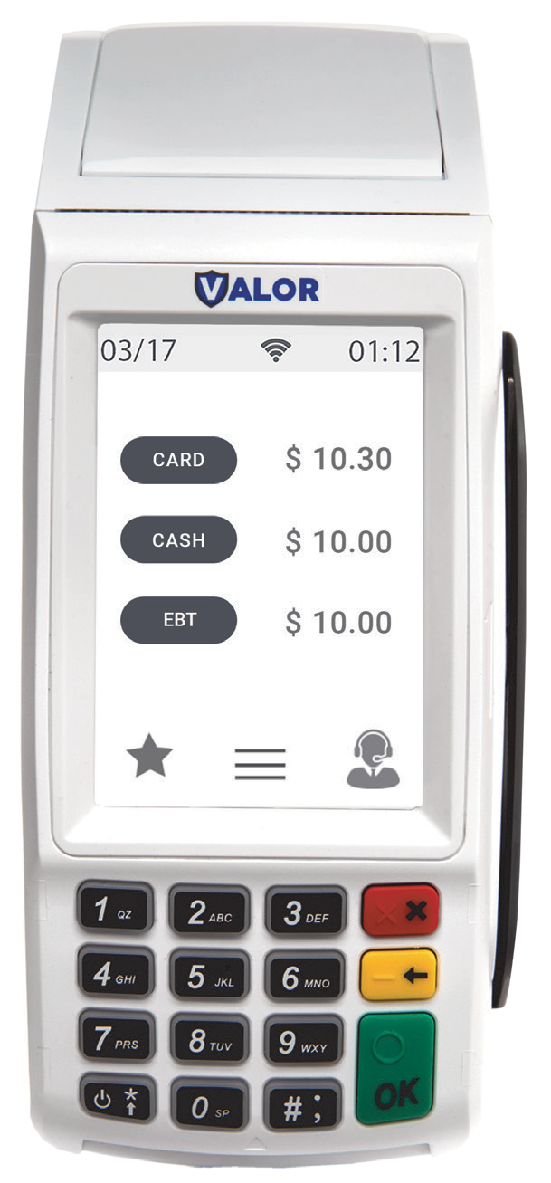









The Ultimate Countertop Solution
Explore the VL100, the ultimate countertop solution, featuring a user-friendly display and advanced technology to improve the customer experience.
User-friendly and Intuitive Experience
Enjoy a user-friendly experience with a spacious touchscreen display on our intuitive interface with digital signature capture feature with print, SMS, or email receipt options. The VL100 oﬀers eﬀortless bill splitting functionality tailored to group payments to enhance convenience.
Secure and Convenient Contactless Payments
Embrace the future of payments through cutting-edge EMV card technology, oﬀering swipe, tap, and dip card payment options along with EBT-enabled devices, catering to a wide range of customers' needs.
Advanced Technological Expertise
Utilize cutting-edge technology for ﬂexible transaction processing with dual merchant IDs (MIDs), uninterrupted service with the auto-connection failback procedure, and enhanced ethernet and Wi-Fi options, ensuring secure and reliable services.
SMS & Email Marketing Opportunities
Increase customer loyalty with our Engage My Customer™ via personalized SMS and email campaigns, enhancing brand awareness. Utilize our integrated feedback rating system for insights to reﬁne services and elevate customer satisfaction.
Large Scale 3.5” Touchscreen Display
Dual MID Supported Technology
Ethernet and Wi-Fi Connectivity
Auto-Connection Failback Procedure
Digital Signature Capture with SMS & Email Receipt options
EBT Enabled
SMS & Email Marketing With Engage My CustomerTM
Full Transaction Information Display
Bill Splitting
Built-in Customer Feedback Rating System

Slide 2
Speciﬁcations
VL100
Countertop Series
Processor |  | 32-bit secure microprocessor running a powerful Linux-based operating system
Memory | Flash/DDRRAM | 128 MB/64 MB (up to 256 MB/128 MB)
 | Micro-SD Socket | Yes
Display |  | 3.5” Color TFT LCD | 320 x 480 Pixels
Touchscreen |  | Yes
Card Reader | Magnetic Stripe | ISO 7810, 7811, 7813 Triple track, bi-directional
 | Contact Card (User Card) | ISO 7816 ID-1 1.8V/3V/5V T=0, T=1
 | Contactless (Optional) | ISO 14443 Type A, B | ISO 18092 NFC Mifare & Sony FeliCa Working Frequency 13.56 MHz
Communications Interface Options | Wireless | Wi-Fi
 | Wired | Ethernet
Indicators | LED - Contactless | No
 | Audio Buzzer | Yes
Keypad | Standard Keys | 15
 | Function Keys | No
Printer |  | 57 mm x 50 mm, 100 mm/sec
Software |  | SDK | KMS | TMS | GDB | CTOS library | ISO 8583 library | Crypto library
Crypto |  | TRNG | DES | T’DES | AES | RSA | MK/SK | DUKPT | T’DES DUKPT
Power Supply | Power Adapter | DC 9V/4A
Dimensions (mm) |  | 190(L) x 78(W) x 78(H)
Weight |  | 350 g
Environment | Operating Temperature | 0°C to 50°C
 | Storage Temperature | -20°C to 70°C
 | Relative Humidity | 5% to 90% non-condensing
Certiﬁcations |  | PCI PTS 4.x | EMV L1/L2 | payWave| PayPass | ExperssPay | D-PAS | Interac Flash | J-Speedy | FeliCa | UnionPay UICS | TQM | PBOC L1/L2

