Slide 1
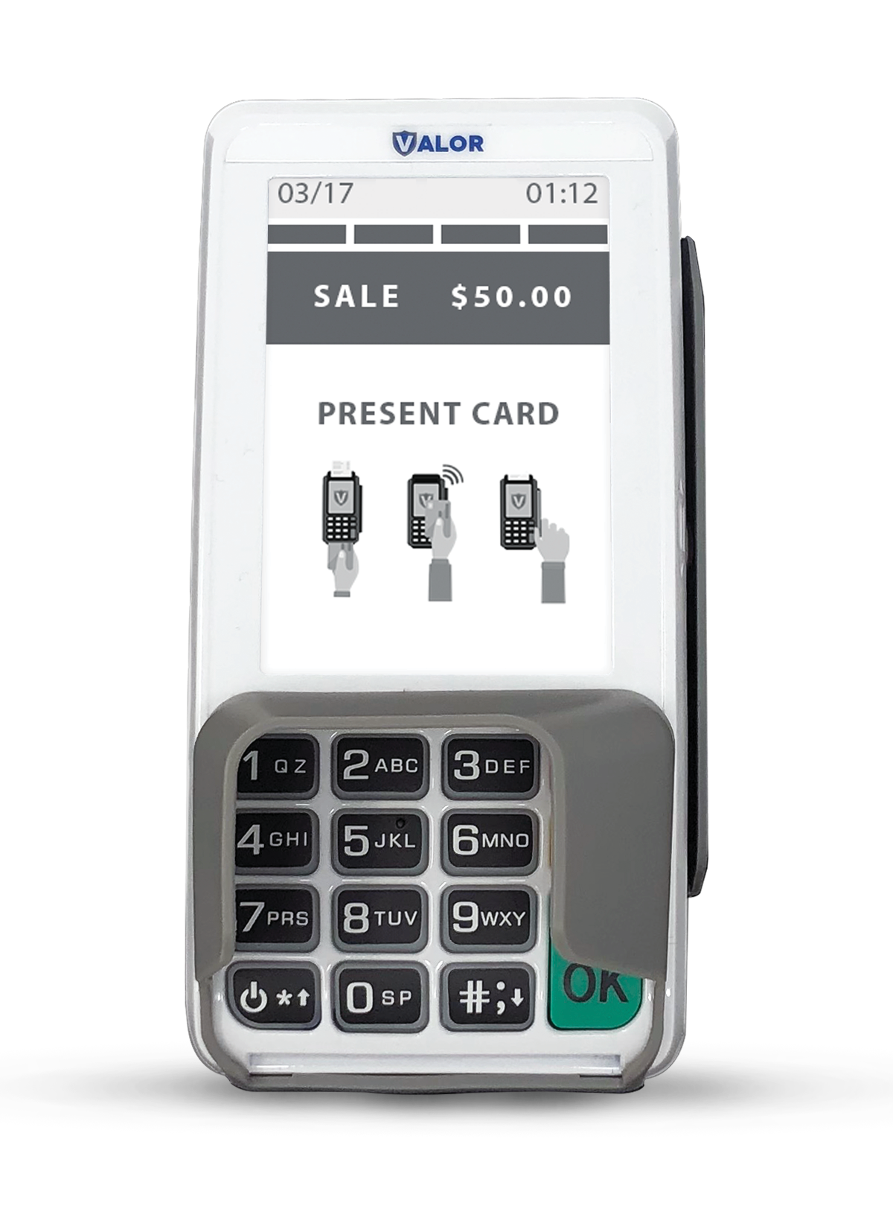






The Trusted Pin Pad
Payment Solution
Eﬀortlessly accept payments with the VL300, a seamless, reliable solution for growing businesses.
User-friendly and Intuitive Experience
Enjoy a user-friendly experience with a spacious touchscreen display on our intuitive interface. The VL300 oﬀers enhanced visibility in dimly lit environments
with backlit keys, providing a user-friendly experience.
Enhanced Payment Security
Provide your customers heightened security features with our enhanced pin pad technology, providing an extra layer of protection during the PIN entry process. The PCI-PTS 5.0 ensures customer security.
Customer Feedback & Satisfaction
Utilize our integrated built-in customer feedback rating system for insights to reﬁne services and increase customer satisfaction. Elevate your service excellence, one feedback survey at a time.
Secure and Convenient Contactless Payments
Embrace the future of payments with advanced EMV technology, ensuring utmost security for transactions. Choose from swipe, tap, and dip card payment options, accompanied by a secure digital signature capture feature, making payments safe and convenient.
Large Scale 3.5”
Touchscreen Display
Backlit Keys
EMV
Digital Signature Capture
PCI-PTS 5.0
Certiﬁed Pin Pad

Slide 2
Speciﬁcations
VL300
PIN Pad
Processor |  | 32-bit secure microprocessor running a powerful Linux-based operating system
Memory | Flash/RAM | 256 MB / 128MB
Display |  | 3.5” Color TFT LCD | 320 x 480 Pixels
Touchscreen |  | Yes
Card Reader | Magnetic Stripe | ISO 7810, 7811, 7813 Triple track, bi-directional
 | Contact Card (User Card) | ISO 7816 ID-1 1.8V/3V/5V T=0, T=1
 | Contactless (Optional) | ISO 14443 Type A, B | ISO 18092 NFC Mifare & Sony FeliCa Working Frequency 13.56 MHz
Communications Interface Options | Wired | Ethernet
Audio |  | Speaker
Keypad | Standard Keys | 15
Software |  | SDK | KMS | TMS | GDB | CTOS library | ISO 8583 library | Crypto library
Dimensions (mm) |  | 150(L) x 78.5(W) x 39(H)
Weight |  | 225g
Environment | Operating Temperature | 0°C to 50°C
 | Storage Temperature | -20°C to 70°C
 | Relative Humidity | 5% to 90% non-condensing
Certiﬁcations |  | PCI PTS 4.x | EMV L1/L2 | payWave | PayPass | ExperssPay | D-PAS | Interac Flash | J-Speedy | FeliCa | UnionPay UICS | TQM

