Slide 1
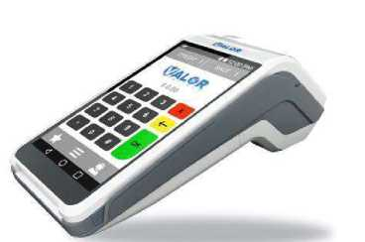
CREDIT SALE
VALOR VL500 RETAIL/RESTAURANT
MANUAL BATCH
On Idle Screen Verify SALE is selected Enter Transaction Amount and press OK Confirm Amount and Press OK Insert, Swipe, Tap or Manually enter Card Number
If Prompted Enter TIP and Press OK
Merchant Copy Will Print
Press Yes if you want Customer Copy
From the Main Idle Screen Press H ICON Press SETTLEMENT Enter Password Batch Will Print
REPRINT RECEIPTS
From Main Idle Screen press EH ICON Press on REPRINT
Enter Transaction Number from Original Receipt and press GREEN BUTTON MERCHANT COPY Prints by Default Press YES when prompted to print CUSTOMER COPY
CREDIT VOID (ONLY IF BATCH OPEN
On Idle Screen Press Sale to Cycle until it Shows VOID
Enter Trans Number and press GREEN BUTTON
Enter Password and Press OK
Verify Transaction Details and Press OK
Merchant Copy Will Print
Press Yes if you want Customer Copy
OPERATOR PASSWORD
Last 4 Of EPI (SHOWS UP ON SCREEN)
lADJUSTING TIPS
From the Main Idle Screen Press H ICON Press on TIP ADJUST Enter Transaction Number & Press OK Confirm & Press OK Enter Tip & Press OK
Repeat until all Transactions are Adjusted
CREDIT REFUND (IF BATCH CLOSED'
On Idle Screen Press Sale to Cycle until it Shows REFUND
Enter Transaction Amount and press OK Confirm Amount and Press OK Insert, Swipe, Tap or Manually enter Card Number
Merchant Copy Will Print
Press Yes if you want Customer Copy
PRINT TIP REPORT
From Main Idle Screen press B ICON
Press on REPORT
Enter Password
Press on TIP REPORT
Press on PRINT REPORT
Matthew Burm - November 16, 2023

