Slide 1
Clover Overview
February 2024

Slide 2

Agenda
Overview & Benefits
Clover Hardware
Clover Care
Clover Security
Clover SaaS (Software as a Service)
Clover Value Add
Clover App Market
Clover Placement
Resources
Demo Device Program
Accessories
Enter Name
Phone
Email
Company Name
Your Logo
Goes Here

Slide 3

Businesses Run Better With Clover
Benefits
Run Your Business
Timesheets, payroll, marketing, accounting – Clover handles all the tasks that merchants don’t have time for
Sell More
Clover gives merchants the tools to increase sales with both their new and existing customers
Get Paid
Clover makes doing business easier by providing merchants with the right mix of POS hardware and software to accept credit card, EMV chip and contactless payments from customers, safely and securely
Hardware cannot be re-provisioned outside your book of business
SaaS flexibility
Dedicated Clover Marketplace with 500+ apps
Cloud-based platform
Remote access and management
Clover Support 24x7/365
Clover Care
Clover Security (encryption and tokenization)
EMV chip, MSR, NFC and other payment acceptance methods (checks, GC, etc.)
Offline processing capability

Slide 4
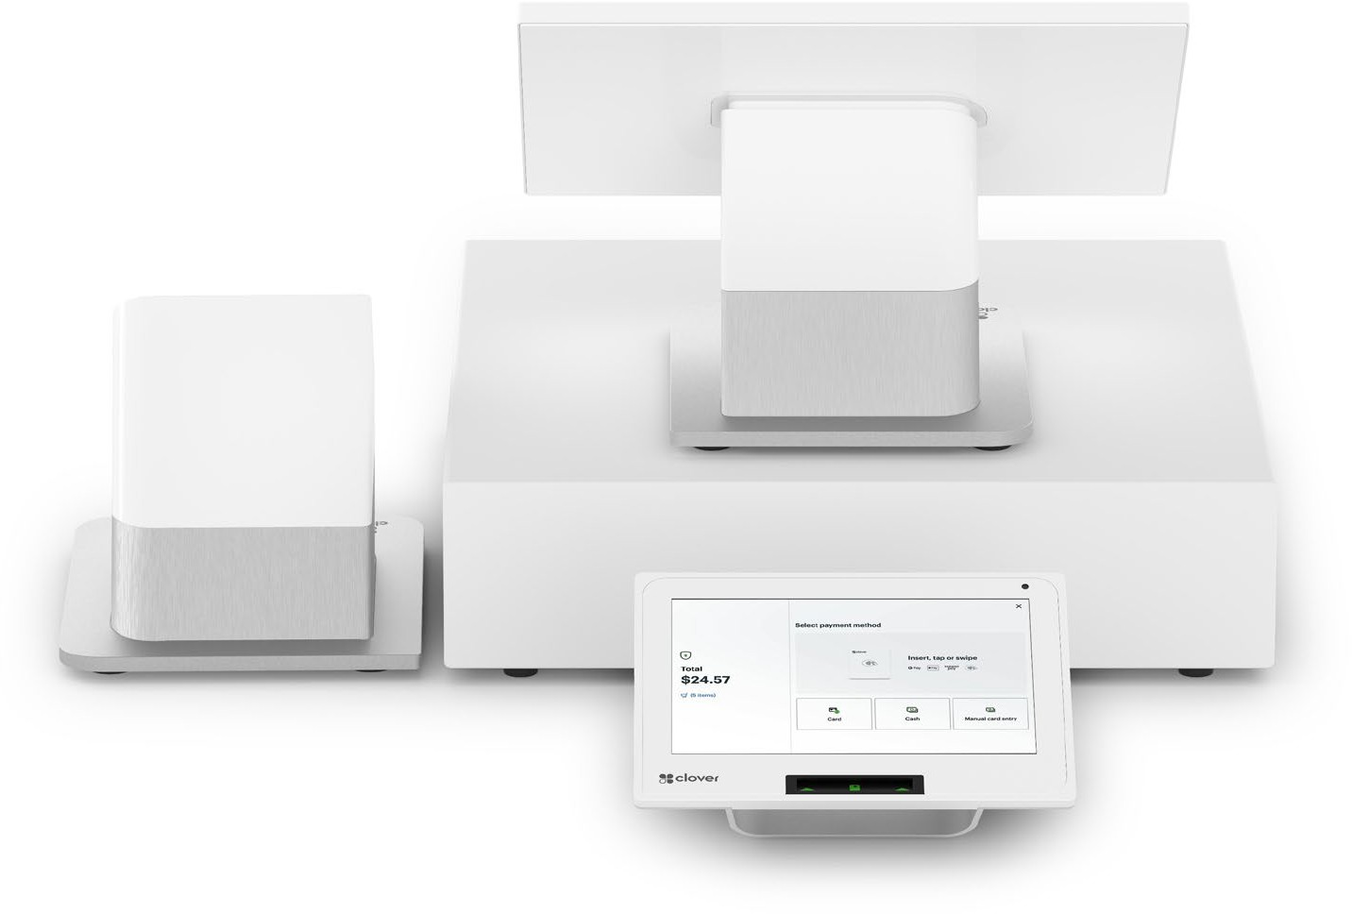
Clover Station Duo 2
Station Duo is a bundle that consists of the following components geared towards Retail, QSR and service-related merchants:
  14” non-swivel, tiltable, non-payment accepting tablet
  Station Duo payments terminal (customer facing display)
  Receipt printer
  Cash drawer (optional)
Dedicated customer-facing display for order accuracy, customer engagement, and loyalty program facilitation
Supports pre-authorized bar tab functionality
Customer display is durable and thoughtful, built with strengthened glass which includes anti-fingerprint coating
Fully integrated with EMV chip, NFC, MSR, PIN debit, and EBT capability
Connectivity options include Ethernet, WiFi, LTE, or mobile hotspot
14” high resolution merchant-facing screen that tilts to accommodate viewing from a range of heights, like Station Solo
Compatibility with same peripherals as previous Station to reduce additional costs (for existing Station merchants)

Slide 5
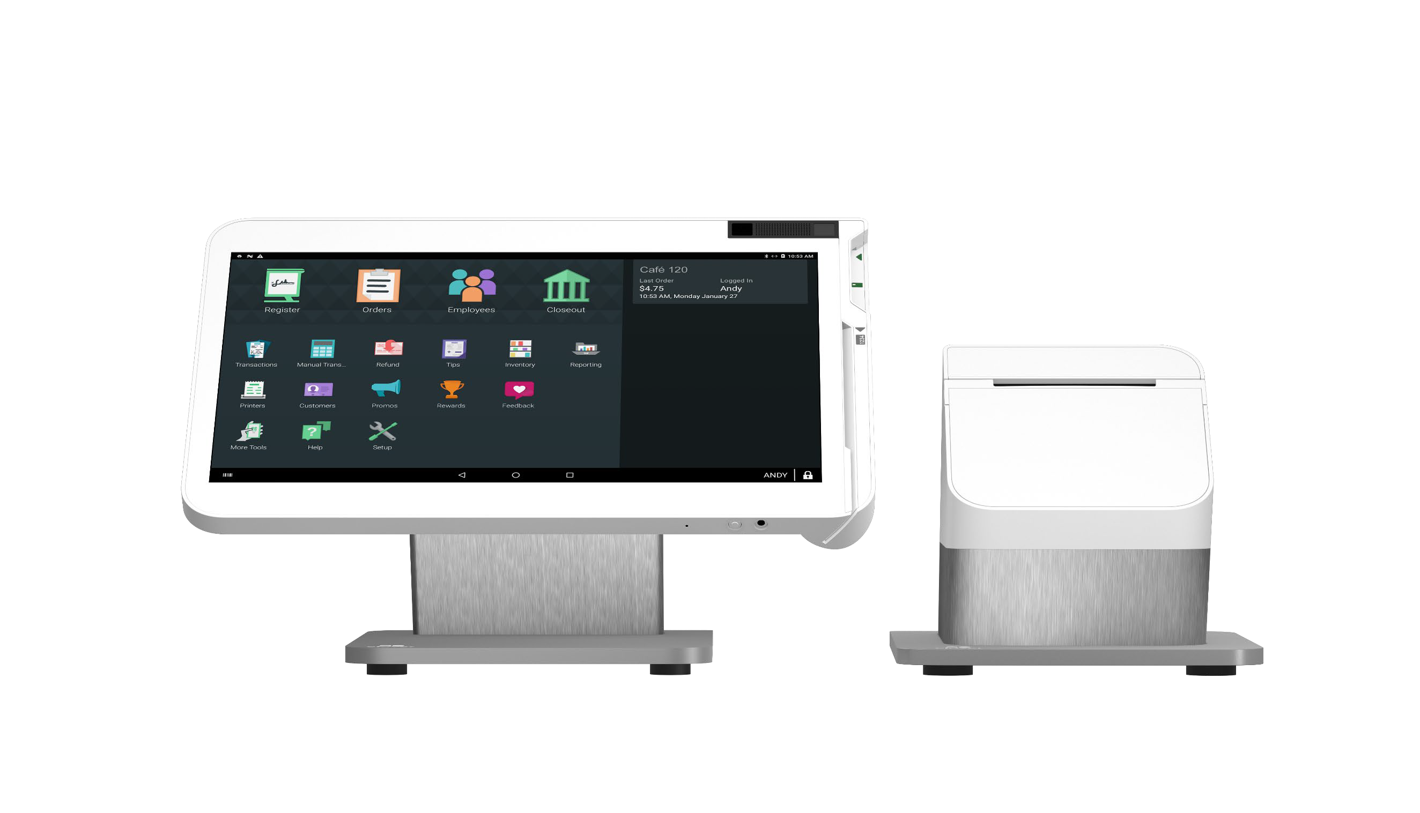
Clover Station Solo
Clover Station Solo is a powerful, all-in-one Clover Station device that has one-merchant facing screen
Clover Station Solo is best-suited for full-service restaurants and other types of merchants who don’t need a customer-facing screen to process payments
Clover Station Solo is a one-screen alternative to the two- screen Station Duo
Features Include:
  Connection methods include WiFi, Ethernet, LTE, and mobile hotspot
  EMV and MSR only – No NFC, PIN debit, or EBT
  Integrated battery backup up to 1 hour
  Includes receipt printer
Clover Station Solo does NOT support tethering of a Mini, Flex, or NFC printer
  Optional proprietary charging cable for a Flex

Slide 6
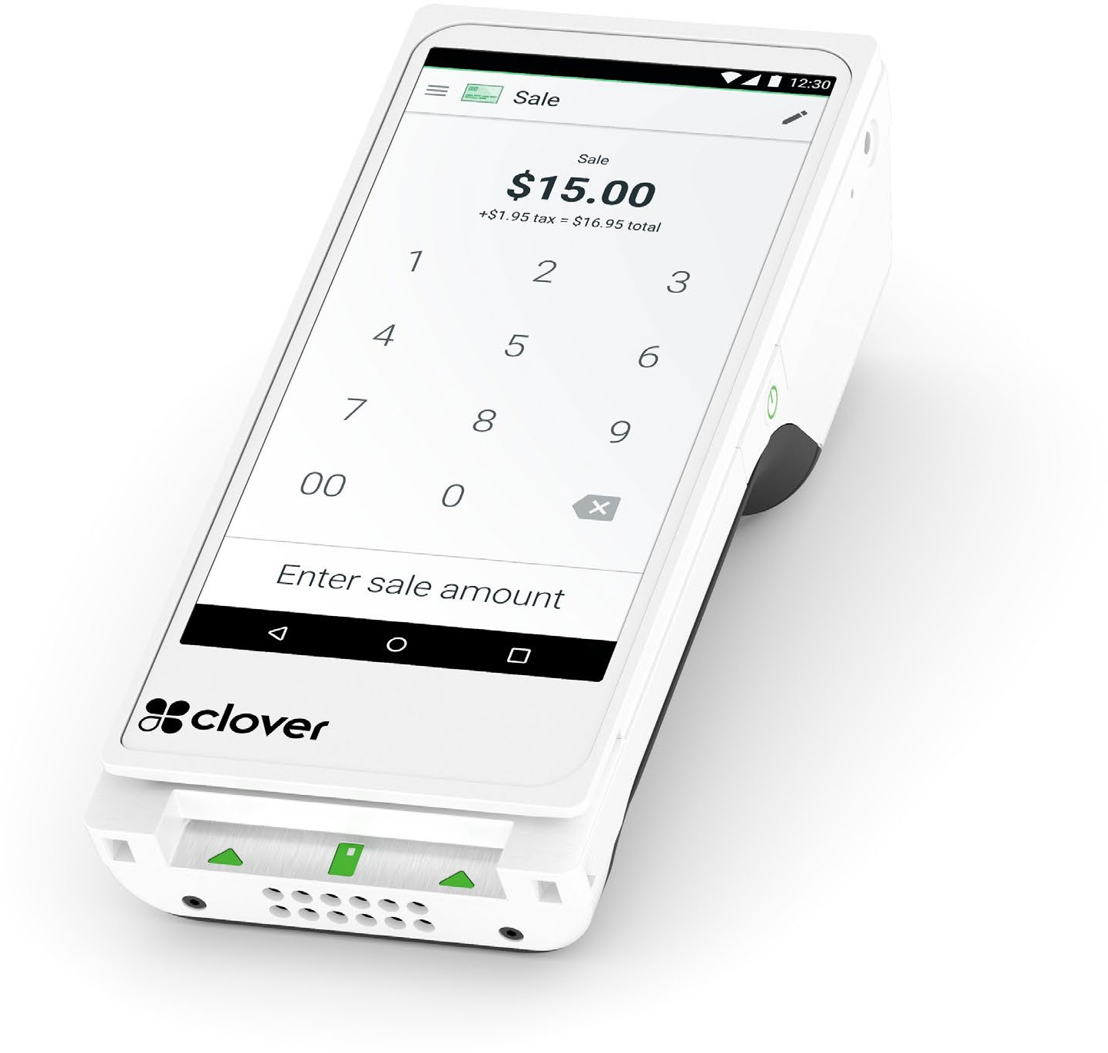
Clover Flex 3rd Gen
6” screen vs 5” via Flex Gen 2
Android 10.X operating system
Supports LTE (4G), WiFi, and mobile hotspot
Extended battery life and improved & redesigned charging dock
  Static charging
  USB-C charging
  Supports at least 8 hours of use for typical SMB
1D/2D barcode scanning with dedicated external button for barcode
fully integrated with Clover devices but cannot be tethered to any device over a wire
Available optional accessories include Flex Travel Kit and ADA Compliant PIN Entry Aid

Slide 7
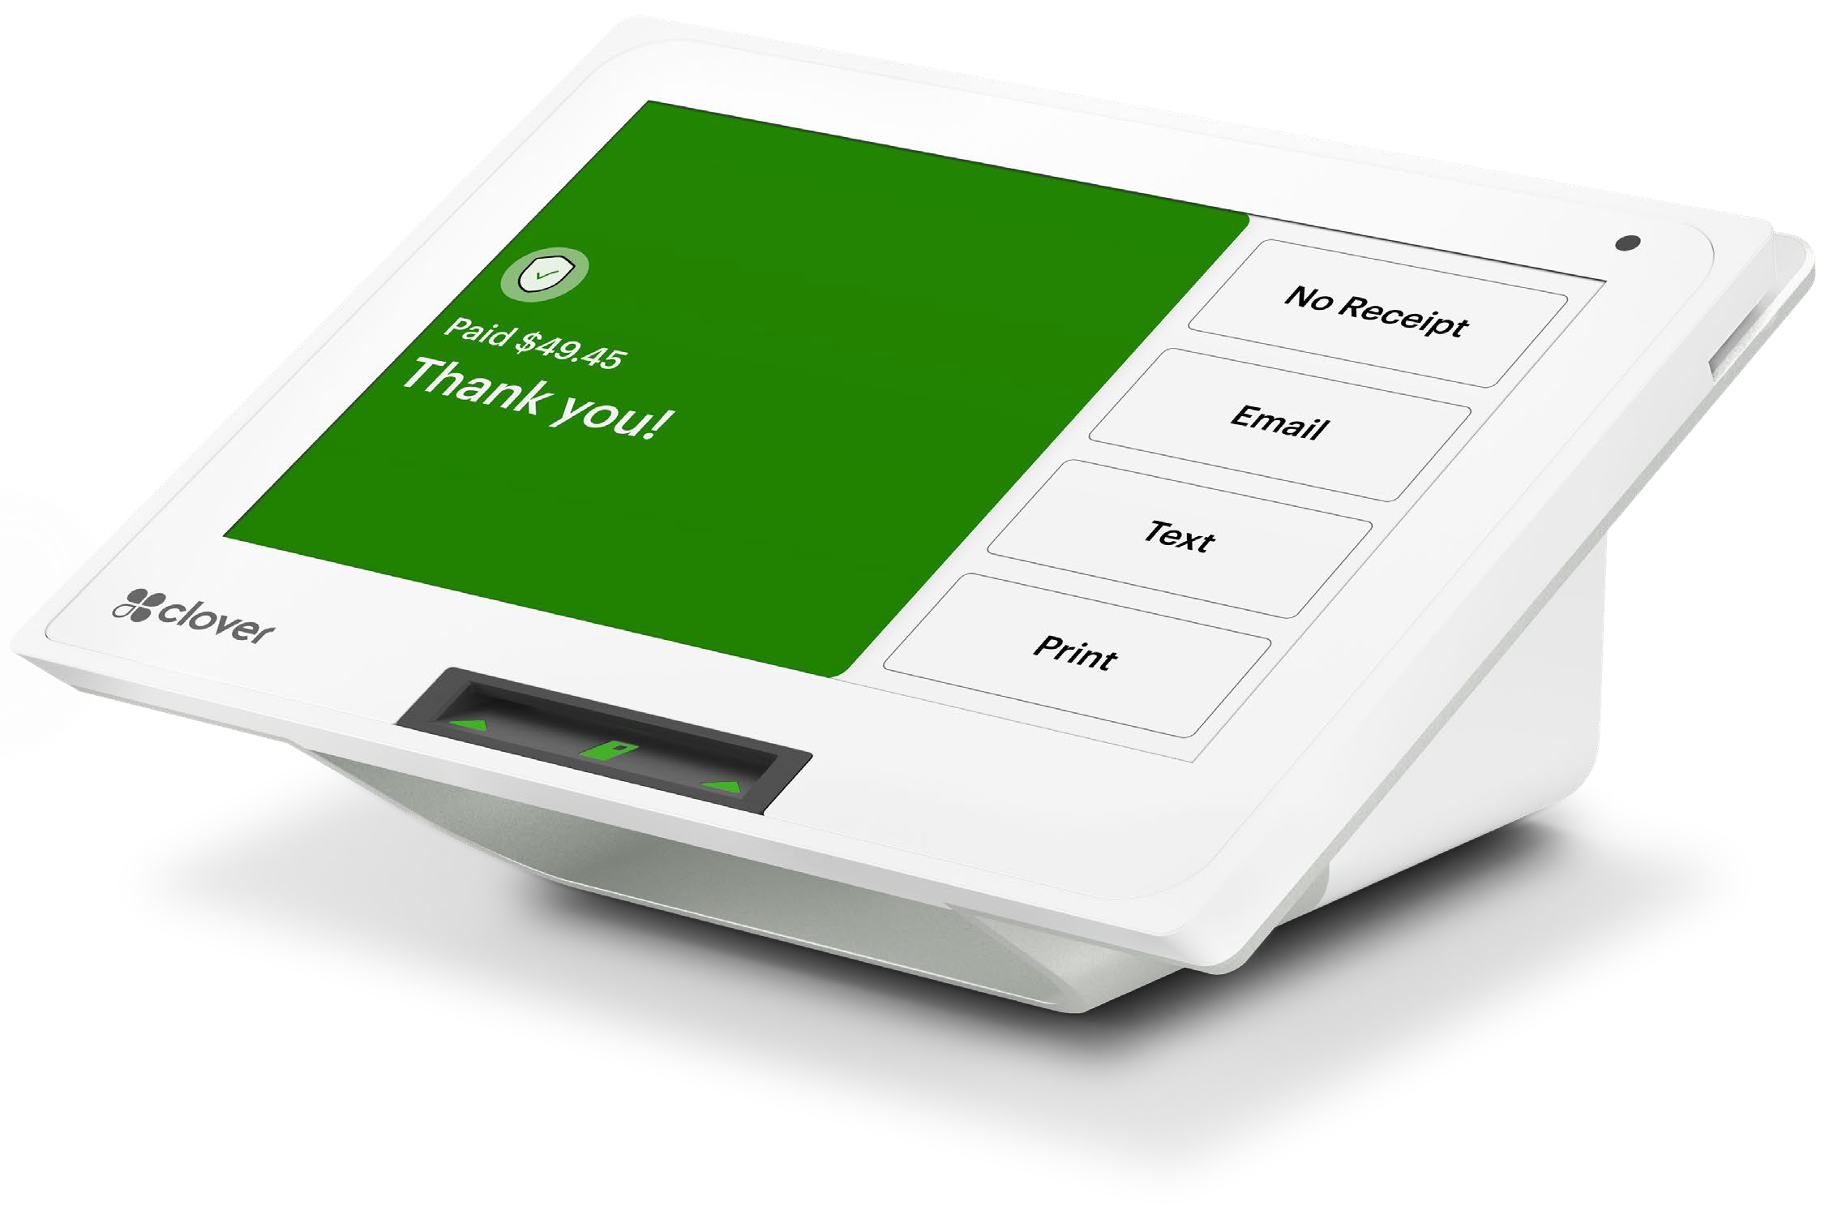
Clover Mini 3rd Gen
Powerful and sleek. Clover Mini takes swipe, chip, and contactless payments right out of the box
Fixed and portable countertop use case
8” capacitive multitouch touch screen
Fully integrated with EMV chip, NFC, MSR, PIN debit, and EBT capability
  PIN bypass available
Front facing camera
  Barcode scanner
  Telecheck reader
Connects via LTE, Ethernet, WiFi, or mobile hotspot
Embedded thermal receipt printer
  Supports digital receipts and signatures
2 USB power hub
  Supported peripherals
  Can be tethered to another Mini 3rd Gen
Clover Mini 3 swivel available

Slide 8
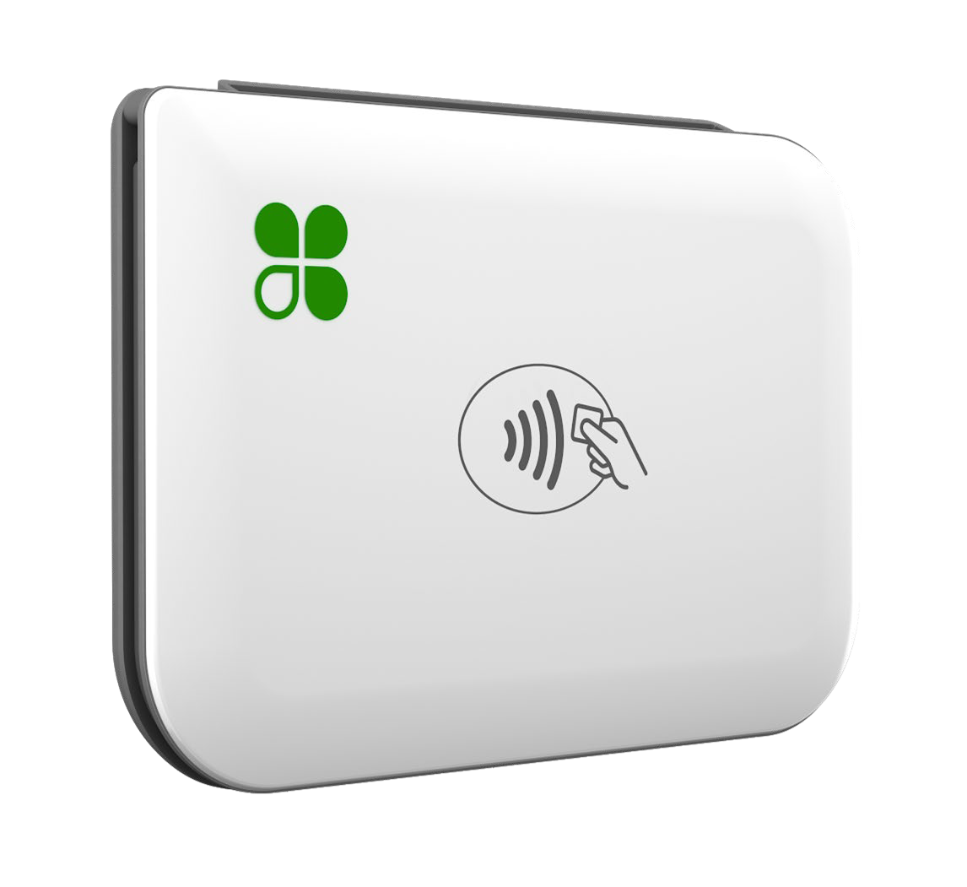
Clover Go 3rd Gen
The newest Clover Go peripheral can be used to take card- present transactions from anywhere
Compared to the original Clover Go, the new Clover Go is sleeker, processes payments faster, and has a longer battery life
Custom built by Clover to provide the latest chip and contactless payment acceptance technology, Clover Go (3rd Gen) includes features that address the constantly evolving payment and business management needs:
  Accept the latest in EMV chip card and NFC contactless payments, so your customers can pay the way they want
  Built-in Clover security to help protect both customers and merchants from fraud - secure processor ensures cardholder data is encrypted
  Ability to email receipts directly from your tablet or phone
Credit and Signature Debit Card - Chip and contactless payment acceptance wherever you do business, in the shop, in the field, or on the road
Multi MID / multiuser capability
Clover Go dock available
Record cash and check transactions via Clover Go applications

Slide 9
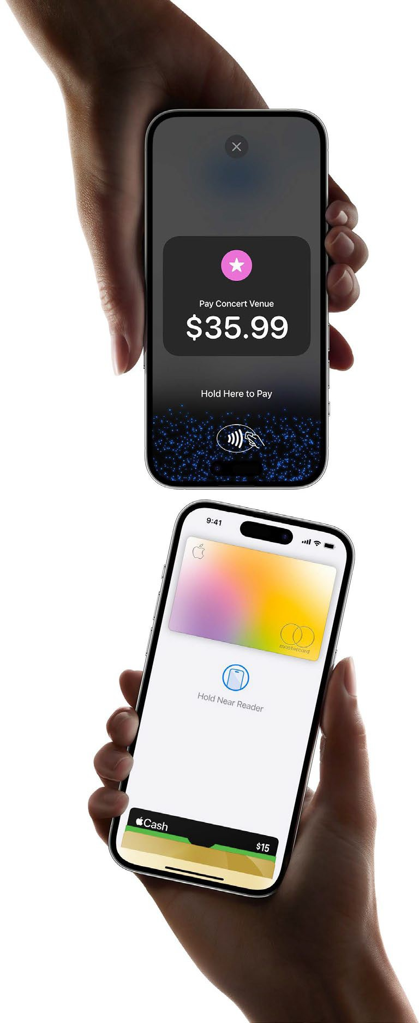
Apple Tap to Pay
The newest way for merchants to accept contactless payments
No extra hardware needed – just an iPhone and the Clover Go app
  Requires iPhone Xs or higher, iOS 16 or higher
Accept contactless payments from debit and credit cards, ApplePay, and other digital wallets (Samsung Pay and Google Pay)
Easy set up process
  Existing (Clover Go) merchants simply enable Tap to Pay on their iPhone, accept Apple terms and conditions, and link their iCloud account to their Clover MID
  New Merchants sign up for a Clover Go account, download the app, accept Apple terms and conditions, and link their iCloud account to their Clover MID

Slide 10
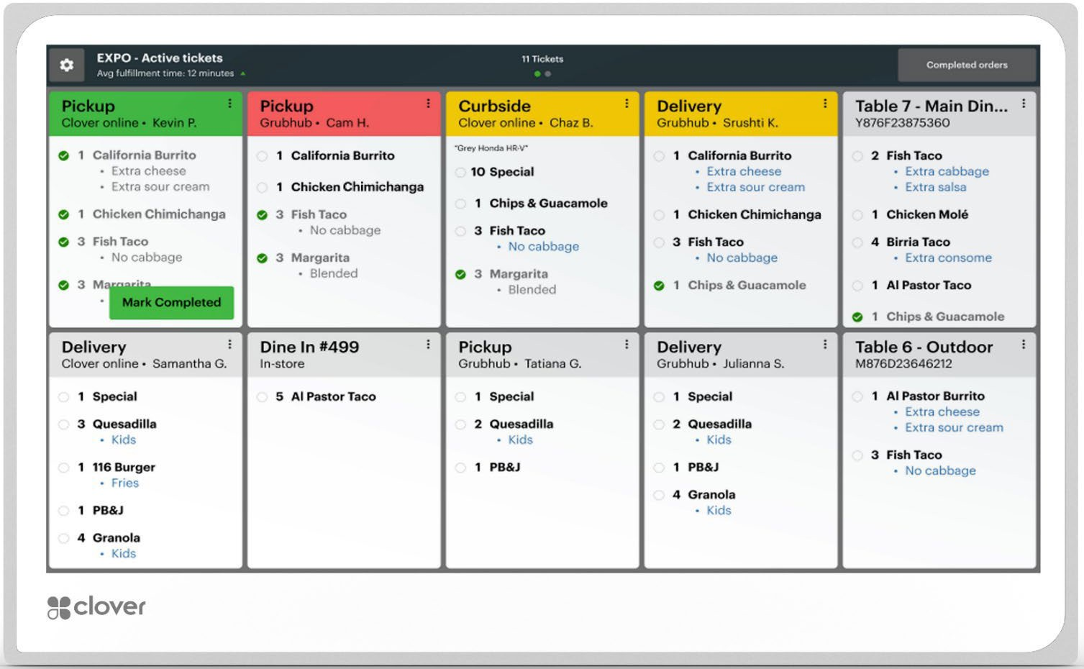
Clover KDS
KDS improves diner experience by speeding up service without losing order accuracy
remove risk of lost/destroyed tickets and provide more robust information
  i.e., ticket time, order status and support FIFO and complex firing
14.0” IPS FHD Display Chemically strengthened cover glass with Anti-glare, Anti- fingerprint coating
Connection methods supported: WiFi and Ethernet
Available for Register, Counter Service Restaurant, Table Service Restaurant SaaS Plans
Available accessories for purchase include a wall mount or countertop stand

Slide 11
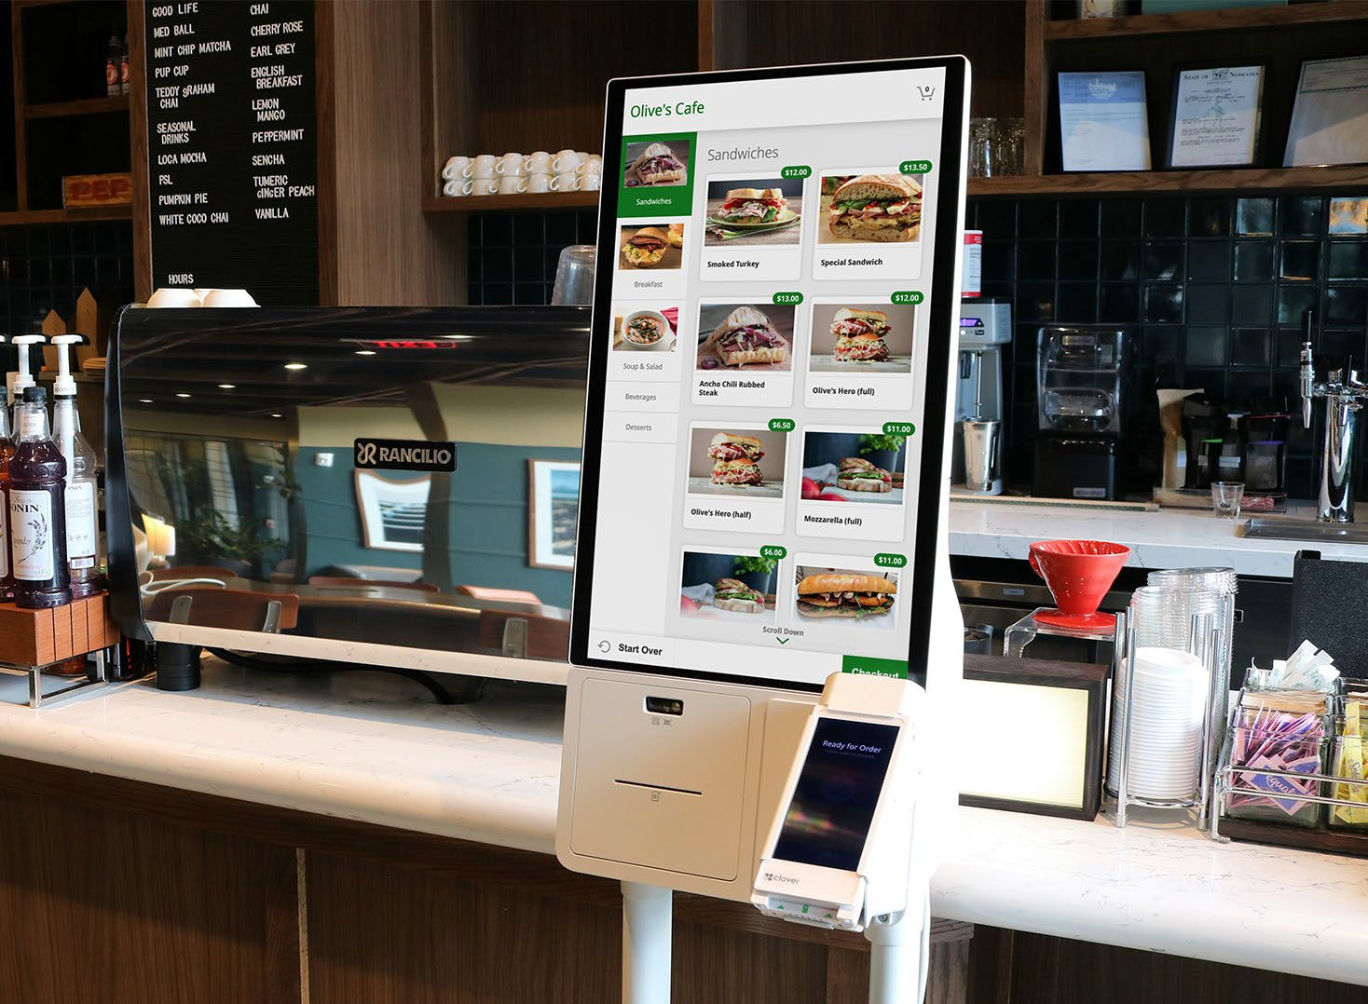

Samsung Ordering Kiosk powered by Clover
The Samsung Ordering Kiosk accessory, powered by Clover, is an all-in-one solution for restaurants
Presents your merchants Clover menu in a good looking and easy to use design that allows customers to quickly place their orders
Clover Flex Gen 3 takes payments and orders are sent to the kitchen printer keeping your restaurant flowing
Shorter Wait Times
Use kiosks for overflow or to handle all your orders
Improve Accuracy
Put the customer in control to order and customize exactly how they want
Speed + Quality = Satisfied Customers

Slide 12
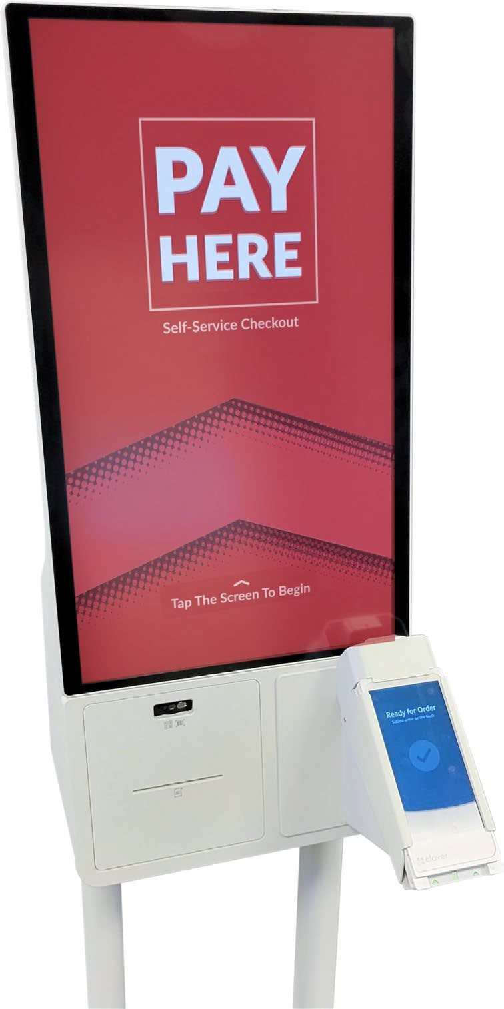
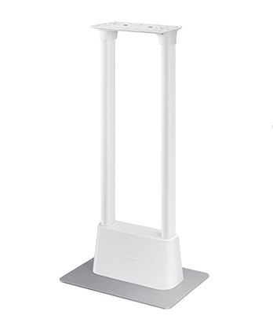
Samsung Ordering Kiosk powered by Clover
Solution consists of:
Pedestal
24” Samsung touchscreen tablet
Integrated printer
Mount for Clover Flex Gen 3
Pedestal optional in lieu of countertop setup design
Solution requires
24” touchscreen
Samsung Kiosk
Clover Flex Gen 3
Counter Service Restaurant or Table Service Restaurant SaaS Plan
Either of the following 3rd party apps:
Samsung Ordering Kiosk by Nanonation
Samsung Kiosk App by GRUBBRR
Flex Gen 3 mount
Integrated
Kiosk does not support Clover Flex Gen 1
Not available for merchants located in Alaska, Hawaii, or Puerto Rico
receipt printer

Slide 13
Samsung Ordering Kiosk – Additional Details
Samsung Hardware | Clover Flex
Purchased as a turnkey bundle from Fiserv Not available for merchants located in Alaska, Hawaii, or Puerto Rico | New Flex Gen 3 device purchased through your normal process
Additional deployment fee | Flex and kiosk arrive at the merchant separately and the Flex must be physically mounted to the kiosk on-site
DOES NOT include Clover Flex (does not support Flex Gen 1 devices) | Clover Care applicable to devices with coverage
Includes 3-year on-site warranty from Samsung
Pedestal stand sold separately
3rd Party Applications
Available in the Clover App Market
Allows merchants to use either the Nanonation or GRUBBRR application for optimizing the kiosk menu display and includes a Clover Flex app download
Utilizes normal Clover App Market billing mechanism
Requires either the Counter Service Restaurant or Table Service Restaurant SaaS plan
Monthly SaaS fee, per kiosk, through Clover App Market billing

Slide 14

Clover Hardware by Vertical
Station Solo
Station Duo
Mini
Flex
Go
QSR
FSR
Retail
Services
QSR
FSR
Retail
Services
Professional, Personal and Home Services
Away from the Shop, Pop-Up Stores, Markets, Fairs, Events, Festivals
Restaurants
Service + Repair
Professional Services
Price-Sensitive Merchants
QSR
Looking for a Customer Facing Display
Retailers
Looking for PIN debit & NFC
Integrated Loyalty Program
Services
FISERV CONFIDENTIAL

Slide 15

Clover Care & Clover Protection Plans
Clover Care is an extended protection plan that cover accidental damage and provides up to 3 replacements for each eligible Clover device
Protection Period: 3 years from when the device is initially shipped from FHS
Eligible Devices: Station Duo, Station Solo, Mini, Flex, and KDS
  Purchased hardware only – leased devices excluded
  US based merchants only, including Puerto Rico
What’s Protected | Clover Care / Protection | Standard Warranty
Manufacturers Defects | ✓ | ✓
Cracked/Broken Screen* | ✓ | 
Environmental* (dust, dirt, etc.) | ✓ | 
Liquid Damage* | ✓ | 
Theft/Loss/Flood/Fire |  | 
*Excludes merchants and Partners located in New York. Coverage includes 3 years and/or replacements for manufacturers defects only.

Slide 16
Clover Care & Clover Protection Plans – What’s The Difference
 | Clover Care | Clover Protection
Who Purchases | Merchants, at time of boarding, or up to one year from device ship date | Bulk Partners, at time of hardware purchase via FD Marketplace
Length of Term | 3 years and/or 3 replacements
Coverage | Remains with the merchant account, hardware and future replacements | Remains with the Bulk partner’s device (and future replacements), regardless of where it goes
Pricing | Device specific – similar for both options
FISERV CONFIDENTIAL

Slide 17
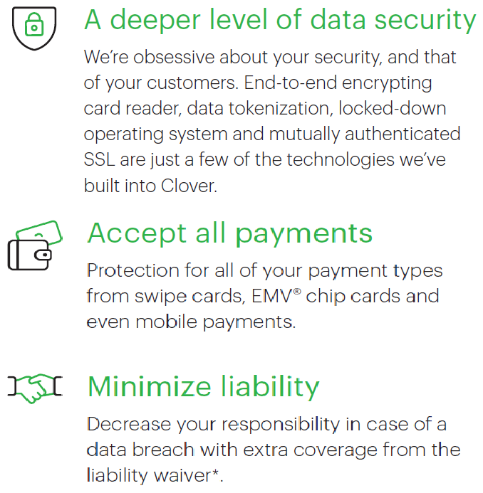

Clover Security
Multi-Layered State-of-the-Art Security & Compliance Solution
Helps to protect many types of payment options, including mobile payments
Easy and cost-effective way to increase protection for customer’s data and business
FISERV CONFIDENTIAL

Slide 18
Clover SaaS Plans – For Legacy Merchants
Will no longer be available on 4/1/2024
Healthcare Focused
Payments Focused
Retail Price to Merchant
Clover For Healthcare: offers basic payment acceptance functionality for healthcare merchants that removes PHI (protected health information) from the experience. These merchants must comply with HIPAA.
Available for Clover Mini, Flex and Clover Go only that reside in specific MCCs
Payments Plus: offers basic payment acceptance functionality to accept swipe, EMV and NFC payments. Limited access to the Clover App Market is included.
Register Lite: Includes electronic cash drawer functionality, such as item and category selections, simple inventory management and sales discounts and taxes. Limited access to the Clover App Market is included.
Available for Clover Mini and Flex only
Clover for Healthcare
$4.95 per device/month
Payments Plus
$4.95 for 1st device / $7.95 per additional device / month
Register Lite
$14.95 for 1st device / $9.95 per additional device / month
FISERV CONFIDENTIAL

Slide 19
Clover SaaS Plans – For Legacy Merchants continued
Will no longer be available on 4/1/2024
Business Management / Customer Engagement Focused
Retail Price to Merchant
Register: Provides core POS functionality for various verticals, including enhanced inventory and order management, support for item variants, weight scale support and other business management functionality. Full access to the Clover App Market is included.
Counter Service Restaurant: Vertical based software designed for pay-at-counter establishments. Includes all features of the Register plan (minus support for item variants + exchanging items) plus modifier groups and kitchen printer integration. Full access to the Clover App Marketing included.
Table Service Restaurant: Vertical based software designed for full-service restaurants with front-of-house restaurant software functionality. Includes full access to the Clover App Market.
Available for Station Solo, Station Duo, Mini and Flex
Register
$49.95 for 1st device / $14.95 per additional device / month
Counter Service Restaurant
$54.95 for 1st device / $14.95 per additional device / month
Table Service Restaurant
$84.95 for 1st device / $14.95 per additional device / month
FISERV CONFIDENTIAL

Slide 20
Clover Merchant Platform SaaS Plans (2021 Plan Group)
Available now
Clover for Healthcare
Payments
Essentials
Offers basic payment acceptance functionality for healthcare merchants that removes PHI (protected health information) from the experience. These merchants must comply with HIPAA.
Available for Clover Mini, Flex and Go only that reside in specific MCCs
$0 per device / month
New, simple, and flexible service plan for merchants who only need to accept and track payments with or without a Clover POS device
Available for Clover Mini, Flex and Go, or no hardware at all
$0 for 1st device / $7.95 per additional device / month
A new SaaS plan which includes features of Clover Payments, plus business management functionality such as order management, inventory management, employee management, and customer management
Available for Clover Mini, Flex and Go, or no hardware at all
$14.95 for 1st device / $7.95 per additional device / month
FISERV CONFIDENTIAL

Slide 21
Clover Merchant Platform SaaS Plans (2021 Plan Group)
Register
Counter Service Restaurant
Table Service Restaurant
Provides core POS functionality for various verticals, including enhanced inventory and order management, support for item variants, weight scale support and other business management functionality. Full access to the Clover App Market is included.
Available for Clover Mini, Flex, Station, and Go
$49.95 for 1st device / $14.95 per additional device / month
Clover KDS: $25 / device / month
Vertical based software designed for pay-at-counter establishments. Includes all features of the Register plan (minus support for item variants + exchanging items) plus modifier groups and kitchen printer integration. Full access to the Clover App Marketing included.
Available for Clover Mini, Flex, Station, and Go
$54.95 for 1st device / $14.95 per additional device / month
Clover KDS: $25 / device / month
Vertical based software designed for full-service restaurants with front-of-house restaurant software functionality. Includes full access to the Clover App Market.
Available for Clover Mini, Flex, Station, and Go
$84.95 for 1st device / $14.95 per additional device / month
Clover KDS: $25 / device / month
FISERV CONFIDENTIAL

Slide 22
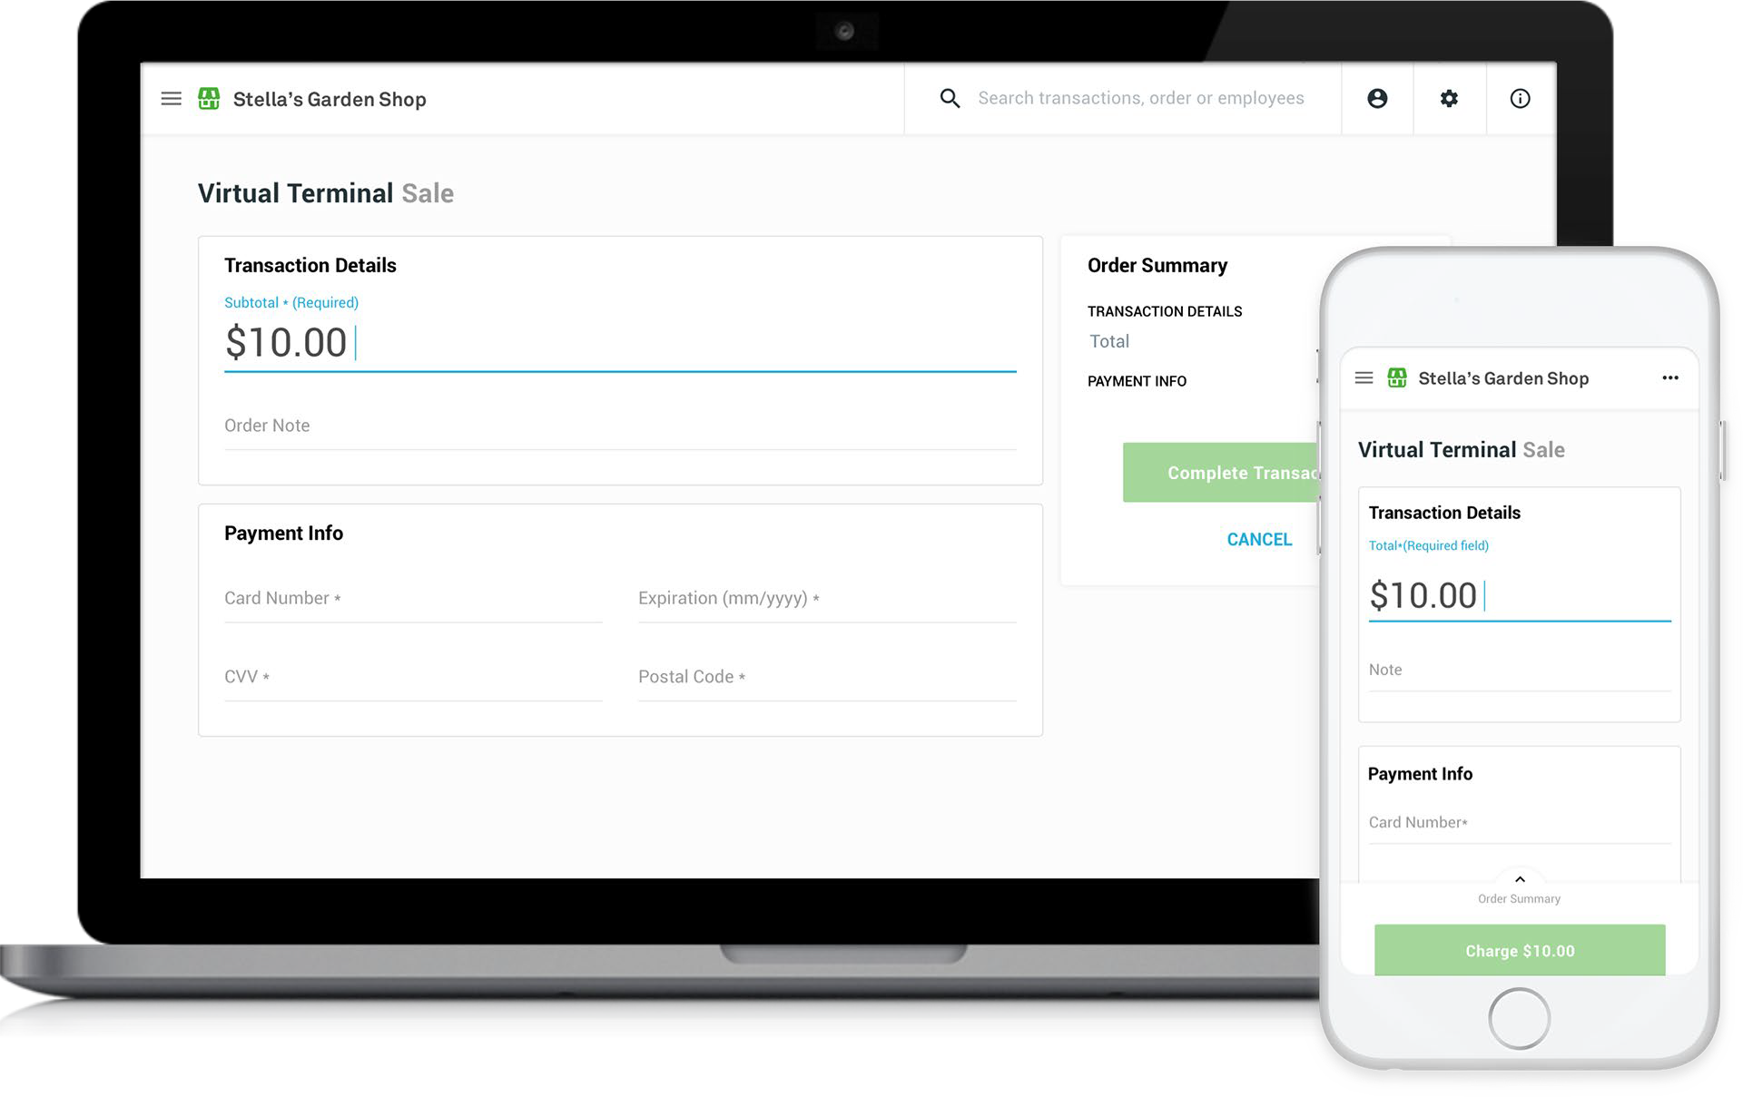
Virtual Terminal
Clover Virtual Terminal makes it easy to get paid virtually anytime, anywhere – all you need is your smartphone, tablet, or computer and an internet connection. No extra equipment or software required.
Two factor authentication required
  https://www.clover.com/us/en/help/two-factor- authentication/
Card on File Supported
Transaction will be determined as keyed, card not present
Transactions can be completed on a smartphone, tablet or computer with an internet connection
Email or text receipts provided
2323 © 2024 Fiserv, Inc. or its affiliates. FISERV CONFIDENTIAL
|

Slide 23
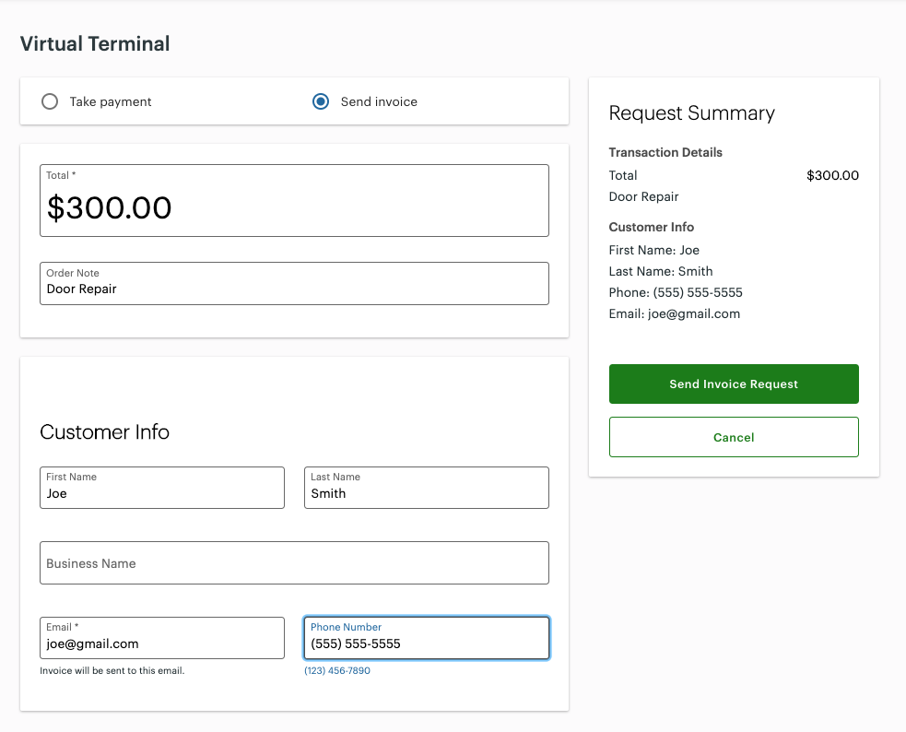
Request for Payment via Virtual Terminal
Clover merchants will have the ability to send out basic, electronic invoices
  Does not support inventory
Inclusive of all SaaS plans EXCEPT Clover for Healthcare - due to PHI data
  Payment Plus merchants can send invoices, but cannot manage them
2424 © 2024 Fiserv, Inc. or its affiliates. FISERV CONFIDENTIAL
|

Slide 24


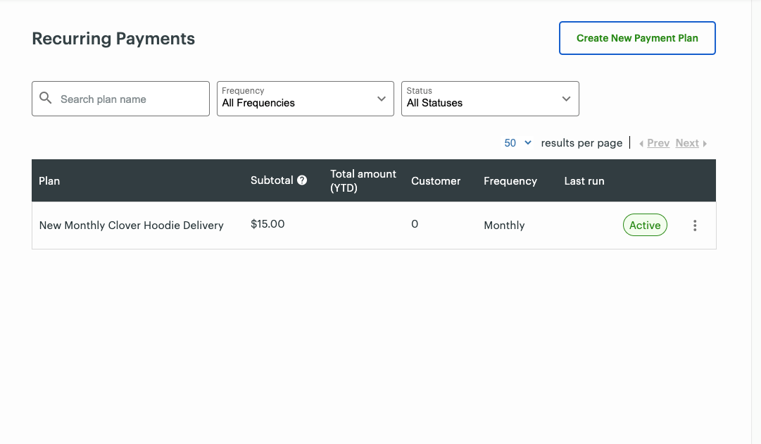
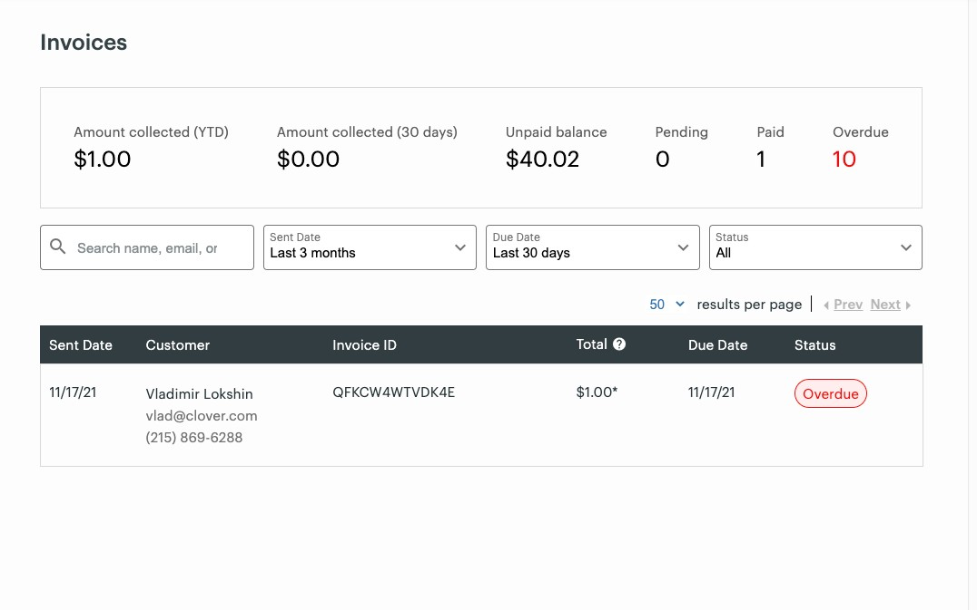
Recurring Payments and Invoice Management via Virtual Terminal
Recurring Payments Invoice Management
Merchants can create plans, set collection amounts, frequency and add subscribers to automatically process payments.
Customer profile and card-on-file are used to process the payment.
Customers will receive a reminder notification (invoice) 3 days prior to billing, and a digital receipt at the time of payment.
See all invoices, paid and outstanding, and a summary of collected funds, unpaid balance and invoice summaries.
Search, filters and pagination for merchants with many invoices to find specific invoices
Recurring payments jobs will create invoices 3 days prior to billing which will be displayed in Invoices together with one-off invoices.
2525 © 2024 Fiserv, Inc. or its affiliates. FISERV CONFIDENTIAL
|

Slide 25
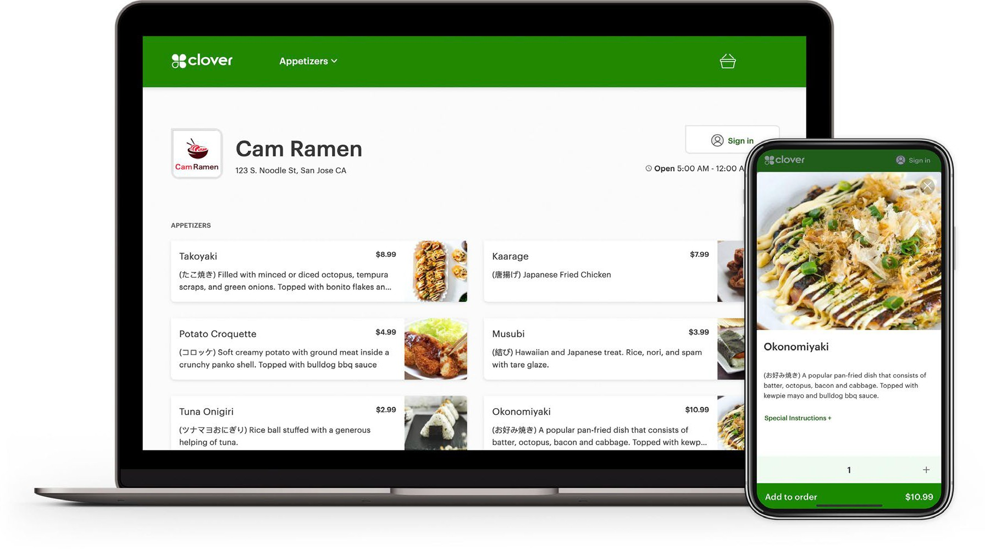
Clover Online Ordering Platform
Clover can build you a powerful online e-commerce presence while other merchant solutions are just now entering the market
Clover Online Ordering (COLO) enables you the ability to receive and process online menu orders coming from customers wherever they discover your business
Target Audience | Excluded Audience
Quick Service Restaurants Full Service Restaurants MCC 5812, 5813, 5814 Clover Dining Users Counter Service or Table Service Restaurant Plan | Retail and service merchants Register Lite and Payments Plus SaaS plan merchants Merchants who cannot use online ordering services (e.g., alcohol exclusive)
2626 © 2024 Fiserv, Inc. or its affiliates. FISERV CONFIDENTIAL
|

Slide 26
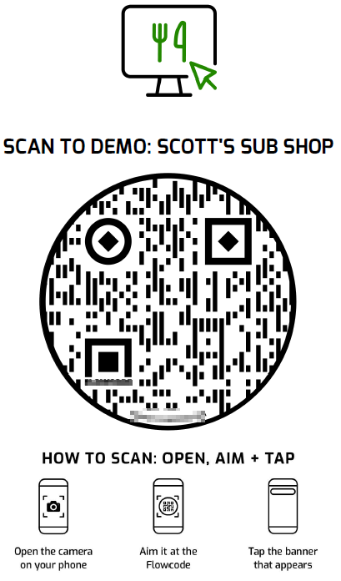
Features of Clover Online Ordering
Scan to Order and Digital Menus
Customers scan the QR code with their iOS or Android device to open to the Clover Web Ordering site in “Dine In” mode Customers can view the merchant's menu, add items to the cart, and pay. Orders will be automatically fired to the kitchen.
Scheduled Orders
Guests will be able to place ASAP orders or plan ahead and place a scheduled order Merchants can set how far out in advance a customer can place an order and when they would like the order receipt printed
Curbside Pickup
Merchants will be able to deliver an order to a guest at the "curbside" when the order is ready Guests can pick up their orders and can pick up from the convenience of their cars
Delivery via DoorDash
DoorDash will allocate an on-demand delivery driver to fulfill each order placed via Clover Web or App orderings Consumers can track their orders in real-time using a DoorDash progress tracker website
2727 © 2024 Fiserv, Inc. or its affiliates. FISERV CONFIDENTIAL
|

Slide 27
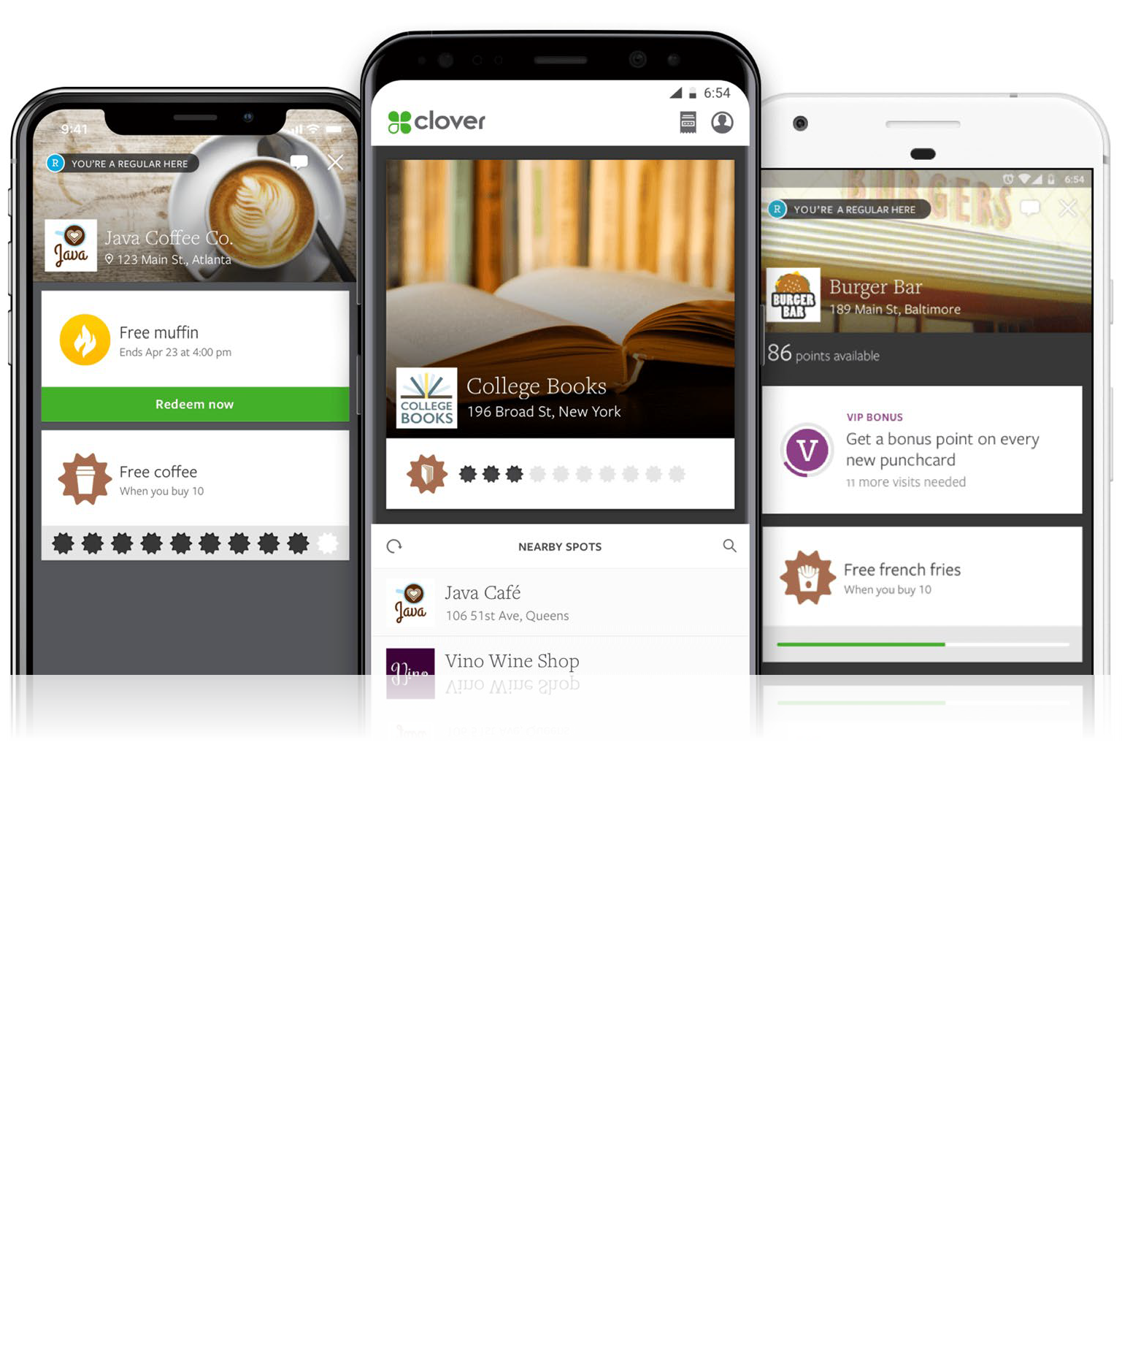

Clover Consumer App
Merchants can reward loyal customers and keep them coming back to their business
Enable autopay for hands-free + wallet-free transactions with the Clover app
Consumers can use their rewards and perks with Clover Online Ordering
Encourage customers to download the Clover app with Clover order ahead functionality
Customers can place mobile orders and pick up just by saying their name — and automatically earn Rewards points, too. Skip the line!
Create a Rewards program now to jump-start customers using the Clover app to be ready to accept orders for FREE!
Consumers earn rewards and perks at their favorite local businesses
Android — Google Play
  iOS — App Store
2828 © 2024 Fiserv, Inc. or its affiliates. FISERV CONFIDENTIAL
|

Slide 28
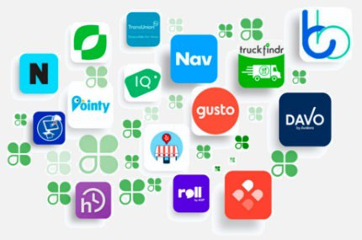
Clover App Market
Clover Apps
Clover apps can help businesses enhance their point-of-sale operations, streamline workflows, and improve the overall efficiency and effectiveness of their business processes.
FISERV CONFIDENTIAL

Slide 29
Clover App Market
Developer Information
Stats
User’s have access to an ‘open platform’ powered by a robust community of developers and more than 500+ apps
Developers can register and obtain access to APKs, APIs, codes & sample codes, developers chat community and purchase DevKits
1900+ registered app developers
500+ apps available for download
2 Million+ apps have been opted in & installed by merchants
3+ downloaded apps increases ‘stickiness’ and reduces attrition
FISERV CONFIDENTIAL

Slide 30
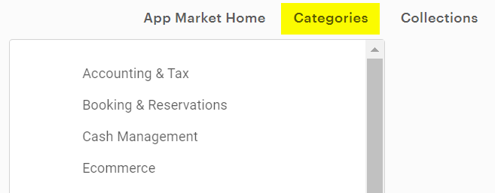
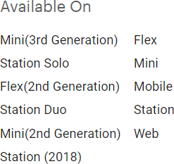
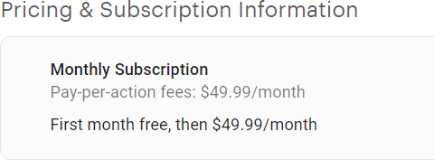
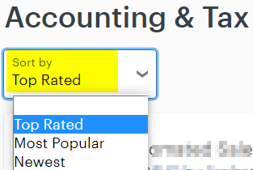
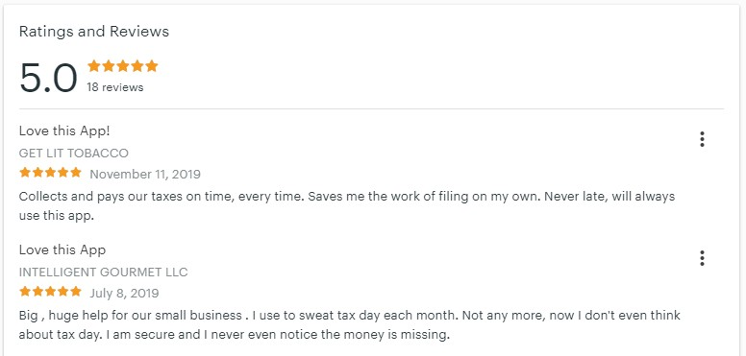
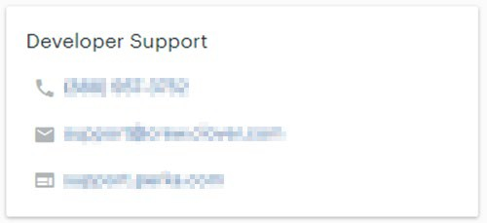
Clover App Market
Apps itemized in 18 different categories
  Sortable by Top Rated, Most Popular, and Newest
Device compatibility per app
Pricing and subscription information
Apps are rated and reviewed by end users
App developer contact information
|

Slide 31
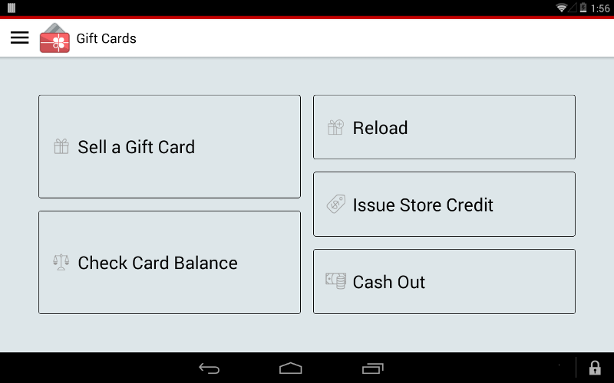
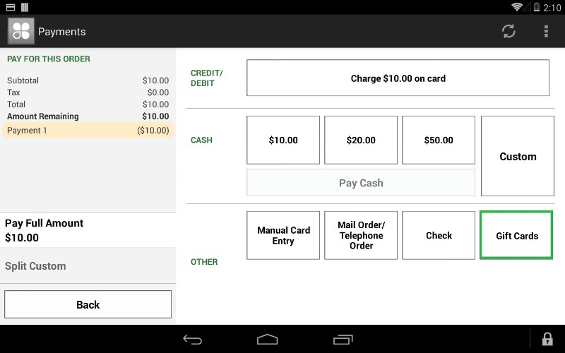

Clover Gift Cards
Simplifies selling and managing custom-branded plastic and digital gift cards
Customers can purchase, redeem and send gift cards right from their smartphones
Convert any gift cards that have been issued to your customers from a previous gift card program to be redeemable via Clover Gift Cards app
https://support.giftcards.clover.com/
FISERV CONFIDENTIAL

Slide 32






Clover Customer Engagement Suite
Customers
Understand customers and provide great service
Rewards
Keep your regular customers coming back
Promos
Reach out and bring customers through the door
Feedback
Hear what your customers think, in private
The four Clover Customer Engagement apps – Customers, Rewards, Promos and Feedback – are designed to work separately or together to deepen your customer relationships, and to help you create new ones.
Note: these applications are not available for merchants boarded in MCC 5993.
FISERV CONFIDENTIAL

Slide 33
Clover Customer Engagement – Who and Why
Target Audiences
Target Use Cases
Audience | Why
Current Clover Merchants | Current Clover merchant who needs to better reach their customers and keep them coming back at a low price
Non-Clover Merchants | Non-Clover merchants who are looking to get a Clover POS and grow their business
The merchant needs to reach out to their customers, create better relationships, and keep them coming back
The merchant is just starting up and needs to build a customer list by soliciting feedback
Merchant knows loyalty is important and wants to lay the groundwork for a future rewards program by implementing feedback today
Merchant was active in a different Customer Engagement program and/or has a list of customers to import
Merchant wants to increase traffic at key times
Merchant wants to build community by retaining customers and creating regulars
|

Slide 34
Clover CE Feature Comparison – Basic vs. Plus
 | Basic Free | Plus $99/mo
Rewards
Customizable Rewards program | ✓ | ✓
Multiple Rewards offers |  | ✓
Welcome, Regular, and VIP Bonuses |  | ✓
Birthday Bonus |  | ✓
Promos
Audience Builder | ✓ | ✓
Real-Time Promos | Limited* | Unlimited
Advance scheduling |  | ✓
Target to Regulars or VIPs |  | ✓
Win back lost customers |  | ✓
Feedback
Receive + respond to customer feedback | ✓ | ✓
Clover provides the basics to help any merchant interact with their customers. Upgrading to Clover Customer Engagement Plus unlocks additional capabilities across the entire set of customer engagement tools.
Whether a merchant’s business is growing or stable, if they’re ready to do more, we can do a lot more for them.
Note: Apps that make up the Clover Customer Engagement Suite are not available for merchants boarded in MCC 5993.
*At Basic, Real-Time Promos are free for a limited time trial, then charged per-use at 10¢ per customer.
Customer Engagement Plus includes unlimited Real-Time Promos.
FISERV CONFIDENTIAL

Slide 35
Where Does Clover Fit Best
Best Suited For
Not Intended For
SMB
Retail
Service Industry
  Medical Offices
  Personal
    i.e., Salons, Electricians, Plumbers, Food Trucks, Lawn Services, etc.
Big box retailers & multi- lane grocery chains
  Exceeds 50,000 SKUs
  Proprietary POS solution
  Multi-location functionality
Hotels & Lodging
  Does not support incremental pre- authorizations
Full B2B
Restaurants
  QSR
  FSR
3636 © 2024 Fiserv, Inc. or its affiliates. FISERV CONFIDENTIAL
|

Slide 36
Resources
Clover Websites | Clover Presales Helpdesk | Clover Webinars
clover.com/help clover.com/appmarket Clover Suggestions Clover YouTube Channel | 800-788-9516 presales@clover.com Will not support inquiries regarding merchant support, pricing, channel specific questions or merchant correspondence Obtain Clover presales support and demo device assistance Available for clients and sales agents only | Clover Webinars Choose among a variety of business types and topics. Click “Register Now” to join a live, complimentary session including a question-and- answer period.
Clover Marketing | Clover Blog and Menu build request | Clover White Glove Service
FirstDataClients.com Website that contains Clover sales materials, go to market decks, product sheets, etc. Clover Brand Portal - Lingo a great tool for users looking for the latest and greatest Clover product images, logos, and more Public Kit: Contains brand resources, logo & logo mark, and colors Open to the public | Clover Blog Practical tips and insights that can help you run your business better Clover Menu Builds Clover will build a menu for any type of restaurant merchant (QSR or TSR), complimentary Not available for Retail based merchants MSC ticket must be submitted at the same time as placing the merchant’s device order Legible copy of the menu is required PDF, Word doc, Website URL, Photo, etc. No handwritten menus will be accepted | Accounts with 7 or more devices (Station Duo, Solo, Mini, Flex) and/or more than 3 locations are provided White Glove treatment during the activation process Major Account Installer assigned Responsible for ensuring a successful installation/activation for all of the locations Assist with any menu or inventory issues Installer will reach out to the ISO Partner to coordinate when to contact the locations Request form available via firstdataclients.com
3737 © 2024 Fiserv, Inc. or its affiliates. FISERV CONFIDENTIAL
|

Slide 37
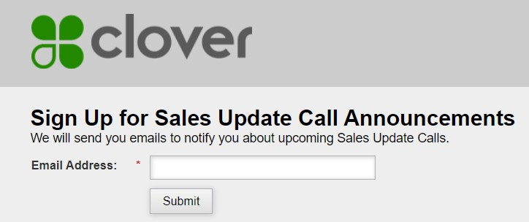

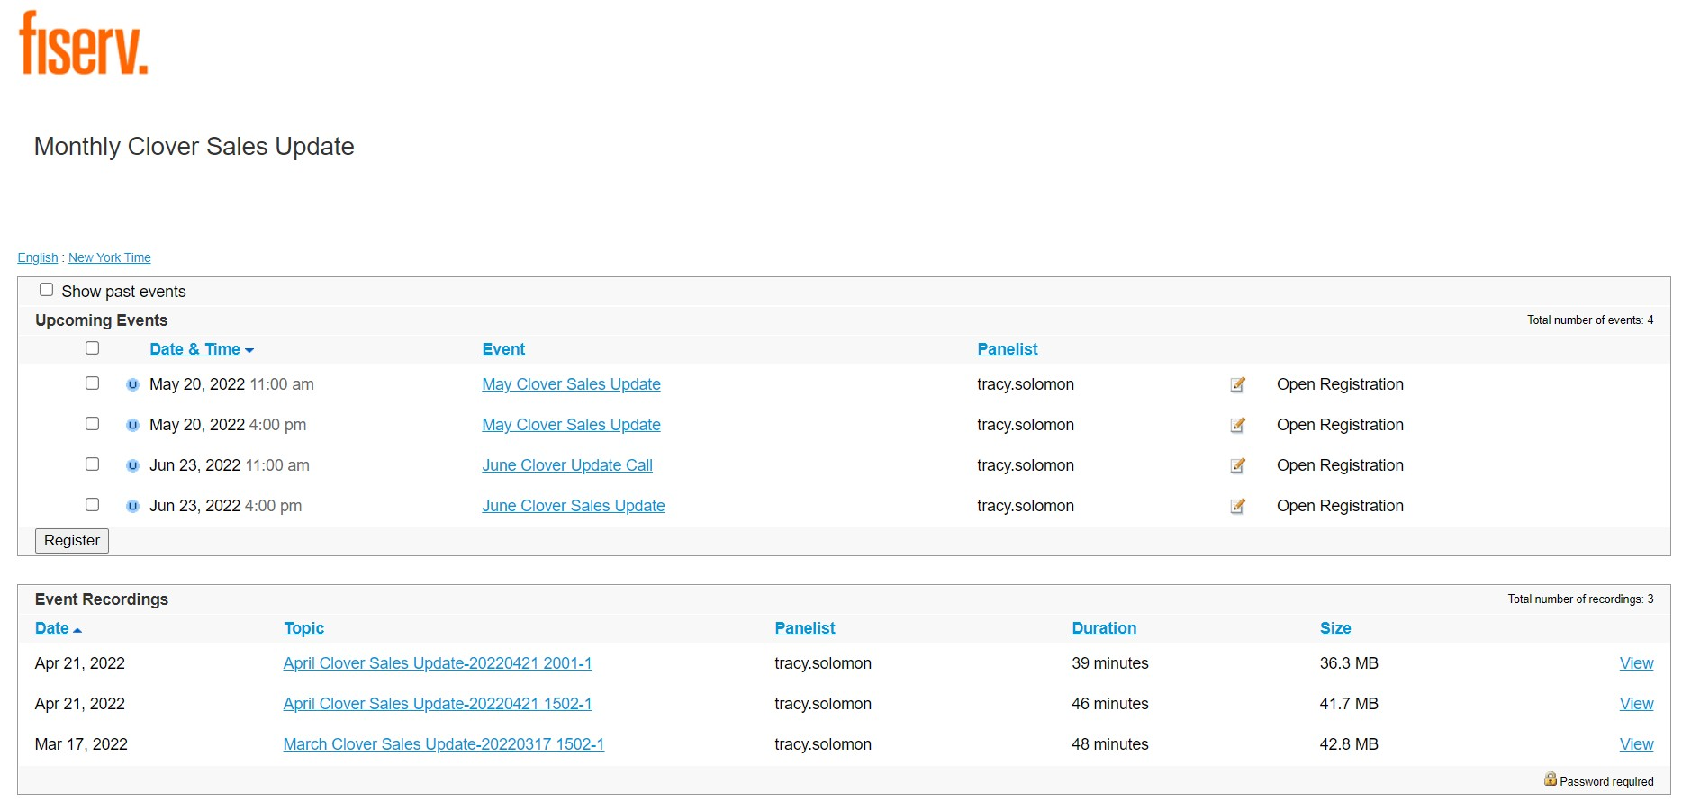
Clover Monthly Product Update Calls
Clover hosts a monthly product call, providing updates on hardware, software and ecosystem
Calls are held the 3rd week of every month
  11am EST
  Calls are conducted over Webex, recorded, and archived for future playback needs
Sign up for sales update call announcements here
Registration for the call is required each month via Fiserv Enterprise site
3838 © 2024 Fiserv, Inc. or its affiliates. FISERV CONFIDENTIAL
|

Slide 38

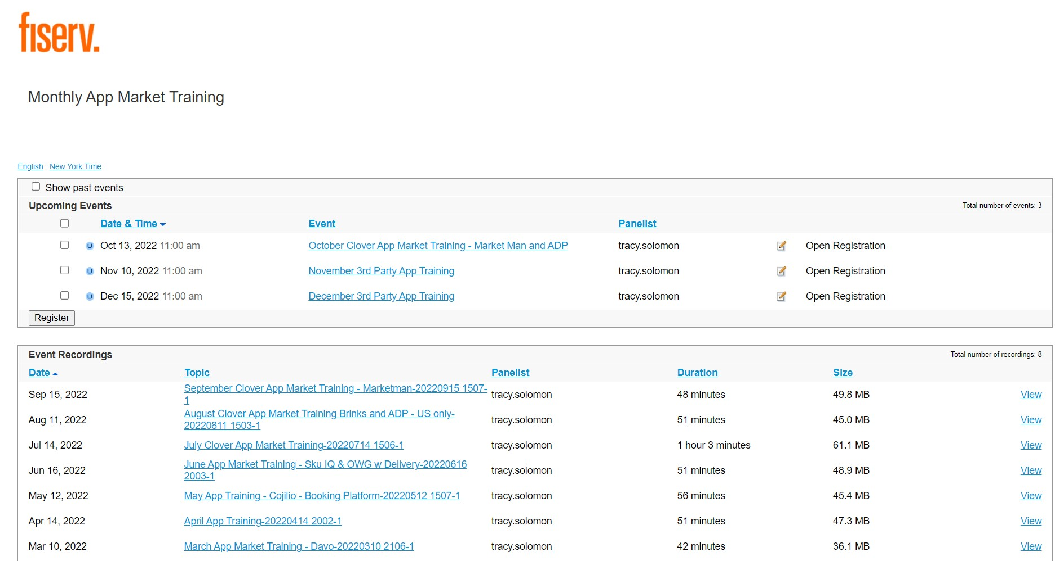
Clover Monthly App Review Calls
Clover hosts a monthly app review call, with 3rd party developers, providing an overview of a specific app each month with
Calls are held either the 2nd or 3rd week of every month
  11am EST
  Calls are conducted over Webex, recorded, and archived for future playback needs
Registration for the call is required each month via Fiserv Enterprise site
3939 © 2024 Fiserv, Inc. or its affiliates. FISERV CONFIDENTIAL
|

Slide 39
Tailor Your Merchant Onboarding Process
Pre-Sales Demo Webinars
Clover Activation Team Training
Equip your sales agents with a broader understanding of products, offerings, and tips on successfully selling Clover.
Webinars are offered Monday - Thursday (excludes holidays).
Topics include:
  Table Service Restaurant
  Counter Service Restaurant
  Clover General, Services, Salons
  Retail (Register)
  Clover Go
Schedule a demo here
Pre-scheduled training webinars offered daily to better equip your merchants on navigating and understanding their Clover device and product offering.
Webinars are offered Monday - Friday from 830a-6p ET/730a-5p CT (excludes holidays).
Topics include:
  Table Service
  Counter Service
  Gyft/Rewards/Promo
Build training into your merchant’s onboarding experience for consistent information and quicker processing.
Schedule your merchant’s training here
40
FISERV CONFIDENTIAL

Slide 40
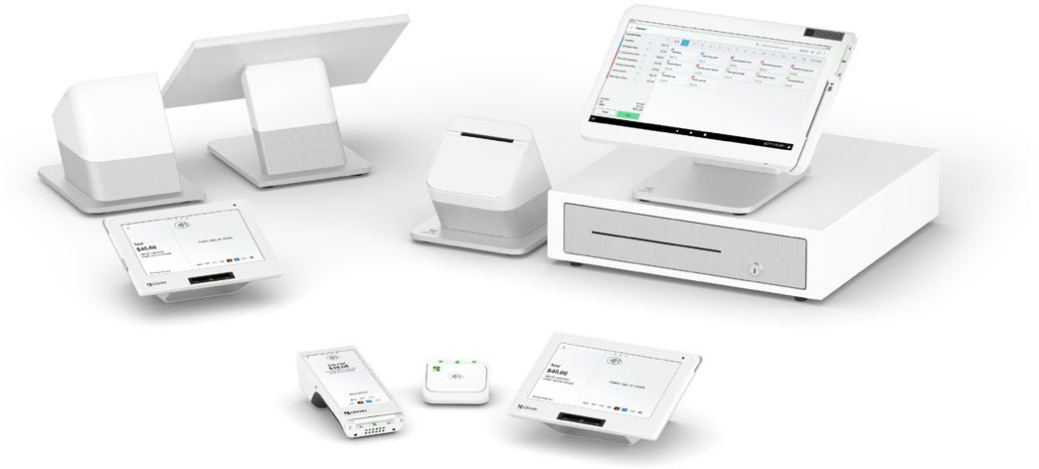
Benefits of Demo Devices
Demos are fully functional providing the same features and functionalities of production units that include:
Running transactions (sales and returns in a demo environment)
Web dashboard and App market access
  Majority of Clover Apps available for download, free of charge
No monthly SaaS or Wireless Manager fees
Inventory, Menus and Receipts can be customized to reflect your potential merchant’s business
Pricing provided by your CBE
Ordering procedures and form available via www.firstdataclients.com
Demo Devices Available for Purchase
Clover Station Duo 2
Clover Station Solo
Clover Mini 3rd Gen
Clover Flex 3rd Gen
Clover KDS
4141 © 2024 Fiserv, Inc. or its affiliates. FISERV CONFIDENTIAL
|

Slide 41
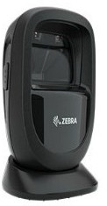
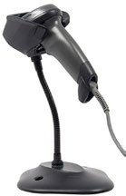
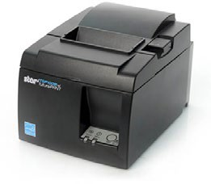
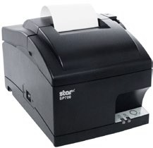
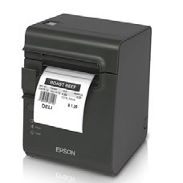
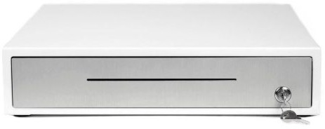
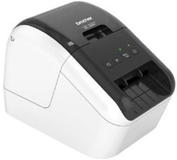
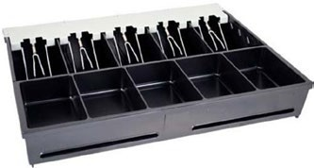
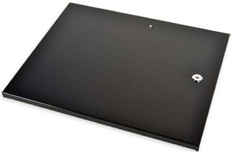
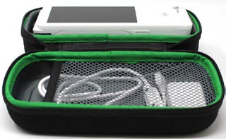
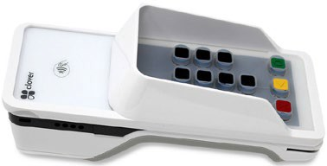
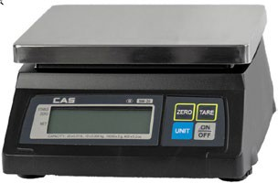

Clover Accessories
Cash Drawer | Hands Free Scanner | Handheld Scanner | Kitchen Printer | Thermal Kitchen Printer | Sticky Label Printer
Label Printer* | Bill & Coin Tray | Tray Locking Lid | Flex Travel Kit | Flex Accessibility Pad | Weight Scale
Printer Paper
Clover accessories are available via your FHS representative except for the *label printer, which is available at most major US retailers and the Flex Extender Arm, which is available via the Clover Supply Desk
4242 © 2024 Fiserv, Inc. or its affiliates. FISERV CONFIDENTIAL
|

Slide 42
Q&A
FISERV CONFIDENTIAL

Slide 43
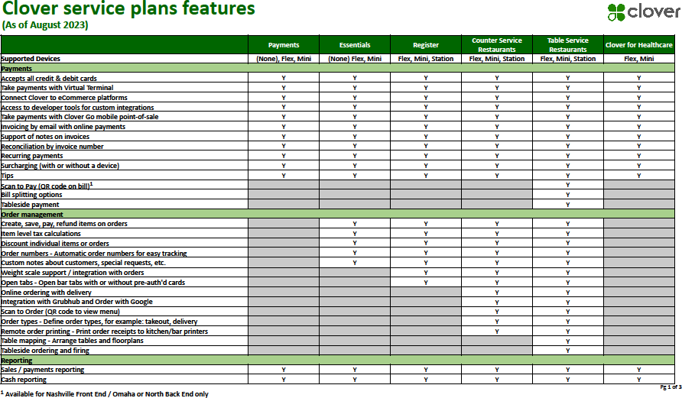
2021 SaaS Plan Group Features
FISERV CONFIDENTIAL

Slide 44
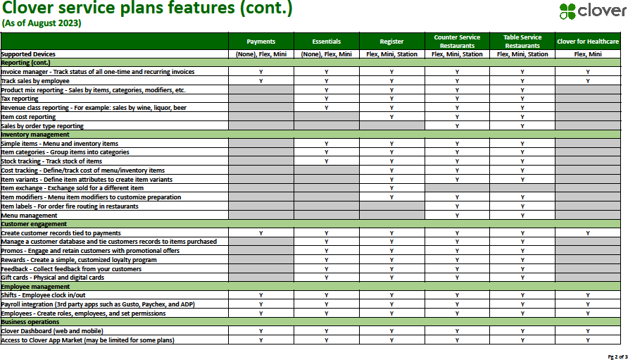
2021 SaaS Plan Group Features - continued
FISERV CONFIDENTIAL

Slide 45
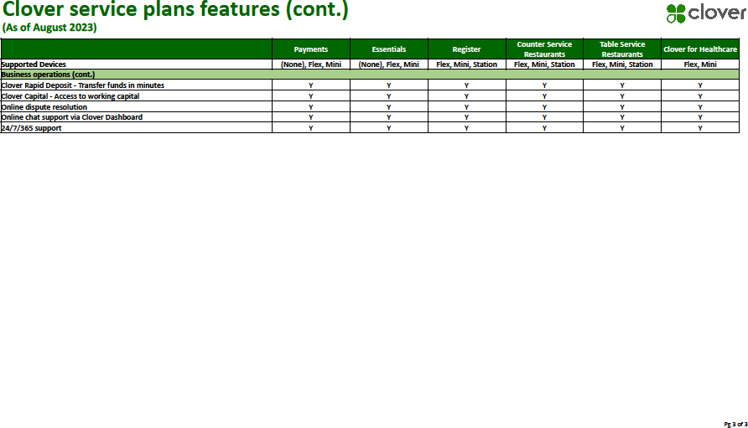
2021 SaaS Plan Group Features - continued
FISERV CONFIDENTIAL

Slide 46
Appendix: Clover for Healthcare Information
Target Merchants
Merchants that fall into the following Merchant Category Codes are the target market for the Healthcare plan
Basics
MCC will be the only criteria evaluated to determine whether a merchant is participating in the HIPAA program
Any merchant boarded with a HIPAA MCC will be part of the program--NO EXCEPTIONS
Devices
The Healthcare plan will be available on the Mini, Flex and Go. Virtual Terminal is also included.
NO STATION DEVICES ALLOWED
MCC | Description
4119 | Ambulance
5912 | Pharmacies or Drug Stores
5975 | Hearing Aids
5976 | Orthopedic Goods Artificial Limbs
8011 | Doctors and Physicians (Not Elsewhere Classified)
8021 | Dentists and Orthodontists
8031 | Osteopaths
8041 | Chiropractors
8042 | Optometrists and Ophthalmologists
8043 | Opticians, Opticians Goods and Eyeglasses
8049 | Podiatrists and Chiropodists
8050 | Nursing and Personal Care Facilities
8062 | Hospitals
8071 | Medical and Dental Laboratories
8099 | Medical Services and Health Practitioners (Not Elsewhere Classified)
FISERV CONFIDENTIAL

Slide 47

Thank You!
Enter Name
Phone
Email
Company Name
Your Logo
Goes Here
FISERV CONFIDENTIAL

